Slide 1
Discuss Our Progress
To leverage a multigenerational workforce
Notes:
Update senior leaders and propose next steps
Use 30 minutes in your regular leadership team meeting to provide an update on recent efforts to leverage a multigenerational workforce, and secure buy-in to continue to address it as a strategic priority.
Participants: Leadership team of organization
Facilitator: CHRO or senior HR leader
Cost: Free
Time Commitment: 2 hrs to plan, 30 min to present
To re-align senior leaders and secure their buy-in to a follow-up initiative to leverage the value of a multi-generational workforce, request time to present at an upcoming senior leadership team meeting. Simply copy this email draft into a fresh email, edit it as needed, and send it out!
Dear ,
I’m reaching out to request a 30-minute agenda item at an upcoming senior leadership team meeting. The goal is to update senior leaders on our recent efforts to address age inclusion as a strategic opportunity. I also hope we can secure buy-in for a follow-up initiative to help us leverage the power of a multi-generational workforce.
We have been using a suite of resources AARP has created for employers to help us add the critical lens of age to strategic workforce planning and talent management practices. I’ll be happy to share an overview of the actions we took this year using these resources. I’ll bring a summary of our progress and learnings, and assess how efficiently we have used staff, employee and financial resources.
Please let me know your thoughts on scheduling time with the team.
Best,

Slide 2
Discuss Our Progress
It’s time to provide an update on our recent efforts to address age inclusion as a strategic opportunity. We have been using a suite of resources AARP has created for employers to help us add the critical lens of age to strategic workforce planning and talent management practices.
Today, we’ll share an overview of the actions we took this year using these resources. We’ll also share a summary of our progress and learnings, and assess how efficiently we have used staff, employee and financial resources.
We hope to secure buy-in for the next initiative to help leverage the power of a multigenerational workforce.
Courtesy Getty Images

Slide 3
Agenda
|
|
|
|
|
Why we value a multigenerational workforce
Overview of actions and resources
Summary of progress and learnings
Efficiency of our use of resources
Next steps
Courtesy Getty Images

Slide 4
Strategic value of a multigenerational workforce
A value creation strategy hiding in plain sight
In a recent AARP study, 83%¹ of employers said that creating a more multigenerational workforce would drive their success and growth.
The depth of experience and skill sets in an age-diverse workforce – whether technical, professional, or durable human skills –creates major opportunities for employers who can unleash those synergies.
The best decisions result when people from different life and career stages work together to define problems and create solutions.
Source: 1 AARP Global Employer Survey 2020
Notes:
Note: "durable human skills" are often called soft skills – critical thinking, communication, negotiation, judgement calls, etc.
1 “According to the AARP Global Employer Survey 2020, 83% of employers state that it would be very or at least somewhat valuable to their organisation’s success and growth to create a more multigenerational workforce. Executives in large global companies recognize that their organization would need to undertake more efforts to maximise the full potential that an age-diverse workforce offers, listing age, besides disability, as the area of diversity management that requires most improvement (Forbes Insights, 2011[33]).”

Slide 5
Strategic value of a multigenerational workforce
A talent management necessity
“Declining populations or labor force participation rates among younger workers may lead to talent shortages. Retaining older workers can help employers address this challenge.”
We are on the cusp of a significant demographic shift affecting the U.S. labor market. Over the coming decades, more people will exit the workforce than will enter it.
In the near future, the Bureau of Labor Statistics forecasts that workers 65+ will be the fastest-growing portion of the labor market, with other age groups either holding steady or declining.
Sources: 1 AARP Global Employer Survey 2020
2 https://www.oecd-ilibrary.org/docserver/59752153-en.pdf?expires=1636142224&id=id&accname=guest&check
3 https://www.oecd-ilibrary.org/docserver/59752153-en.pdf?expires=1636142224&id=id&accname=guest&check
Notes:
https://blog.aarp.org/thinking-policy/how-population-age-shifts-will-affect-us-labor-market

Slide 6
Strategic value of a multigenerational workforce
A proven way to improve team performance
Research has shown that mixed-age teams perform better than homogenous-aged teams:
In companies that utilized mixed-age work teams, the relative productivity of both older and younger workers was higher than in companies that did not use mixed-age teams.
When the task “entails dealing with strategic and complex decision-making with vaguely defined problems in a dynamic setting…increased age diversity can lead to enhanced group discussions, better analysis and superior problem-solving.”
Courtesy Getty Images
Sources: Human Resource Management Journal, vol. 23, Issue 3, (2013); Personnel Psychology, 67, (2014); Labour Economics, 22, (2013); Journal of Applied Psychology, 93, (2008). https://ideas.repec.org/p/iso/educat/0093.html http://repec.business.uzh.ch/RePEc/iso/leadinghouse/0093_lhwpaper.pdf
Notes:
Facilitator note: As you customize this deck to meet your needs, feel free to bring in additional data from AARP’s Business Case for Age-Inclusion slide deck at https://employerportal.aarp.org/age-inclusive-workforce/commit-to-an-age-inclusive-culture/business-case-basic-slides

Slide 7
Our age-inclusion action plan (final version)
Timeline for this action plan: 3/6/ 12 months?
Action | Owner | Contributors to organizing | Employee participants (#, type) | Completion Date | Budget cost (not including staff time)
Courtesy Getty Images
Source: xxx
Notes:
Note to host: This should be the final updated version of the Action Plan slide from Step 2: Chart Our Plan in the AARP Generations at Work resource suite.

Slide 8
Reflect
Did you participate in any of these efforts? If so, what did you hear from the employees who joined you?
First, jot for yourself, then we can share out.

Slide 9
Our progress and learnings
Action: [List the specific action that you took using resources from the AARP Generations at Work tool.]
Key statistics:
[If you chose to host workshops, could be # program sessions, # employees who participated, NPS score]
[For other actions, might include: # employees reached, changes in employee engagement survey results or other]
[Note where we might not yet see results of this action.]
What did employees say?
High level survey results
Quotes from participants
Other qualitative or quantitative feedback
Courtesy Getty Images
Source: AARP Generations at Work resource suite
Notes:
Note to host: Create one slide for each action your team took as part of your plan.

Slide 10
Our progress and learnings
Action: [List the specific action that you took using resources from the AARP Generations at Work tool.]
Key statistics:
[If you chose to host workshops, could be # program sessions, # employees who participated, NPS score]
[For other actions, might include: # employees reached, changes in employee engagement survey results or other]
[Note where we might not yet see results of this action]
What did employees say?
High level survey results
Quotes from participants
Other qualitative or quantitative feedback
Courtesy Getty Images
Source: AARP Generations at Work resource suite
Notes:
Note to host: Create one slide for each action your team took as part of your plan.

Slide 11
Our progress and learnings
Action: [List the specific action that you took using resources from the AARP Generations at Work tool.]
Key statistics:
[If you chose to host workshops, could be # program sessions, # employees who participated, NPS score]
[For other actions, might include: # employees reached, changes in employee engagement survey results or other]
[Note where we might not yet see results of this action.]
What did employees say?
High level survey results
Quotes from participants
Other qualitative or quantitative feedback
Courtesy Getty Images
Source: AARP Generations at Work resource suite
Notes:
Note to host: Create one slide for each action your team took as part of your plan.

Slide 12
Reflect
Thoughts on additional progress you have seen, or learnings you want us to consider as we move ahead?
First, jot for yourself, then we can share out.

Slide 13
Current base on which we will build
Progress highlights to inform our next phase
[List a handful of high-level progress highlights. These may be related to a specific action, or more general such as overall increased awareness, buy-in, engagement, etc.
[Note where we might not yet see results of this action. ]
Xx
Key learnings to inform our next phase
[List a handful of high-level learnings that will make your planning and execution more effective in the next phase of your action plan. These may be related to a specific action, or more general such as overall increased awareness, buy-in, engagement, etc.]
Xx
xx
Courtesy Getty Images
Source: xxx

Slide 14
Current base on which we will build
Are we making progress in areas that create strategic value that we really value?
[List a handful of high-level issues that are key to the leadership team and the organization. These may have been discussed if you used Step 1: Find our Why workshop resources. Otherwise, use your best judgment here.]
[Did we see a shift in employee engagement survey results among our youngest and oldest groups of employees?]
[Did we affect the rate of voluntary turnover among our youngest and oldest groups of employees?]
[Did we affect metrics that reflect managers’ sense of feeling prepared to lead, and successful in reaching goals?]
[Did we see examples of innovation on mixed-age teams that can be in/directly attributed to mixed-age teams?]
[Can we see any direct or indirect effect on key metrics of productivity and profit?]
[Are we tracking the right metrics now? Do we want to adjust or start measuring additional metrics?]
Courtesy Getty Images
Source: xxx
Notes:
Facilitator Note: Select 3-4 questions max. T
These listed examples are just to get your mind working!
What really matters the MOST to your leadership team?
If your organization was FULLY leveraging the value of a multigenerational workforce and mixed age teams, what would be the strategic value the leadership team would be MOST excited about?
What types of results would make them want to continue to invest in the effort to leverage a multigenerational workforce?

Slide 15
Current base on which we will build
What should we include in the next phase of our action plan?
[You can pose this as a “next step” that you’ll work on with your HR team and come back with the Phase 2 Action Plan.] OR
[You can go ahead and propose your Phase 2 Action Plan here, listing additional selections from the Generations at Work tool and/or scaling the efforts in your Phase 1 plan. For example, if you provided a workshop on Leading Mixed-Age Teams in Phase I, you might offer more sessions of it in Phase 2 to reach more managers.]
Your decision should reflect how your senior leadership team works.]
Courtesy Getty Images
Source: xxx
Notes:
Facilitator Notes:
You can pose this as a “next step” that you’ll work on with your HR team and come back with the Phase 2 Action Plan. OR
You can go ahead and propose your Phase 2 Action Plan here, listing additional selections from the Generations at Work tool and/or scaling the efforts in your Phase 1 plan. For example, if you provided a workshop on Leading Mixed-Age Teams in Phase I, you might offer more sessions of it in Phase 2 to reach more managers.
Your decision should reflect how your senior leadership team works.

Slide 16
Reflect
As we design the next phase of our effort to leverage a multigenerational workforce, what will you most look forward to as results of those efforts?
First, jot for yourself, then we can share out.

Slide 17
Next steps
Action | Owner | Contributors | Due Date | Notes
[Find answers to questions from today that require follow-up]
[Draft the next phase of our age-inclusion action plan]
[Bring proposed plan to this team for input and discussion]
[Finalize plan by xxx date]
[Begin executing new plan by xxx date]
Courtesy Getty Images
Source: xxx
Notes:
Facilitator note: You can either prepare your proposed next steps OR build them live with the leadership team based on the discussion. This content included is sample only. Please edit to suit the needs of your organization and style of your leadership team.

Slide 18
Thanks for joining us!
Notes:
This is the last slide of the presentation to share with participants.
Slides that follow contain resources for the host to use after the session ends.

Slide 19
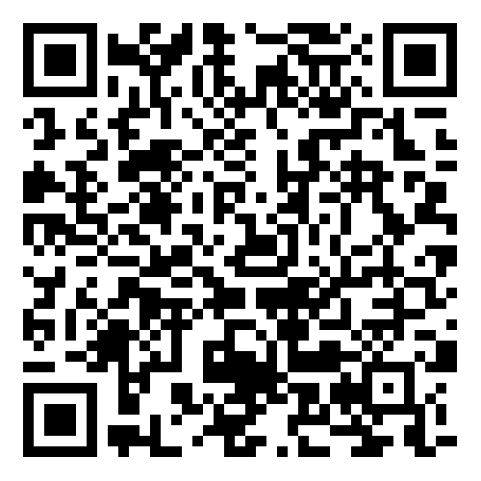
Share your feedback on hosting this session
After your participants have left the session, please complete this short host survey using the QR code or link.
https://aarpresearch.qualtrics.com/jfe/form/SV_4SdIGU3zkKfEgUC
Notes:
This survey is only for people involved in HOSTING the session, not for all of the participants. If your team had multiple people involved in organizing and hosting this session, they are each welcome to fill out their own survey response. Responses are anonymous. AARP’s Work Jobs Team reads all responses and uses your input to celebrate wins and to address opportunities to improve. Thank you for taking 3 minutes of your time to share your feedback.

Slide 20
Follow up with participants after today’s session
You can use the draft email we have added into the Notes section of this slide. Edit as needed and send it out to all who were invited today.
Notes:
Be sure to follow up with those with whom you worked to gain approval and support for additional initiatives to build an age inclusive workplace. Here’s a draft email that you can copy, paste, edit and send out.
Dear ,
Thanks so much for your input in our conversations about our age inclusion initiatives in today’s senior leadership team meeting. Our outcomes this year reinforce that this is a significant strategic opportunity for our organization. I appreciate your support for us to continue the work to leverage the power of a multi-generational workforce.
If you'd like to discuss any aspect of this further, I’d be happy to do so. Please let me know your thoughts when you have a moment. Otherwise, I’ll be sure to keep you apprised of our progress as we move forward.
Best,

Slide 21
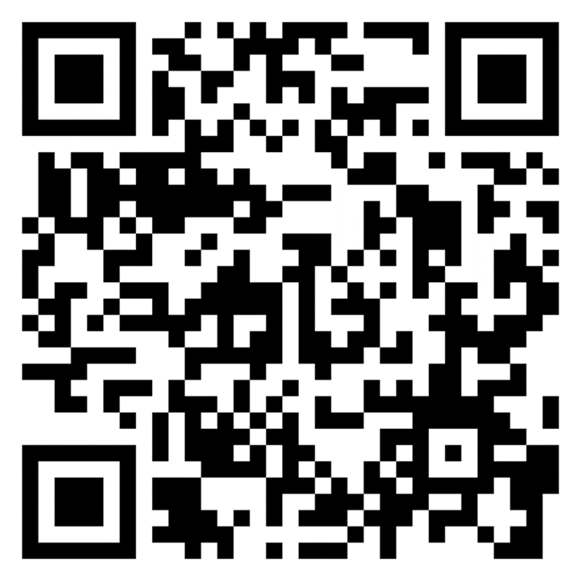
Explore additional actions
AARP’s tool Generations at Work is packed with resources to help you take action to build and leverage a multigenerational workforce
https://employerportal.aarp.org/generations/
Notes:
This workshop is one of a full suite of resources available for leaders, managers and employees to use to create a more age-inclusive workplace. We invite you to explore additional actions, and/or to complete the self-assessment to help you find your next step in the journey.

