Slide 1
Facilitator Instructions: Leading Mixed-Age Teams
Learning Objectives:
Help people managers anticipate and address the dynamics of leading a mixed-age team, so that team members of all ages can thrive professionally under the manager’s leadership and their team operates at its highest performance.
Provide a series of experiments each attendee can use to make their team more age-inclusive for all.
Identify AARP as a “go-to” organization for information and resources on mixed-age teams for both employers and employees.
Facilitator preparation:
Review the full Manager Toolkit: Leading Mixed Age Teams at https://employerportal.aarp.org/age-inclusive-workforce/practice-age-inclusive-management/managing-mixed-aged-teams-guide
(Optional, may require creation of a free AARP log in) Review a video that discusses the toolkit at https://videos.aarp.org/detail/video/6314388966112/a-guide-to-managing-mixed-aged-teams
Event overview:
Ideal number of participants: 5 minimum - unlimited
Target Audience: All employees who are managers of other team members– and “managers of managers.”
Potential “hooks” in existing manager training: Can be incorporated into standard employee onboarding for those who will have direct reports, regular annual manager training, division/ team trainings, professional development plans, and libraries of available learning and development offerings.
Venue/Event Time Considerations: This can be delivered virtually on the technology platform chosen and provided by the employer host or in person. Employer host may consider the maximum size or natural “grouping” of participants and choose to host the workshop multiple times.
Handouts: No physical handouts are required, but facilitators can choose to print the worksheets from the toolkit if they are facilitating in person. All resources are provided in slides at the end of the presentation.
Recording: We do not recommend recording this session, as the knowledge that the session is recorded will likely limit the openness of discussion among the participants. Inistead, offer the workshop in a series of options so that all people managers can find a time to participate live in one session.
Complementary Content: See links in facilitator preparation, and share those directly with participants after the session.
About this Presentation:
This presentation is designed to be flexibly delivered in a 90-minute timeframe, including time to gather, take breaks and wrap up.
Please download your own copy, hide the presenter bio slides you will not be using, update your own speaker bio slide, and modify speaker notes as needed for the purposes of your event.
Notes:
[Facilitator Note: Hide this slide before presenting by right clicking the thumbnail and choosing “Hide Slide” from the list.]

Slide 2
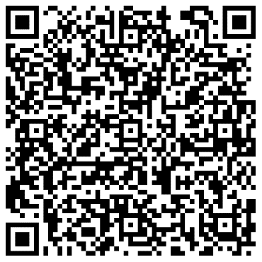
Leading Mixed-Age Teams
Applying research and best practices
Notes:
This 1.5 hour workshop is designed to introduce people managers to key concepts in: the value of mixed-age work teams, the value for people managers who adopt age inclusive team leadership practices, and specific practices they can use day to day. It translates research-backed best practices to hands-on activities for people managers to play with during the workshop, then apply in their daily work with their teams.
Participants: All people managers in the organization
Facilitator: Any HR team member or experienced people manager
Cost: Free
Time Commitment: 3 hours planning, 1.5 hours hosting
If you need to secure buy-in and/or approval from your leadership team in order to host this workshop, copy this email draft into a fresh email, edit it as needed, and send it out!
Dear ,
As you know, we are working towards building a more inclusive workplace, including along dimensions of age. We are also working hard to support the development of our managers so that they feel prepared to lead high performance teams.
I recently learned that AARP research has found that most employees report that their direct supervisors could benefit from training about how to lead teams in which up to five generations work together.
I’d like to bring our people managers together to learn how to lead multigenerational teams-- and why age inclusive teams create value for the team and the organization. AARP has a robust set of resources we can use to host a 90-minute workshop, which will be facilitated by a member of our own Human Resources team. This is an amazing opportunity to use AARP’s research-backed resources to help us adopt best practices-- without any cost to our organization.
Please let me know your thoughts, or if you’d like to review the materials we will use to host this session.
Best,

Slide 3
Leading Mixed-Age Teams
We often lead teams in which up to five generations work together, which creates both opportunities and challenges. Learning how to manage a mixed-age team is key to your own professional growth — and to your team’s success.
This 1.5-hour workshop is designed to introduce people managers to key concepts in: the value of age-inclusive work teams, the value for people managers who adopt age-inclusive team leadership practices, and specific age-inclusive managerial practices. It translates research-backed best practices to hands-on activities for people managers to play with during the workshop, then apply in their daily work with their teams.
You’ll leave with a set of resources AARP has designed to support your ongoing work to lead a mixed-age team.
Courtesy Getty Images
Source: xxx
Notes:
Here is the draft invitation to team members to join the workshop. You can edit and use it. Or if you are presenting, this is the information that set expectations for those joining you today.
Join us for a workshop on Leading Mixed Age Teams
Managers often lead teams in which up to five generations work together, which creates both opportunities and challenges. Learning how to manage a multigenerational team is key to your own professional growth- and to your team’s success.
This 1.5 hour workshop is designed to introduce people managers to key concepts in: the value of age-inclusive work teams, the value for people managers who adopt age-inclusive team leadership practices, and specific age-inclusive managerial practices. It translates research-backed best practices to hands-on activities for people managers to play with during the workshop, then apply in their daily work with their teams. You’ll leave with a set of resources AARP has designed to support your ongoing work to lead a mixed-age team.
We hope one of these dates works for you!
Date: [choose a day when participation will be higher, usually Tu-Th]
Time: [choose a time that works for all time zones]
How to join: [indicate if virtual/ in person/ hybrid]
Register here: [add registration link or meeting invitation for this session]
Date: [If you are offering the workshop multiple times, vary the day]
Time: [If you are offering the workshop multiple times, vary the time of day]
How to join: [indicate if virtual and/or at office location]
Register here: [add registration link or meeting invitation for this session]
Date: [If you are offering the workshop multiple times, vary the day]
Time: [If you are offering the workshop multiple times, vary the time of day]
How to join: [indicate if virtual and/or at office location]
Register here: [add registration link or meeting invitation for this session]

Slide 4
Using AARP resources
AARP’s mission is to empower people to choose how they live as they age.
This is why AARP supports people like you who are creating workplaces that work for all. Employers and managers are key elements in everyone’s ability to thrive both at work and at home as they age, so AARP has created resources to help you build and lead mixed-age teams.
Disclaimer: This presentation is intended to provide general guidance.​ Individual circumstances may differ and should be taken into consideration before acting. ​ Consult your HR team for advice regarding specific situations on your team.
Courtesy Getty Images

Slide 5
Today’s key resource
Managing Mixed-Age Teams Guide
Use this toolkit to leverage your manager training initiatives to build the careers of your employees across all ages. It has everything you need—from the data you need to garner support and win resources to the tactical training exercises managers can use.
https://employerportal.aarp.org/age-inclusive-workforce/practice-age-inclusive-management/managing-mixed-aged-teams-guide
Family Caregiving
AARP Family Caregiver
Notes:
Facilitator Notes: Mention that the ideas and practices in this resource can be used by all types of leaders in the organization
Full introduction to the resource:
Managing Mixed Age Teams Guide by AARP
https://employerportal.aarp.org/age-inclusive-workforce/practice-age-inclusive-management/managing-mixed-aged-teams-guide
If you’re reading this, you’re curious about how your organization can be one where all employees can thrive in in their work teams without encountering age or generational biases. The issue has never been more pressing. In a recent AARP study, 83% of employers said that creating a more multigenerational workforce would drive their success and growth. They believe that their organizations need to do more to maximize the full potential of an age-diverse workforce. In fact, these executives highlighted age as a top area of diversity management that requires the most improvement. This creates major opportunities for employers, who now consider it a key business strategy to address the needs and unleash the synergies of a workforce that can span as many as 5 generations. Given conventional wisdom that employees leave managers and not organizations, a valuable tactic is to provide managers with training on how to successfully lead a mixed-age team. You’re holding a powerful toolkit that you can use to leverage your manager training initiatives (onboarding, new manager training, and ongoing supervisor training) to build the careers of your employees across all ages and career phases. You don’t have to be the CEO or head of HR to use this toolkit. You can use it as a supervisor of a team, a supervisor of other managers, a senior leader, or someone in the HR, DEI, CSR or L&D teams. The tools here can be used by organizations of all sizes, from 5 employees to over 25,000. They can be adapted for organizations with all types of employees, and across all industries.
This toolkit is intended for:
Business leaders committed to developing leaders internally
Human resource managers and leadership
People managers who manage a multigenerational team
You can use this toolkit to: 1) Win buy-in from key influencers in your organization to engage managers around age inclusion, 2) Start a new initiative to train managers to lead mixed-age teams, or 3) Build elements into your existing manager development practices to address leading a mixed-age team. The kit has everything you need to design and build your initiative—from the data you need to garner support and win resources to the tactical training exercises you can use.

Slide 6
[My name]
[My role]
[2-3 sentence facilitator introduction/ bio.]
You can reach me at [insert your email or other contact info here.]
Notes:
Facilitator note: Swap in a photo of yourself instead of the illustration and update the speaker bio. If you are willing, be sure to share your contact information so participants can reach out to you afterwards with additional questions or for support on how to put these best practices into action in their teams.

Slide 7
Introductions
Use any or all of these prompts
My name is __________________________________________
I manage a team of ___ people directly and ___ people who roll up to me
One word to describe how it feels to manage a mixed-age teams is ________________________________________
Today I want to talk about ____________________________
Courtesy Getty Images
Notes:
Facilitator Note:
Edit these prompts to fit your team. We recommend including a prompt that allows each individual to share some aspect of how they are feeling/ what they are hoping for about this working session. This provides the facilitator with a good “read” of the group, and it makes it more likely that the participants will engage more deeply in the content and exercises throughout the training.

Slide 8
Agenda
|
|
|
|
|
How do mixed-age teams drive organizational performance?
Why is the manager role key to creating an age-inclusive workforce?
Gut check
What can I do as a manager?
Q&A and resources to use and share
Courtesy Getty Images

Slide 9
Strategic value of mixed-age teams
A value creation strategy hiding in plain sight
In a recent AARP study, 83%¹ of employers said that creating a more multigenerational workforce would drive their success and growth. They believe that their organizations need to do more to maximize the full potential of an age-diverse workforce.
This creates major opportunities for employers, who now consider it a key business strategy to address the needs and unleash the synergies of a workforce that can span as many as 5 generations.
Source: 1 AARP Global Employer Survey 2020
Notes:
1 “According to the AARP Global Employer Survey 2020, 83% of employers state that it would be very or at least somewhat valuable to their organisation’s success and growth to create a more multigenerational workforce. Executives in large global companies recognize that their organization would need to undertake more efforts to maximise the full potential that an age-diverse workforce offers, listing age, besides disability, as the area of diversity management that requires most improvement (Forbes Insights, 2011[33]).”

Slide 10
Strategic value of a mixed-age teams
A value creation strategy hiding in plain sight
“Employers who can successfully combine the talents and diverse outlooks of their employees — whatever their age — generally find that their workforce is enriched and more productive as a result,” according to the OECD.”²
“Reaping these benefits will require putting in place tailored support at all ages and strengthening collaboration between generations.”³
Sources: 1 AARP Global Employer Survey 2020
2 https://www.oecd-ilibrary.org/docserver/59752153-en.pdf?expires=1636142224&id=id&accname=guest&check
3 https://www.oecd-ilibrary.org/docserver/59752153-en.pdf?expires=1636142224&id=id&accname=guest&check

Slide 11
The business case for mixed-age teams
Age diversity improves team performance
Research has shown that mixed-age teams perform better than homogenous-aged teams:
In companies that utilized mixed-age work teams, the relative productivity of both older and younger workers was higher than in companies that did not use mixed-age teams.
When the task “entails dealing with strategic and complex decision-making with vaguely defined problems in a dynamic setting…increased age diversity can lead to enhanced group discussions, better analysis and superior problem-solving.”
Courtesy Getty Images
Sources: Human Resource Management Journal, vol. 23, Issue 3, (2013); Personnel Psychology, 67, (2014); Labour Economics, 22, (2013); Journal of Applied Psychology, 93, (2008). https://ideas.repec.org/p/iso/educat/0093.html http://repec.business.uzh.ch/RePEc/iso/leadinghouse/0093_lhwpaper.pdf
Notes:
Facilitator note: As you customize this deck to meet your needs, feel free to bring in additional data from AARP’s Business Case for Age-Inclusion slide deck at https://employerportal.aarp.org/age-inclusive-workforce/commit-to-an-age-inclusive-culture/business-case-basic-slides

Slide 12
Reflect
Where do you think our organization is in our potential to fully leverage mixed-age teams?
1 (newly exploring) ←→ 10 (consistent organization-wide action)
Notes:
Facilitator note: If hosting virtually, prompt this to be input to Chat. If in person, consider a “popcorn” call out where you are jotting their responses on a white board as they try to brainstorm as many as possible in 60 seconds.

Slide 13
Reflect
Where do you think your team is in our potential to fully leverage mixed-age teams?
1 (newly exploring) ←→ 10 (consistent organization-wide action)
Notes:
Facilitator note: If hosting virtually, prompt this to be input to Chat. If in person, consider a “popcorn” call out where you are jotting their responses on a white board as they try to brainstorm as many as possible in 60 seconds.

Slide 14
Agenda
|
|
|
|
|
How do mixed-age teams drive organizational performance?
Why is the manager role key to creating an age-inclusive workforce?
Gut check
What can I do as a manager?
Q&A and resources to use and share
Courtesy Getty Images

Slide 15
Why are managers the key?
1. An outsize effect on employee engagement
Both positive and negative! Managers account for 70% of the variance in employee engagement.¹
Research shows many employees see or experience age bias, but few report it. This puts the onus on managers to notice and interrupt age bias in their own team and in the broader teams with whom their direct reports work.
Managers can increase engagement by building teams where all members see how the skills, experience and perspectives of colleagues of all ages create value.
Courtesy Getty Imagess
Source 1 https://news.gallup.com/businessjournal/182792/managers-account-variance-employee-engagement.aspx
Notes:
From the Leading Mixed Age Teams Guide:
Managers have an outsize effect on employee engagement — both positive and negative. Almost any employee will tell you that their experience of their workplace — and their level of engagement — is most heavily determined by their manager’s actions and inactions. In fact, research by Gallup found that managers account for 70%8 of the variance in employee engagement. So how might this play out on mixed-aged teams? We work in a world where, research shows, many employees see or experience age bias; however, few report it. If the employees are not going to report it to their manager, the onus is on the employee’s manager to notice and interrupt age bias both in their own team and in the broader organizational teams with whom their direct reports work. Managers can increase employee engagement and cultivate a sense of belonging by building mixed-age teams where all members can observe how the skills, experiences and views of colleagues across the age spectrum create value. Alternately, managers can choose not to do so. Employees are paying attention — and both managerial action and inaction affect their level of engagement.

Slide 16
Why are managers the key?
2. Employees stay mum about their concerns
Younger workers may be more inclined to notice age bias but may underreport because they are unaware that many state laws protect workers regardless of age.
Among workers age 45+ only 3% have made an official complaint about age discrimination. But 15% have heard negative remarks related to their older age from a colleague or supervisor. And 12% cited being passed up for a promotion or other chance to get ahead.¹
Employees underreport age bias because they fear retaliation in the form of reduced roles or uncharacteristically low performance reviews that result in termination.² Their concern is reasonable. In fact, about half of full-time workers between the ages of 50 and 54 will lose their jobs involuntarily.³
Courtesy Getty Imagess
Source 1 https://www.aarp.org/research/topics/economics/info-2018/multicultural-work-jobs.html 2 https://www.fisherphillips.com/news-insights/age-is-more-than-a-number-trends-in-workforce-composition-ageism-and-efforts-to-address-the-elephant-in-the-room.html 3 https://www.urban.org/research/publication/how-secure-employment-older-ages
Notes:
From the Leading Mixed Age Teams Guide:
Employees are highly reluctant to talk to their managers about age-bias concerns. Of course, managers cannot easily address employee issues about which they have little awareness. In terms of the risks of age bias and the value of mixed-age teams, most managers are in the dark. Consider how managers could make themselves more approachable if they paused to think about the implications of these basic statistics:
Only 3% of workers age 45+ have ever made an official complaint about age discrimination. This, even though 15% of workers age 45+ have heard negative remarks related to their older age from a colleague or supervisor, 16% cited not getting hired for a job they applied for because of their age, and 12% cited being passed up for a promotion or another chance to get ahead.9
• Younger workers are often more aware of bias in general and are potentially more inclined to notice age bias, but they may underreport because they are aware that federal age discrimination law does not protect employees under age 40 and may be unaware that some state age-discrimination laws protect workers regardless of age.
• Employees underreport age bias because they fear retaliation in the form of reduced roles or uncharacteristically low performance reviews that result in termination.10 Their concern is reasonable. In fact, about half of full-time workers between the ages of 50 and 54 will lose their jobs involuntarily.11

Slide 17
Why are managers the key?
3. Managers create their own team cultures
Managers can make or break an organization’s goals by supporting or ignoring them within their own team practices and culture. Managers will run more productive, successful teams if they lead with an active awareness of intersectional data such as:
Overall, Black/African American employees are more likely to have seen or experienced age discrimination.
Among workers age 40+, Hispanic/Latino workers are most likely to have seen or experienced workplace age discrimination.
Ageism hits women earlier and harder.
Men of all ages no longer have predictable “ages” or roles for involvement in parenting, caregiving and shared family duties.
The LGBTQ workforce is being reshaped by younger workers who are more diverse and stronger allies, including on age-related bias.
Courtesy Getty Imagess
Sources www.aarp.org/intergenERG p. 17-23
Notes:
From the Leading Mixed Age Teams Guide:
Managers can make or break an organization’s DE&I goals by supporting or ignoring them within their own team practices and culture.
Multigenerational issues intersect with all DE&I focus populations, creating unique challenges and opportunities for each one. Managers will help their organizations achieve their DE&I goals and run more productive, successful teams if they lead with an active awareness that:
• “Ageism hits women earlier and harder.”12
• Men of all ages are navigating changing gender norms in the workplace and no longer have predictable “ages” or time requirements for involvement in parenting, caregiving and shared family duties.
• The LGBTQ workforce is being reshaped by younger workers who are more diverse and stronger allies, including around age-related bias.
• Black employees overall are more likely to have seen or experienced age discrimination.
• Hispanic/Latino workers age 40+ are most likely to have seen or experienced workplace age discrimination.
For more data and details on the intersectional nature of multigenerational workplaces, see pages 17–23 of the Intergenerational ERG Toolkit at www.aarp.org/intergenERG.

Slide 18
Why are managers the key?
4. Managers drive retention– and turnover
Conventional wisdom (and perhaps personal experience) tells us that employees leave managers, not organizations. The research starkly supports this. Consider how managerial styles that are not age-inclusive may be reflected in this data:
“1 in 2 employees have left their job to get away from their manager at some point in their career.”¹
82% of employees surveyed for a recent report said they “would consider quitting their job because of a bad manager.”²
“52% of exiting employees say that their manager or organization could have done something to prevent them from leaving their job. ³ But only about a third of former employees said they had a conversation with their manager about leaving before they quit.” ⁴
Courtesy Getty Images
Sources 1 https://www.gallup.com/workplace/215384/gallup-manager-team-leader-development.aspx 2 https://www.valuepenguin.com/news/majority-workers-would-leave-job-becuase-of-manager 3 https://www.gallup.com/workplace/357104/ways-managers-stop-employee-turnover.aspx 4 https://www.gallup.com/workplace/357104/ways-managers-stop-employee-turnover.aspx
Notes:
From the Leading Mixed Age Teams Guide:
Managers are the key drivers of employee attrition — and retention. Conventional wisdom (and perhaps personal experience) tells us that employees leave managers, not organizations. The research starkly supports this. Consider how issues of age bias or a lack of actively age-inclusive managerial behaviors might be reflected in this data:
- “1 in 2 employees have left their job to get away from their manager at some point in their career.” In fact, 82% of employees surveyed for a recent report said they “would consider quitting their job because of a bad manager.”
• Employees are open to manager support right up to the point when they leave. According to Gallup Research, “52% of exiting employees say that their manager or organization could have done something to prevent them from leaving their job. But only about a third of former employees said they had a conversation with their manager about leaving before they quit.”
• Gallup has also found that “it’s disengaged workers who are at the highest risk of leaving. It takes more than a 20% pay raise to lure most employees away from a manager who engages them, and next to nothing to poach most disengaged workers. High-quality managers who inspire and support their teams are an effective moat of protection for retaining their most talented workers.”

Slide 19
OK, so…
What do organizational leaders do when they realize that those in managerial positions can drive — or drag down — employee engagement, organizational productivity, the ability to achieve DE&I goals, and employee retention based on their ability to lead mixed-age teams?
They look for ways to set up the people in that role for success.
Courtesy Getty Images
Sources 1 https://www.gallup.com/workplace/215384/gallup-manager-team-leader-development.aspx 2 https://www.valuepenguin.com/news/majority-workers-would-leave-job-becuase-of-manager 3 https://www.gallup.com/workplace/357104/ways-managers-stop-employee-turnover.aspx 4 https://www.gallup.com/workplace/357104/ways-managers-stop-employee-turnover.aspx
Notes:
From the Leading Mixed Age Teams Guide:
Managers are the key drivers of employee attrition — and retention. Conventional wisdom (and perhaps personal experience) tells us that employees leave managers, not organizations. The research starkly supports this. Consider how issues of age bias or a lack of actively age-inclusive managerial behaviors might be reflected in this data:
- “1 in 2 employees have left their job to get away from their manager at some point in their career.” In fact, 82% of employees surveyed for a recent report said they “would consider quitting their job because of a bad manager.”
• Employees are open to manager support right up to the point when they leave. According to Gallup Research, “52% of exiting employees say that their manager or organization could have done something to prevent them from leaving their job. But only about a third of former employees said they had a conversation with their manager about leaving before they quit.”
• Gallup has also found that “it’s disengaged workers who are at the highest risk of leaving. It takes more than a 20% pay raise to lure most employees away from a manager who engages them, and next to nothing to poach most disengaged workers. High-quality managers who inspire and support their teams are an effective moat of protection for retaining their most talented workers.”

Slide 20
And also…
Meanwhile, many managers say that they feel they are in the “buffer zone” — tasked with making the organization’s productivity goals, culture, DE&I goals, benefits and policies real for the individuals who report to them. They often do this without full clarity, support, training and coaching from their organizations. Often, they pay the price when their team is under-resourced due to the resulting attrition.
The activities in the Leading Mixed-Age Teams Guide were designed with both senior leadership goals and manager realities in mind.
Courtesy Getty Images
Sources 1 https://www.gallup.com/workplace/215384/gallup-manager-team-leader-development.aspx 2 https://www.valuepenguin.com/news/majority-workers-would-leave-job-becuase-of-manager 3 https://www.gallup.com/workplace/357104/ways-managers-stop-employee-turnover.aspx 4 https://www.gallup.com/workplace/357104/ways-managers-stop-employee-turnover.aspx
Notes:
From the Leading Mixed Age Teams Guide:
Managers are the key drivers of employee attrition — and retention. Conventional wisdom (and perhaps personal experience) tells us that employees leave managers, not organizations. The research starkly supports this. Consider how issues of age bias or a lack of actively age-inclusive managerial behaviors might be reflected in this data:
- “1 in 2 employees have left their job to get away from their manager at some point in their career.” In fact, 82% of employees surveyed for a recent report said they “would consider quitting their job because of a bad manager.”
• Employees are open to manager support right up to the point when they leave. According to Gallup Research, “52% of exiting employees say that their manager or organization could have done something to prevent them from leaving their job. But only about a third of former employees said they had a conversation with their manager about leaving before they quit.”
• Gallup has also found that “it’s disengaged workers who are at the highest risk of leaving. It takes more than a 20% pay raise to lure most employees away from a manager who engages them, and next to nothing to poach most disengaged workers. High-quality managers who inspire and support their teams are an effective moat of protection for retaining their most talented workers.”

Slide 21
Agenda
|
|
|
|
|
How do mixed-age teams drive organizational performance?
Why is the manager role key to creating an age-inclusive workforce?
Gut check
What can I do as a manager?
Q&A and resources to use and share
Courtesy Getty Images

Slide 22
Poll
To what extent is your team set up to be an effective mixed-age team?
A bit
Pretty well, thanks
Absolutely
Courtesy Getty Images
Source: xxx
Notes:
Facilitator Note: Go through these polls quickly as they are really intended not to spark lots of conversation, but instead to re-energize the group and move towards active participation in the exercises to follow. Note that these poll questions each align with a specific training exercise in the Leading Mixed-Age Teams resource, so those who answer A or B on any question can find an activity to help them in that area if they look in the Leading Mixed Age Teams guide.

Slide 23
Poll
How comfortable are you managing up and down across age difference?
A bit uncomfortable, to be honest
I feel pretty comfortable
I’m always aware of and able to manage these dynamics with my own manager and my direct reports
Courtesy Getty Images
Source: xxx

Slide 24
Poll
How often does the topic of age of team members come up in conversations among your team members?
Never
Sometimes
Often
Courtesy Getty Images
Source: xxx

Slide 25
Poll
How often do you notice tension between team members of different ages?
Never
Sometimes
Often
Courtesy Getty Images
Source: xxx

Slide 26
Poll
How often do you consider age inclusion in the products and/or experiences your team influences?
Never
Sometimes
Often
Courtesy Getty Images
Source: xxx

Slide 27
Agenda
|
|
|
|
|
How do mixed-age teams drive organizational performance?
Why is the manager role key to creating an age-inclusive workforce?
Gut check
What can I do as a manager?
Q&A and resources to use and share
Courtesy Getty Images

Slide 28
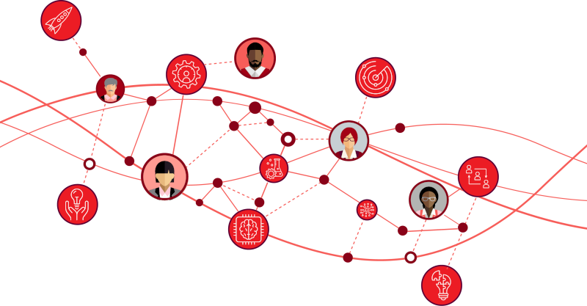
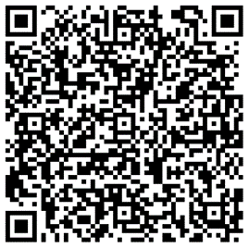
Practice activities from the Leading Mixed-Age Teams Toolkit
Today we’ll play with a handful of these: #1, 5 and 7
The activities are designed to be especially useful when you use them in the order listed, so you are continually building your own skills and your team’s skills.
Each one can be done in about 15-30 minutes.
Courtesy Getty Images
Source: https://employerportal.aarp.org/age-inclusive-workforce/practice-age-inclusive-management/managing-mixed-aged-teams-guide

Slide 29
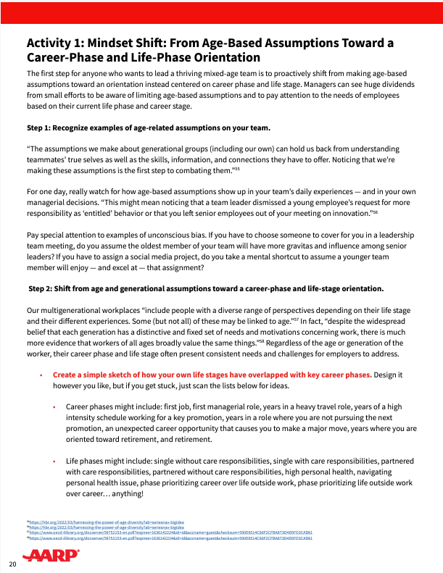
Try it now
Activity 1: Mindset Shift
The first step for anyone who wants to lead a thriving mixed-age team is to proactively shift from making age-based assumptions toward an orientation instead centered on career phase and life stage.
Managers can see huge dividends from small efforts to be aware of limiting age-based assumptions and to pay attention to the needs of employees based on their current life phase and career stage.
Courtesy Getty Images
Source: https://employerportal.aarp.org/age-inclusive-workforce/practice-age-inclusive-management/managing-mixed-aged-teams-guide
Notes:
Facilitator notes: We recommend that you print copies of the activities included in this workshop from the Leading-Mixed Age Teams Guide and distribute so participants can fill them out individually as you work on the activities together.

Slide 30
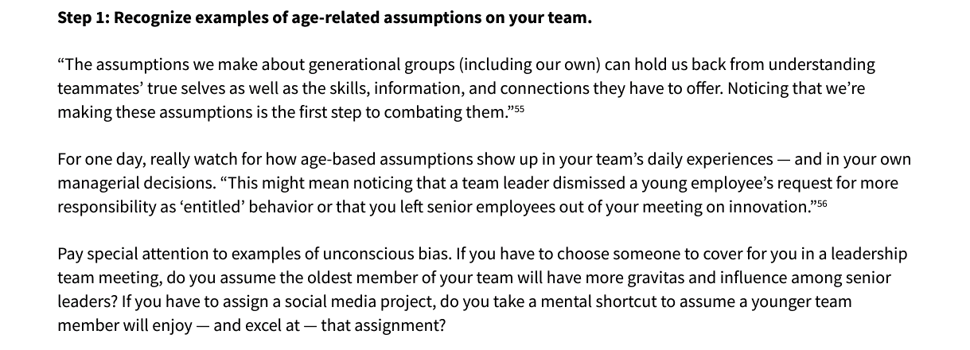
Try it now
Activity 1: Mindset Shift
Notes:
Facilitator notes: While we recommend asking participants to use the paper-based activity worksheets, we include the sections on these slides to help you facilitate discussion. Consider asking individuals to complete Step 1 on their own, then discuss as a group. Then to the same for Step 2, etc.
In this case, Step 1 can not include spending a day observing, so instead prompt participants to reflect on the past week with their team.

Slide 31
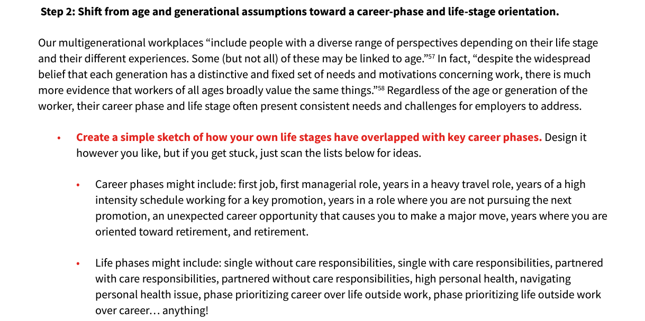
Try it now
Activity 1: Mindset Shift
Notes:
Facilitator notes: While we recommend asking participants to use the paper-based activity worksheets, we include the sections on these slides to help you facilitate discussion. Consider asking individuals to complete Step 1 on their own, then discuss as a group. Then to the same for Step 2, etc.
In this case, Step 1 can not include spending a day observing, so instead prompt participants to reflect on the past week with their team.

Slide 32
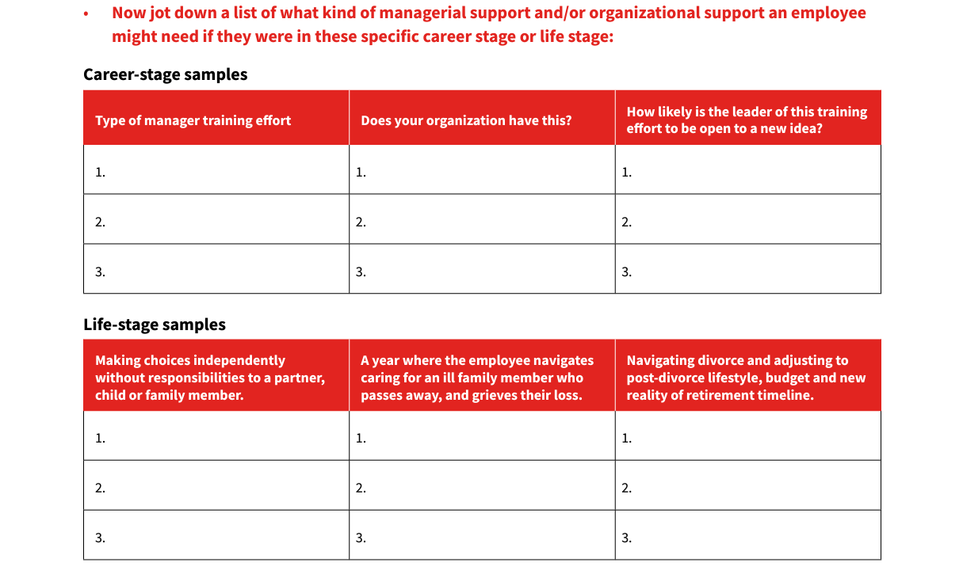
Try it now
Activity 1: Mindset Shift
Notes:
Facilitator notes: While we recommend asking participants to use the paper-based activity worksheets, we include the sections on these slides to help you facilitate discussion. Consider asking individuals to complete Step 1 on their own, then discuss as a group. Then to the same for Step 2, etc.
In this case, Step 1 can not include spending a day observing, so instead prompt participants to reflect on the past week with their team.

Slide 33
Reflect
What are some examples of life-stage needs that may not map with our age-based assumptions?
Share your thoughts in Chat or in our conversation
Notes:
Facilitator note: If hosting virtually, prompt this to be input to Chat. If in person, consider a “popcorn” call out where you are jotting their responses on a white board as they try to brainstorm as many as possible in 60 seconds.
Potential responses might include: A 24 year-old employee who cares for his mom with advancing MS, a 31 year-old who wants to retire by age 45, a 47 year-old employee who just welcomed a new baby to the family, a 58 year-old new hire who considers this an role to grow in for the next 15 years rather than a bridge to retirement.
** You might allow time for a brief break between the three exercises if you have time.

Slide 34
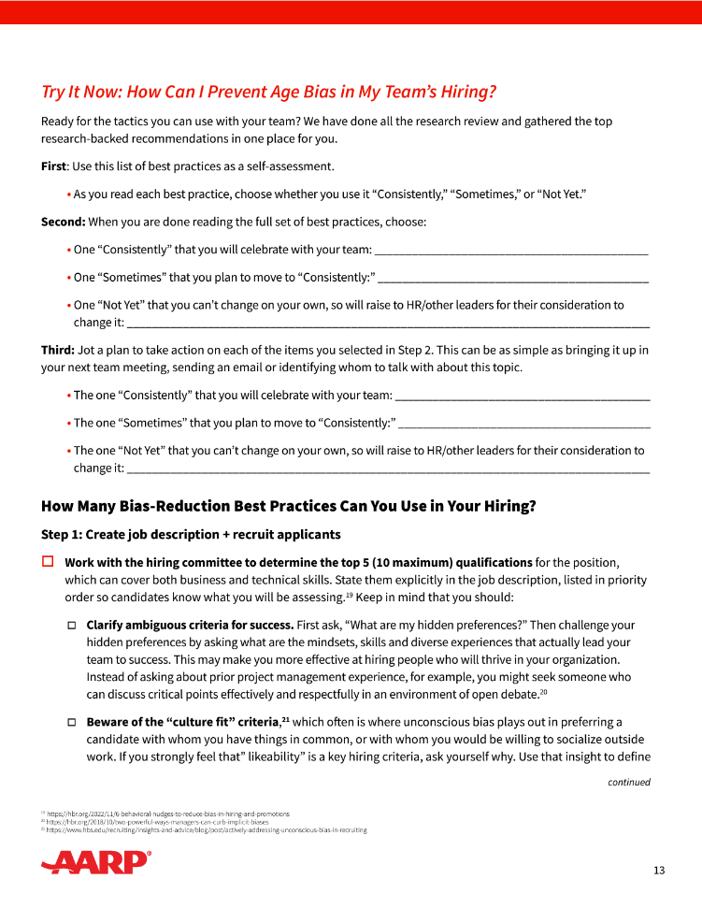
Try it now
Activity 5: How Can I Talk About Age Inclusion with My Team?
All team members need to develop their own age-inclusive work practices and mindsets. Here are a few ideas for how you can start the conversation — and keep it going — on your own team.
You can personally lead each of these activities with your team, or you can use these as opportunities for team members to step up and lead these activities during a team meeting.
Courtesy Getty Images
Source: https://employerportal.aarp.org/age-inclusive-workforce/practice-age-inclusive-management/managing-mixed-aged-teams-guide

Slide 35
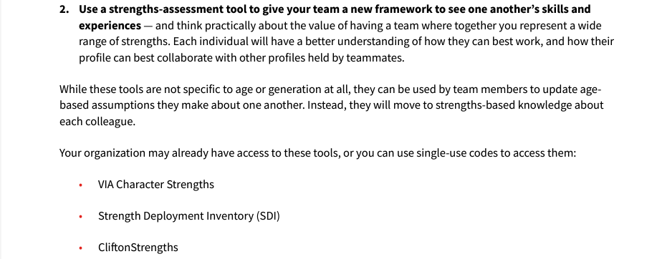
Try it now
Activity 5: How Can I Talk About Age Inclusion with My Team?
Take 3 minutes to mark up your copy of the full worksheet with ideas and notes about how you could use this with your own team. When can you use these? Who on the team could lead each one?
Notes:
Facilitator: Please print the full worksheet and distribute to all participants. If hosting virtually, you can share a link to the resource with participants for them to access.

Slide 36
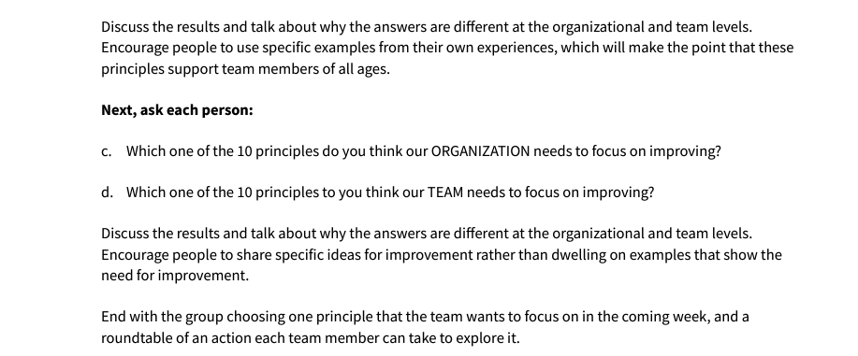
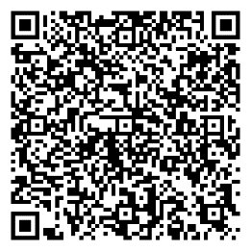
Try it now
Activity 5: How Can I Talk About Age Inclusion with My Team?
In small groups, complete Option #3. Then debrief on how you can facilitate it with your team.
Notes:
Facilitator: Please print the full worksheet and distribute to all participants. If hosting virtually, you can share a link to the resource with participants for them to access.
To prompt participants to do Option #3 in small groups, share this link in the Chat https://employerportal.aarp.org/age-inclusive-workforce/practice-age-inclusive-management/guide-10-principles-for-managing-mixed-age-teams and direct them to use their phones to access it via the QR code.

Slide 37
Reflect
It’s very possible that your team will welcome this conversation. Why might that be the case?
Share your thoughts in Chat or in our conversation
Notes:
Facilitator note: If hosting virtually, prompt this to be input to Chat. If in person, consider a “popcorn” call out where you are jotting their responses on a white board as they try to brainstorm as many as possible in 60 seconds.

Slide 38
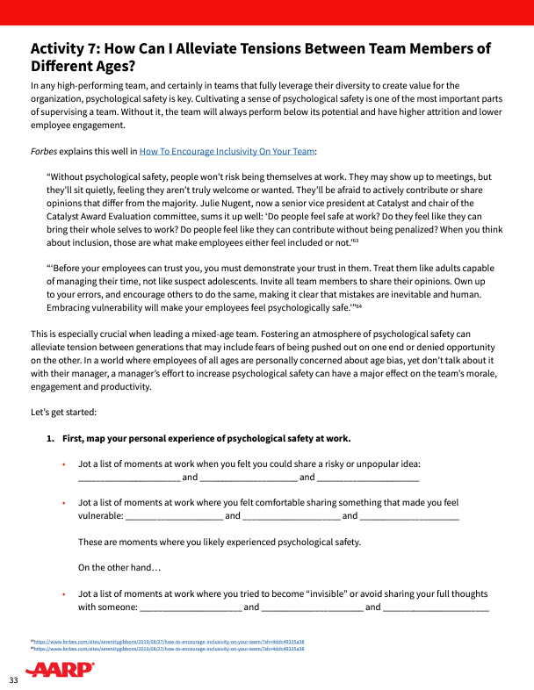
Try it now
Activity 7: How Can I Alleviate Tensions Between Team Members of Different Ages?
In any high-performing team psychological safety is key.
This is especially crucial when leading a mixed-age team.
In a world where employees of all ages are personally concerned about age bias, yet don’t talk about it with their manager, a manager’s effort to increase psychological safety can have a major effect on the team’s morale, engagement and productivity.
Courtesy Getty Images
Source: https://employerportal.aarp.org/age-inclusive-workforce/practice-age-inclusive-management/managing-mixed-aged-teams-guide
Notes:
Facilitator Notes: Please ensure participants have a printed copy of the full worksheet. Encourage them to complete Step 1 all together, then debrief. Then Step 2 individually, followed by debrief, etc.

Slide 39
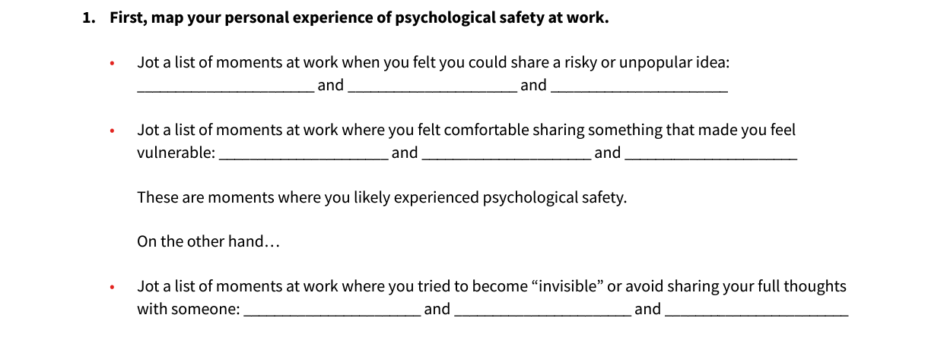
Try it now
Activity 7: How Can I Alleviate Tensions Between Team Members of Different Ages?
Complete Section 1 on your own.

Slide 40
Try it now
Activity 7: How Can I Alleviate Tensions Between Team Members of Different Ages?
In Section 2, choose (b) or (d) and think of an example from the past few weeks in your team.
Be specific about “how I could tell” including body language, energy, eye contact, voice tone and volume, and other indicators.

Slide 41
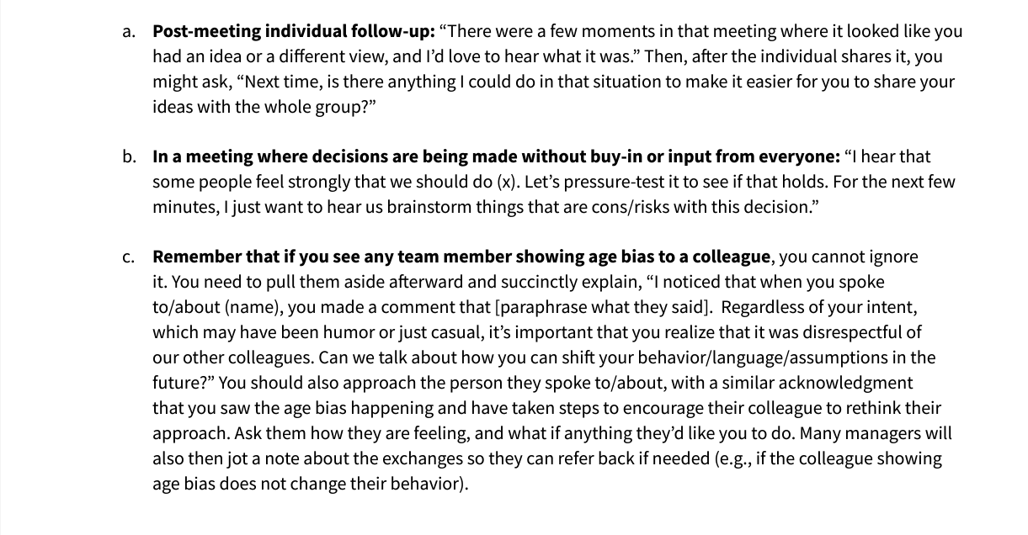
Try it now
Activity 7: How Can I Alleviate Tensions Between Team Members of Different Ages?
In Section 3, use that one specific example and consider how you could have helped. Take a moment to jot your thoughts, then we will share out with the group.
Notes:
Facilitator, please ensure to remind participants that when they share out, they should not share information that will identify any other team members in their example situation. Keep the focus on their OWN actions and possible alternative ways they could have helped build towards psychological safety in this situation.
Ask participants for additional ideas to build when someone shares their example.

Slide 42
Reflect
When have you experienced the “boost” of engagement and productivity that comes from feeling psychologically safe in a work team? What did your manager do to create that context for you?
Share your thoughts in Chat or in our conversation
Source: https://www.forbes.com/sites/serenitygibbons/2019/08/27/how-to-encourage-inclusivity-on-your-team/?sh=3dd0d27d5a38
Notes:
Facilitator note: If hosting virtually, prompt this to be input to Chat. If in person, consider a “popcorn” call out where you are jotting their responses on a white board as they try to brainstorm as many as possible in 60 seconds.

Slide 43
Use more activities from Leading Mixed Age Teams
Today we tried a few activities to help you get started.
Pick others that address needs and challenges that feel relevant for your current situation.
Use them with your team!
Courtesy Getty Images
Source: https://employerportal.aarp.org/age-inclusive-workforce/practice-age-inclusive-management/managing-mixed-aged-teams-guide
Notes:
Facilitator notes
Once we can see age bias, and understand it may be happening unconsciously, we want to take steps to prevent it in our team’s recruiting and hiring efforts.
[Bullets on page]
People:
As a hiring manager, you are a key influencer of every person involved in the processes and conversations you’ll use to recruit, hire and onboard your new team member. Use that leverage to encourage the team to learn to see, prevent and interrupt age bias. These people, whom you can engage to “examine and broaden their definitions of success” and to focus on the “additive contribution” of each potential job candidate, could include: recruiters who filter candidates, your own direct reports, people outside your own team who will participate in interviews or assessments of candidates.
Processes:
As a hiring manager, you likely inherit a set of hiring processes that your organization uses. As you use these processes, remain curious about where they may inadvertently exacerbate bias issues and use your agency to adjust and evolve them as needed.
To help prevent age bias, consider using research-backed best practices at each step of the hiring process.
Content notes:
All from STNT p 11
16 https://hbr.org/2018/10/two-powerful-ways-managers-can-curb-implicit-biases

Slide 44
Agenda
|
|
|
|
|
How do mixed-age teams drive organizational performance?
Why is the manager role key to creating an age-inclusive workforce?
Gut check
What can I do as a manager?
Q&A and resources to use and share
Courtesy Getty Images

Slide 45
Your questions help us all. What’s on your mind?
Q&A
Courtesy Getty Images

Slide 46
How do I overcome the awkwardness of bringing up age-inclusion if my direct report(s) are older than I am as their manager? Can I leverage the power of a mixed-age team without talking explicitly about age? How can I notice and interrupt moments where I notice myself or others slipping into stereotypes?
FAQs
Courtesy Getty Images

Slide 47
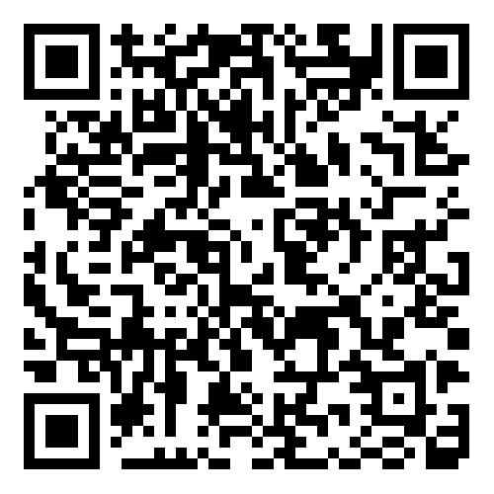
We welcome your feedback on today’s session
Please complete this short participant survey by using the QR code or link now before we wrap up today.
https://aarpresearch.qualtrics.com/jfe/form/SV_6nkTYFpWEmeEI3s
Notes:
Copy and paste this link into the Chat for people to do right now before they leave the session. And ask them to use their phone to scan the QR code and take the brief survey now. Thank you!
Hosts can access the survey summary results by emailing the AARP Work Jobs team to request.

Slide 48
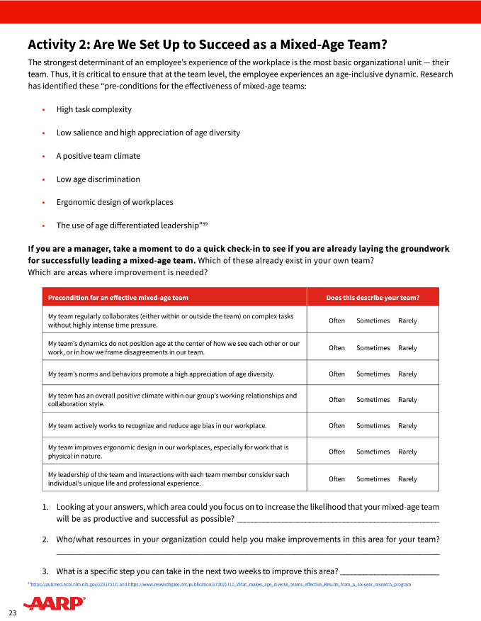
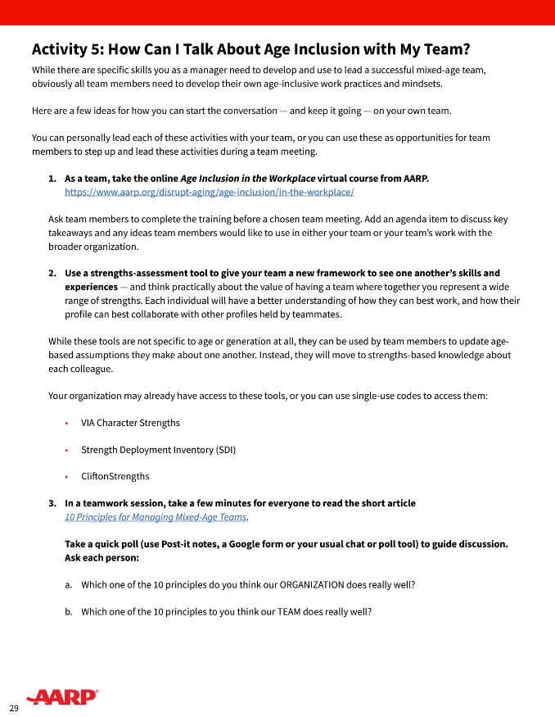
Today’s key takeaways
1| Bookmark the toolkit
2| Spend solo time finishing Activity 2
3| Choose a time to do Activity 5 with your team
Family Caregiving
Family Caregiving
Family Caregiving
AARP Family Caregiver
AARP Family Caregiver
AARP Family Caregiver
Resource Guide
Resource Guide
Resource Guide

Slide 49
Thanks for joining us!
Notes:
This is the last slide of the presentation to share with participants.
Slides that follow contain resources for the host to use after the session ends.

Slide 50
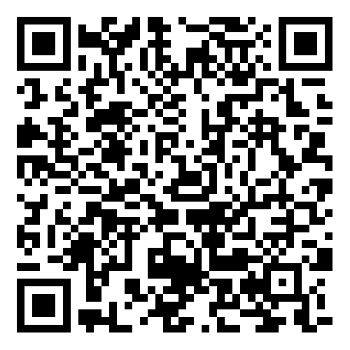
Share your feedback on hosting this session
After your participants have left the session, please complete this short host survey using the QR code or link.
https://aarpresearch.qualtrics.com/jfe/form/SV_4SdIGU3zkKfEgUC
Notes:
This survey is only for people involved in HOSTING the session, not for all of the participants. If your team had multiple people involved in organizing and hosting this session, they are each welcome to fill out their own survey response. Responses are anonymous. AARP’s Work Jobs Team reads all responses and uses your input to celebrate wins and to address opportunities to improve. Thank you for taking 3 minutes of your time to share your feedback.

Slide 51
Follow up with participants after today’s session
You can use the draft email we have added into the Notes section of this slide. Edit as needed and send it out to all who were invited today.
Notes:
Be sure to follow up with all participants as soon as possible after the conclusion of the workshop. Here’s a draft email that you can copy, paste, edit and send out.
If you choose, you can also send it to everyone you invited, or to everyone who registered even if they were unable to make it.
Dear ,
Thanks so much for your interest in today’s workshop, How to Lead a Mixed-Age Team. This is a topic that affects every manager across the organization—and all of our employees—so we appreciate your investing your time to learn about best practices.
The key resource we used in our workshop is AARP’s Manager’s Guide to Mixed Age Teams. We encourage you to bookmark it—and to use the activities with your own direct reports so that your team can explore the opportunities and challenges of different generations at work.
If you have any questions or thoughts about the workshop, please reach out to [name] at [xxx.]
All the best,

Slide 52
Update leaders after today’s session
Update the leader(s) who approved today’s session to highlight wins and learnings from the completed workshop. You can use the draft email we added into the Notes section of this slide.
Notes:
Be sure to follow up with those with whom you worked to gain approval and support to host the workshop. Here’s a draft email that you can copy, paste, edit and send out.
Dear ,
Thanks so much for your support of our team’s efforts to host the AARP workshop How to Lead a Mixed Age Team. This is a topic that affects every manager across the organization—and all employees who report to them—so we are gratified that the workshop was a success.
On [date], [name] welcomed [##] people managers from across the organization for the 1.5-hour workshop. We introduced compelling data about how mixed-age teams can drive employee engagement, knowledge transfer, innovation and productivity. We then introduced and practiced specific exercises for managers of mixed age teams.
[If you have survey data from the participant survey that you’d like to highlight, add a sentence or two about that here.]
The key resource we used in our workshop is AARP’s Manager’s Guide to Mixed Age Teams. If you were not able to join us for the workshop, we encourage you to bookmark it—and to share it with your own direct reports so that your teams can explore how to work together to unleash the value of a multigenerational workforce.
If you have any questions or thoughts about the workshop, please reach out to [name] at [xxx.]
All the best,

Slide 53
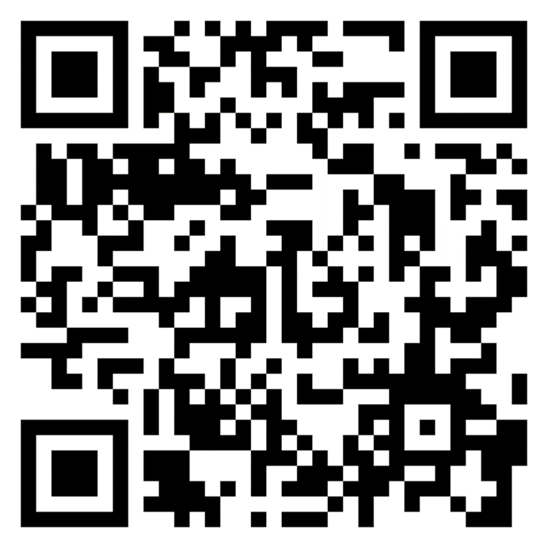
Explore additional actions
AARP’s tool Generations at Work is packed with resources to help you take action to build and leverage a multigenerational workforce
https://employerportal.aarp.org/generations/
Notes:
This workshop is one of a full suite of resources available for leaders, managers and employees to use to create a more age-inclusive workplace. We invite you to explore additional actions, and/or to complete the self-assessment to help you find your next step in the journey.

