Slide 1
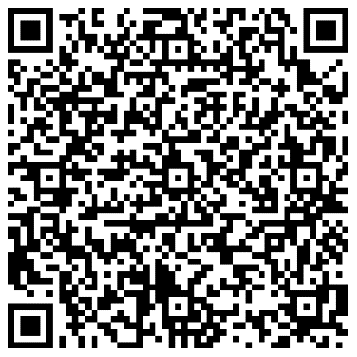
Say This, Not That:
Age-Inclusive Hiring
Notes:
Host a train-the-trainer workshop for your Talent Acquisition team
This 1.5 hour workshop is designed to prepare HR team members to lead 1-hour trainings for all employees involved in the talent acquisition efforts across the organization, including hiring managers and interviewers. It translates research-backed best practices to hands-on activities for all members of a hiring team to play with during the workshop, then apply in their daily work when recruiting and hiring new employees.
Participants: All HR team members working in talent acquisition
Facilitator: Leader of talent acquisition team
Cost: Free
Time Commitment: 3 hours planning, 1.5 hours hosting
If you need to secure buy-in and/or approval from your leadership team in order to host this workshop, copy this email draft into a fresh email, edit it as needed, and send it out!
Dear
As you know, we are working towards building a more inclusive workplace, including along dimensions of age. We are also working hard to integrate best practices into our talent acquisition efforts to source, recruit, and hire a multi-generational workforce. With Baby Boomers hitting peak retirement and a small Generation Alpha coming behind Gen Z, this is as much a strategic imperative as it is a DEI issue.
I’d like to prepare our Talent Acquisition team members to be able to lead 1-hour training workshops for all employees involved in the talent acquisition efforts across the organization, including hiring managers and interviewers. The workshop uses AARP resources that translate research-backed age inclusion practices into hands-on activities for all members of a hiring team to play with during the workshop. They can then apply those best practices in their daily work when recruiting and hiring new employees.
AARP has a robust set of resources we can use to host the workshops-- both to train the HR team members as facilitators, and for those HR team members to deliver the workshop to employees.
This is an amazing opportunity to use AARP’s research-backed resources to help us adopt best practices-- without any cost to our organization. Please let me know your thoughts, or if you’d like to review the materials we will use to host this session.
Best,

Slide 2
Train-the-trainer approach
This presentation is built for a “train-the-trainer” approach.
One person can lead the training for a group of others who are then themselves ready to lead sessions with broader groups of employees who are involved in recruiting and hiring.
Note that the same presentation is used for both 1) the “train the trainer” session and 2) for sessions those trainers will lead. Hence, please hide these slides with “Train-the-trainer” and “facilitator” notes before leading a session with employees.
Courtesy Getty Images
Source: xxx
Notes:
[Facilitator Note: Hide this slide before presenting to a group of employees by right clicking the thumbnail and choosing “Hide Slide” from the list.]

Slide 3
Trainer/ Facilitator Detailed Instructions
Learning Objectives:
Help people involved in any way in the process of sourcing, recruiting, interviewing, assessing and hiring candidates to do so using best practices for age inclusion and building high-performing mixed-age teams.
Provide a series of “hands on” activities to engage participants in learning and starting to apply best practices.
Identify AARP as a “go-to” organization for information and resources on mixed-age teams for both employers and employees.
Facilitator preparation:
Review the full Say This, Not That: Manager’s Guide to Age-Inclusive Hiring at https://higherlogicdownload.s3.amazonaws.com/AARP/c1f2494b-8a7a-4706-b3c0-487f38b16b8e/UploadedImages/age_inclusive_workforce/Follow_Age-Inclusive_Recruitment_Practices/6122_AARP_SayThisNotThat_Toolkit_R4_080923.pdf
Watch the video No Donuts For You! at https://www.aarp.org/videos/government-elections/4747237786001/
Event overview:
Ideal number of participants: 5 minimum - unlimited
Target Audience: All employees who participate in creating tools, resources or who actively engage with candidates in the sourcing, recruiting, interviewing, assessing and hiring of candidates for any hire within the organization.
Potential “hooks” in existing manager training: Can be incorporated into standard employee onboarding for those who will participate in hiring including contractors and staff, regular annual manager training, HR division/ team trainings, professional development plans, and libraries of available learning and development offerings.
Venue/Event Time Considerations: This can be delivered virtually on the technology platform chosen and provided by the employer host or in person. Employer host may consider the maximum size or natural “grouping” of participants and choose to host the workshop multiple times.
Handouts: Facilitators can choose to print the worksheets from the toolkit if they are facilitating in person. All resources are provided in slides at the end of the presentation.
Recording: We do not recommend recording this session, as the knowledge that the session is recorded will likely limit the openness of discussion among the participants. Instead, offer the workshop in a series of options so that all people managers can find a time to participate live in one session.
Complementary Content: See links in facilitator preparation and share those directly with participants after the session.
About this Presentation:
This presentation is designed to be flexibly delivered in a 60-90-minute timeframe depending on the facilitator’s approach to use of the activities, including time to gather, take breaks and wrap up.
Please download your own copy, hide the presenter bio slides you will not be using, update your own speaker bio slide, and modify speaker notes as needed for the purposes of your event.
Notes:
[Facilitator Note: Hide this slide before presenting to a group of employees by right clicking the thumbnail and choosing “Hide Slide” from the list.]

Slide 4
Age-Inclusive Hiring
Hiring managers, interviewers, and others involved in the effort to build high-performing teams recognize that a variety of viewpoints and experiences makes teams perform better. That’s why learning how to recruit and hire employees across the age spectrum is key to your own professional growth- and to your team’s success.
This workshop is designed for all employees involved in talent acquisition efforts across the organization. It translates research-backed best practices into hands-on activities for all members of a hiring team to play with during the workshop. You can then apply these new skills in your daily work when recruiting and hiring new employees.
You’ll leave with AARP’s Say This, Not That: Manager’s Guide to Age-Inclusive Hiring resource, which includes a full hiring kit you can easily customize to use for your next hire.
Courtesy Getty Images
Notes:
Facilitator note: This is the first slide after the title slide that employees should see when you are running the training for a team.
Here is the draft invitation to team members to join the workshop. You can edit and use it. Or if you are presenting, this is the information that set expectations for those joining you today.
Join us for a workshop on Age Inclusive Hiring
Hiring managers, interviewers, and others involved in the effort to build high-performing teams recognize that a variety of viewpoints and experiences makes teams perform better. That’s why learning how to recruit and hire employees across the age spectrum is key to your own professional growth- and to your team’s success.
This 1-hour workshop is designed for all employees involved in talent acquisition efforts across the organization. It translates research-backed best practices into hands-on activities for all members of a hiring team to play with during the workshop. You can then apply these new skills in your daily work when recruiting and hiring new employees. You’ll leave with AARP’s Say This, Not That: Manager’s Guide to Age-Inclusive Hiring resource, which includes a full hiring kit you can easily customize to use for your next hire.
We hope one of these dates works for you!
Date: [choose a day when participation will be higher, usually Tu-Th]
Time: [choose a time that works for all time zones]
How to join: [indicate if virtual/ in person/ hybrid]
Register here: [add registration link or meeting invitation for this session]
Date: [If you are offering the workshop multiple times, vary the day]
Time: [If you are offering the workshop multiple times, vary the time of day]
How to join: [indicate if virtual and/or at office location]
Register here: [add registration link or meeting invitation for this session]
Date: [If you are offering the workshop multiple times, vary the day]
Time: [If you are offering the workshop multiple times, vary the time of day]
How to join: [indicate if virtual and/or at office location]
Register here: [add registration link or meeting invitation for this session]

Slide 5
Using AARP resources
AARP’s mission is to empower people to choose how they live as they age.
This is why AARP supports people like you who are creating workplaces that work for all. Employers and managers are key elements in everyone’s ability to thrive both at work and at home as they age, so AARP has created resources to help you build and lead mixed-age teams.
Disclaimer: This presentation is intended to provide general guidance.​ Individual circumstances may differ and should be taken into consideration before acting. ​ Consult your HR team for advice regarding specific situations on your team.
Courtesy Getty Images

Slide 6
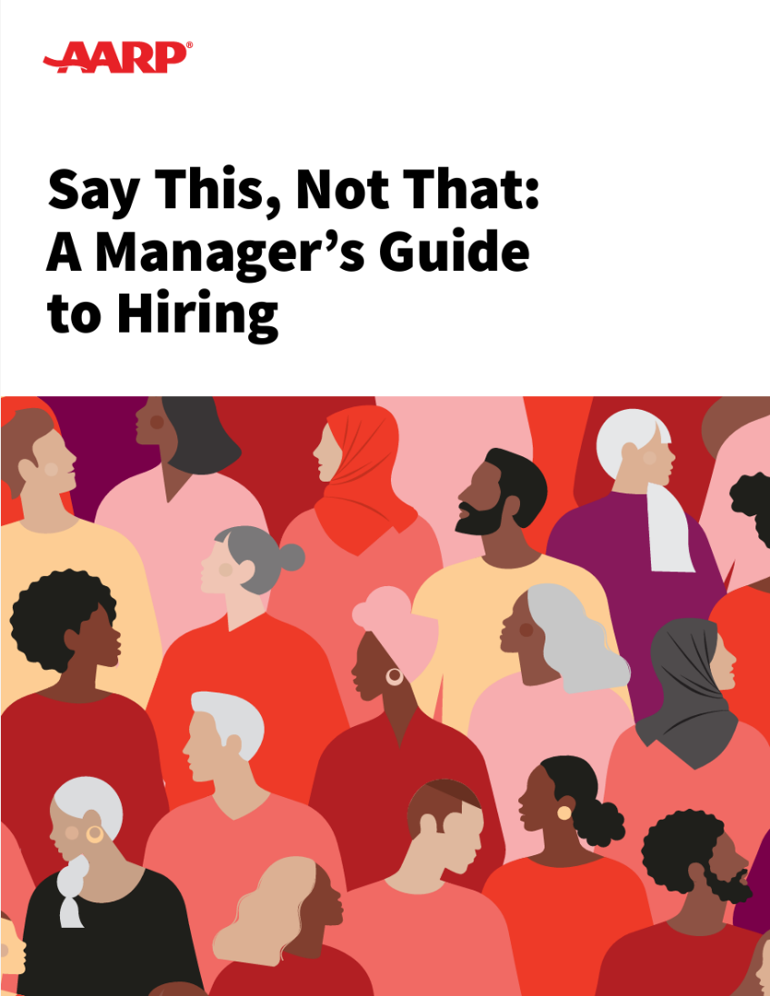
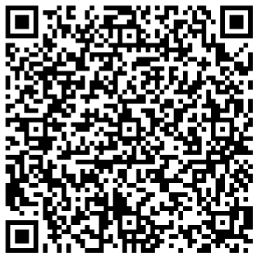
Today’s key resource
Say This, Not That: A Manager’s Guide to Hiring
This guide has what you need to create a more age-inclusive hiring practice — from the data you need to garner support and win resources to the tactical training exercises you can use. We have even synthesized the best practices into a templated hiring kit for you to customize and use throughout your organization.
https://employerportal.aarp.org/age-inclusive-workforce/follow-age-inclusive-recruitment-practices/guide-say-this-not-that
Family Caregiving
AARP Family Caregiver

Slide 7
[My name]
[My role]
[2-3 sentence facilitator introduction/ bio.]
You can reach me at [insert your email or other contact info here.]
Notes:
Facilitator note: Swap in a photo of yourself instead of the illustration and update the speaker bio. If you are willing, be sure to share your contact information so participants can reach out to you afterwards with additional questions or for support on how to put these best practices into action in their teams.

Slide 8
Introductions
Use any or all of these prompts
My name is __________________________________________
I manage a team of ___ people directly and ___ people who roll up to me
One word to describe how it feels to keep age in mind during recruiting and hiring is __________________________
Today I want to talk about ____________________________
Courtesy Getty Images
Notes:
Facilitator Note:
Edit these prompts to fit your team. We recommend including a prompt that allows each individual to share some aspect of how they are feeling/ what they are hoping for about this working session. This provides the facilitator with a good “read” of the group, and it makes it more likely that the participants will engage more deeply in the content and exercises throughout the training.

Slide 9
Agenda
|
|
|
|
|
What is age inclusion and how can it play out in recruiting and hiring?
Why should we recruit and hire with age inclusion in mind?
How can I hire with age inclusion in mind?
How can I use this in my own hiring?
Q&A and resources to use and share
Courtesy Getty Images

Slide 10
What is age inclusion?
An initial thought
We have people of a range of ages in our organization, so that means we are age-inclusive.
…Right?
Courtesy Getty Images

Slide 11
Reflect
We already work to create teams that are inclusive of other employee experiences and identities.
Brainstorm a list of the best practices we already use to create a team where employees feel a sense of belonging. These also support our recruiting and hiring efforts.
Notes:
Facilitator note: If hosting virtually, prompt this to be input to Chat. If in person, consider a “popcorn” call out where you are jotting their responses on a white board as they try to brainstorm as many as possible in 60 seconds.

Slide 12
What is age-inclusion?
Going deeper
Many of these best practices can also be used to limit age bias and build age-inclusive teams, so that our mixed-age teams are high performing teams. But many organizations don’t explicitly talk about age as an element of inclusion. We do!
According to AARP, age-inclusion is:
Welcoming workers of all ages and valuing their experience
Knowing that everyone has something to teach and something to learn.
Working hard to manage differences and celebrate similarities across multiple generations.
Courtesy Getty Images
Notes:
Age inclusion is NOT: putting people in buckets or making assumptions about them based on age.

Slide 13
Poll
How often have you noticed an assumption that younger workers want to be promoted too quickly?
Never
Sometimes
Often
Courtesy Getty Images
Source: xxx
Notes:
Facilitator Note: If virtual, prompt participants to respond to polls in the Chat. If in person, prompt them to say their guess to the person next to them, or to all call out their answer at the same time when you prompt them to. The aqua slides are always indicative of an interactive moment in the workshop, so build into that energy.

Slide 14
Poll
How often have you noticed an assumption that younger workers lack the work ethic of older workers?
Never
Sometimes
Often
Courtesy Getty Images
Source: xxx

Slide 15
Poll
How often have you noticed an assumption that younger workers use their sick time too freely?
Never
Sometimes
Often
Courtesy Getty Images
Source: xxx

Slide 16
Poll
How often have you noticed an assumption that older workers (age 40+) are not suited to working on products or marketing that target younger people?
Never
Sometimes
Often
Courtesy Getty Images
Source: xxx

Slide 17
Poll
How often have you noticed an assumption that older workers are not tech-savvy?
Never
Sometimes
Often
Courtesy Getty Images
Source: xxx

Slide 18
Poll
How often have you noticed an assumption that older workers are distracted by family caregiving?
Never
Sometimes
Often
Courtesy Getty Images
Source: xxx

Slide 19
Age-inclusive recruiting builds mixed-age teams
And why are mixed-age teams crucial?
Both younger and older workers are more productive when they work in companies that have mixed-age teams compared to companies without mixed-age teams.¹⁹ ²⁰
In fact, workers under age 35 experience productivity gains when they work with older workers. Workers over age 50 have similar productivity levels as those age 35–49 and are more productive when there are more younger workers among their colleagues.²¹
When the task “entails dealing with strategic and complex decision-making with vaguely defined problems in a dynamic setting…increased age diversity can lead to enhanced group discussions, better analysis and superior problem-solving.”²⁴
Courtesy Getty Images
Source: 19 AARP, The Business Case for Workers 50+, 2015.
20 https://www.oecd-ilibrary.org/docserver/59752153-en.pdf?expires=1636142224&id=id&accname=guest&checksum=590E9514C66F2CFBA873D4D5FD3CAD81 p.54
21 https://www.oecd-ilibrary.org/docserver/59752153-en.pdf?expires=1636142224&id=id&accname=guest&checksum=590E9514C66F2CFBA873D4D5FD3CAD81 p65
24 https://ideas.repec.org/p/iso/educat/0093.html or http://repec.business.uzh.ch/RePEc/iso/leadinghouse/0093_lhwpaper.pdf
Notes:
For additional background and statistics, see the Manager’s Guide to Mixed-Age Teams, Section 1: How Do Mixed-Age Teams Drive Organizational Performance
at https://higherlogicdownload.s3.amazonaws.com/AARP/c1f2494b-8a7a-4706-b3c0-487f38b16b8e/UploadedImages/age_inclusive_workforce/Practice_Age-Inclusive_Management/AARP_Mixed_Age_Guide_2022.pdf

Slide 20
Age-inclusive recruiting draws key candidates
Who is watching for age-inclusion?
Gallup has found that “it’s disengaged workers who are at the highest risk of leaving. It takes more than a 20%¹⁷ pay raise to lure most employees away from a manager who engages them, and next to nothing to poach most disengaged workers. High-quality managers who inspire and support their teams are an effective moat of protection for retaining their most talented workers.”
The implication? High-performing employees of any age who are concerned about age-bias in their current organization are highly recruitable — but look for signals that our organization and our hiring managers are age-inclusive.
Courtesy Getty Images
Source: 17 https://www.gallup.com/workplace/358346/gallup-workplace-insights-learned-2021.aspx

Slide 21
Reflect
Where do you think our organization is in our journey towards age-inclusive recruiting and hiring?
1 (newly exploring) ←→ 10 (consistent organization-wide action)
Notes:
Facilitator note: If hosting virtually, prompt this to be input to Chat. If in person, consider a “popcorn” call out where you are jotting their responses on a white board as they try to brainstorm as many as possible in 60 seconds.

Slide 22
Reflect
Where do you think your core team is in our journey towards age-inclusive recruiting and hiring?
1 (newly exploring) ←→ 10 (I drive and support consistent action)
Notes:
Facilitator note: If hosting virtually, prompt this to be input to Chat. If in person, consider a “popcorn” call out where you are jotting their responses on a white board as they try to brainstorm as many as possible in 60 seconds.

Slide 23
Agenda
|
|
|
|
|
What is age inclusion and how can it play out in recruiting and hiring?
Why should we recruit and hire with age inclusion in mind?
How can I hire with age inclusion in mind?
How can I use this in my own hiring?
Q&A and resources to use and share
Courtesy Getty Images
Source: xxx

Slide 24
Poll
What percent of job seekers say a diverse workforce is important when considering job offers?
38%
53%
70%
Source: https://www.lucasgroup.com/your-career-intel/value-diversity-inclusion-workspace/
Notes:
Nearly 70% of job seekers say a diverse workforce is important when considering job offers. Since age bias disproportionately affects both younger and older workers, both of these groups of recruits are likely to be watching and listening for indicators that age diversity is valued in our organization.
(https://higherlogicdownload.s3.amazonaws.com/AARP/c1f2494b-8a7a-4706-b3c0-487f38b16b8e/UploadedImages/age_inclusive_workforce/Practice_Age-Inclusive_Management/AARP_Mixed_Age_Guide_2022.pdf P. 10)

Slide 25
Hiring managers want their teams to create more value
“[Age] diverse teams have far more pathways to execute on an idea, which enables them to iterate faster and more cost-effectively… They can also navigate the enterprise on a tight budget and tap into networks they may not have otherwise explored on their own. This type of expansive, serendipitous collaboration is what drives fast action.”⁵
Harvard research suggests that without age-inclusive hiring practices, it is unlikely a manager will be able to build a team that can harness the full breadth of experience for their team’s ability to innovate, solve problems and think creatively.⁷
Courtesy Getty Images
Source: https://higherlogicdownload.s3.amazonaws.com/AARP/c1f2494b-8a7a-4706-b3c0-487f38b16b8e/UploadedImages/age_inclusive_workforce/Follow_Age-Inclusive_Recruitment_Practices/6122_AARP_SayThisNotThat_Toolkit_R4_080923.pdf
Notes:
Content source notes:
All from Say This, Not That
3 https://www.aarpinternational.org/file%20library/llel/OECD_Promoting-An-Age-Inclusive-Workforce.pdf
4 https://www.sciencedirect.com/science/article/abs/pii/S0927537112001236
5 https://www.greatplacetowork.com/resources/blog/why-diverse-and-inclusive-teams-are-the-new-engines-of-innovation
6 https://www.aarpinternational.org/file%20library/llel/OECD_Promoting-An-Age-Inclusive-Workforce.pdf
7 https://www.hbs.edu/recruiting/insights-and-advice/blog/post/actively-addressing-unconscious-bias-in-recruiting

Slide 26
Hiring managers want to stay on the right side of the law
While the “carrot” of the benefits of diversity and inclusion are motivating, so too is avoiding the “stick” of an age discrimination lawsuit against you by a candidate for hiring or promotion on your team.
The Equal Employment Opportunity Commission defines it as “treating an applicant or employee less favorably because of their age.” The Age Discrimination in Employment Act forbids age discrimination against people who are age 40 and older.⁸
The U.S. Supreme Court has even ruled that “stray remarks” among the hiring team or to a candidate, or focusing recruiting on one specific group (e.g., recent college graduates) may be considered evidence of age discrimination.⁹
Courtesy Getty Images
Source: https://higherlogicdownload.s3.amazonaws.com/AARP/c1f2494b-8a7a-4706-b3c0-487f38b16b8e/UploadedImages/age_inclusive_workforce/Follow_Age-Inclusive_Recruitment_Practices/6122_AARP_SayThisNotThat_Toolkit_R4_080923.pdf
Notes:
Content source notes:
All from Say This, Not That
8 https://ideal.com/age-discrimination/
9 https://www.shrm.org/hr-today/news/hr-magazine/0218/pages/hiring-in-the-age-of-ageism.aspx
https://www.shrm.org/hr-today/news/hr-magazine/0218/pages/hiring-in-the-age-of-ageism.aspx

Slide 27
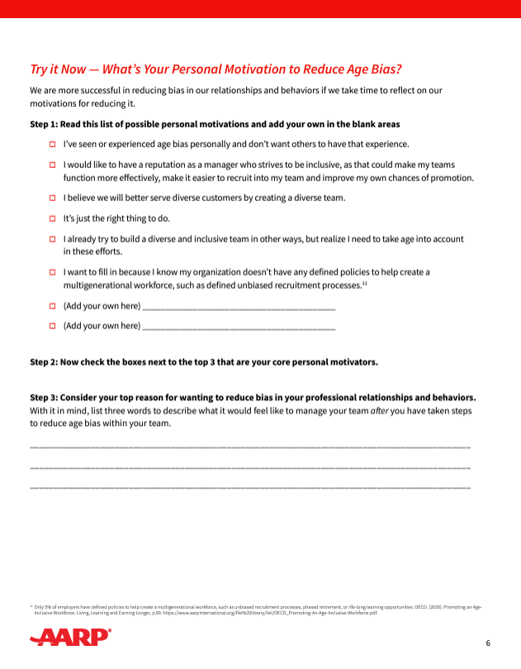
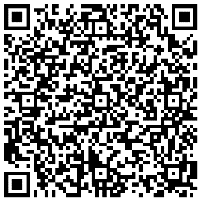
Try it now
What’s Your Personal Motivation?
We are more successful in reducing bias in our relationships and behaviors if we take a moment to reflect on our motivations for reducing it.
Use this worksheet to identify your own core personal motivators and envision what it will feel like to manage your team after you have taken steps to leverage a mixed-age team.
Courtesy Getty Images
Source: https://employerportal.aarp.org/age-inclusive-workforce/follow-age-inclusive-recruitment-practices/guide-say-this-not-that

Slide 28
Try it now
What’s Your Personal Motivation?
Notes:
Facilitator note: You can hide this slide if you are using printed handouts from the guide. If you are hosting virtually, you may choose to include this slide so everyone can see the worksheet clearly together. Beforehand, decide if you want participants to do this individually, in pairs, or as a full group together. It’s a great option for a pair-and-share approach if it works for your set up.
Source: https://employerportal.aarp.org/age-inclusive-workforce/follow-age-inclusive-recruitment-practices/guide-say-this-not-that

Slide 29
Reflect
How can we tap into our personal motivation to move ourselves to adopt best practices in our daily work?
Share your thoughts in Chat or in our conversation
Notes:
Facilitator note: If hosting virtually, prompt this to be input to Chat. If in person, consider a “popcorn” call out where you are jotting their responses on a white board as they try to brainstorm as many as possible in 60 seconds.

Slide 30
Agenda
|
|
|
|
|
What is age-inclusion and how can it play out in recruiting and hiring?
Why should we recruit and hire with age inclusion in mind?
How can I hire with age inclusion in mind?
How can I use this in my own hiring?
Q&A and resources to use and share
Courtesy Getty Images
Source: xxx

Slide 31
Poll
Which of these areas feels most urgent for your own team working on recruiting and hiring efforts?
Learning to recognize age bias
Learning to prevent age bias
Learning to interrupt age bias
Courtesy Getty Images

Slide 32
How can I recognize age bias in recruiting and hiring?
Assume age bias may be present in many of our hiring processes and in the people participating in them, likely unconsciously rather than as blatant bias. Approach with curiosity and a willingness to adjust rather than with defensiveness or blame.
Watch for flags in what IS said and what IS done.
Watch for flags in what is NOT said, and what is NOT done.
Consider both people and processes at each step of the talent acquisition process.
Courtesy Getty Images
Source: https://higherlogicdownload.s3.amazonaws.com/AARP/c1f2494b-8a7a-4706-b3c0-487f38b16b8e/UploadedImages/age_inclusive_workforce/Follow_Age-Inclusive_Recruitment_Practices/6122_AARP_SayThisNotThat_Toolkit_R4_080923.pdf

Slide 33
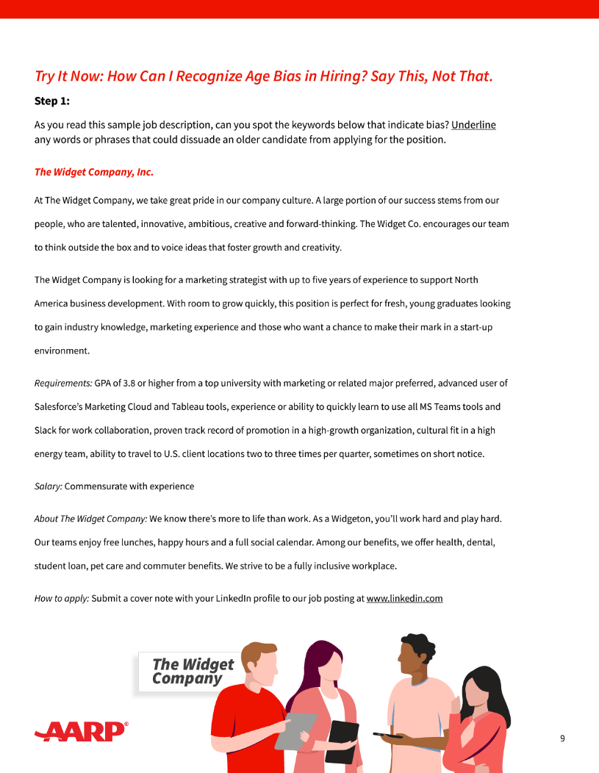
Try it now
How can I recognize age bias in hiring?
The language we use in our posted job descriptions sends powerful messages– even some we may not intend.
As you read this sample job description, can you spot the keywords that are likely to dissuade older candidates from applying?
Put them in the Chat or share in conversation.
Courtesy Getty Images
Source: https://employerportal.aarp.org/age-inclusive-workforce/follow-age-inclusive-recruitment-practices/guide-say-this-not-that
Notes:
Facilitator notes: You can prompt people to use the QR code to open a digital version, and/or advance the slide so the full worksheet is more legible on the next two slides.
You might introduce it with “This Try it Now exercise in the Say This, Not That Guide is great. Let’s do just a little bit of it together. As you read this sample job description, can you spot the keywords that indicate bias? Drop them into the Chat as you read through this job posting.”

Slide 34
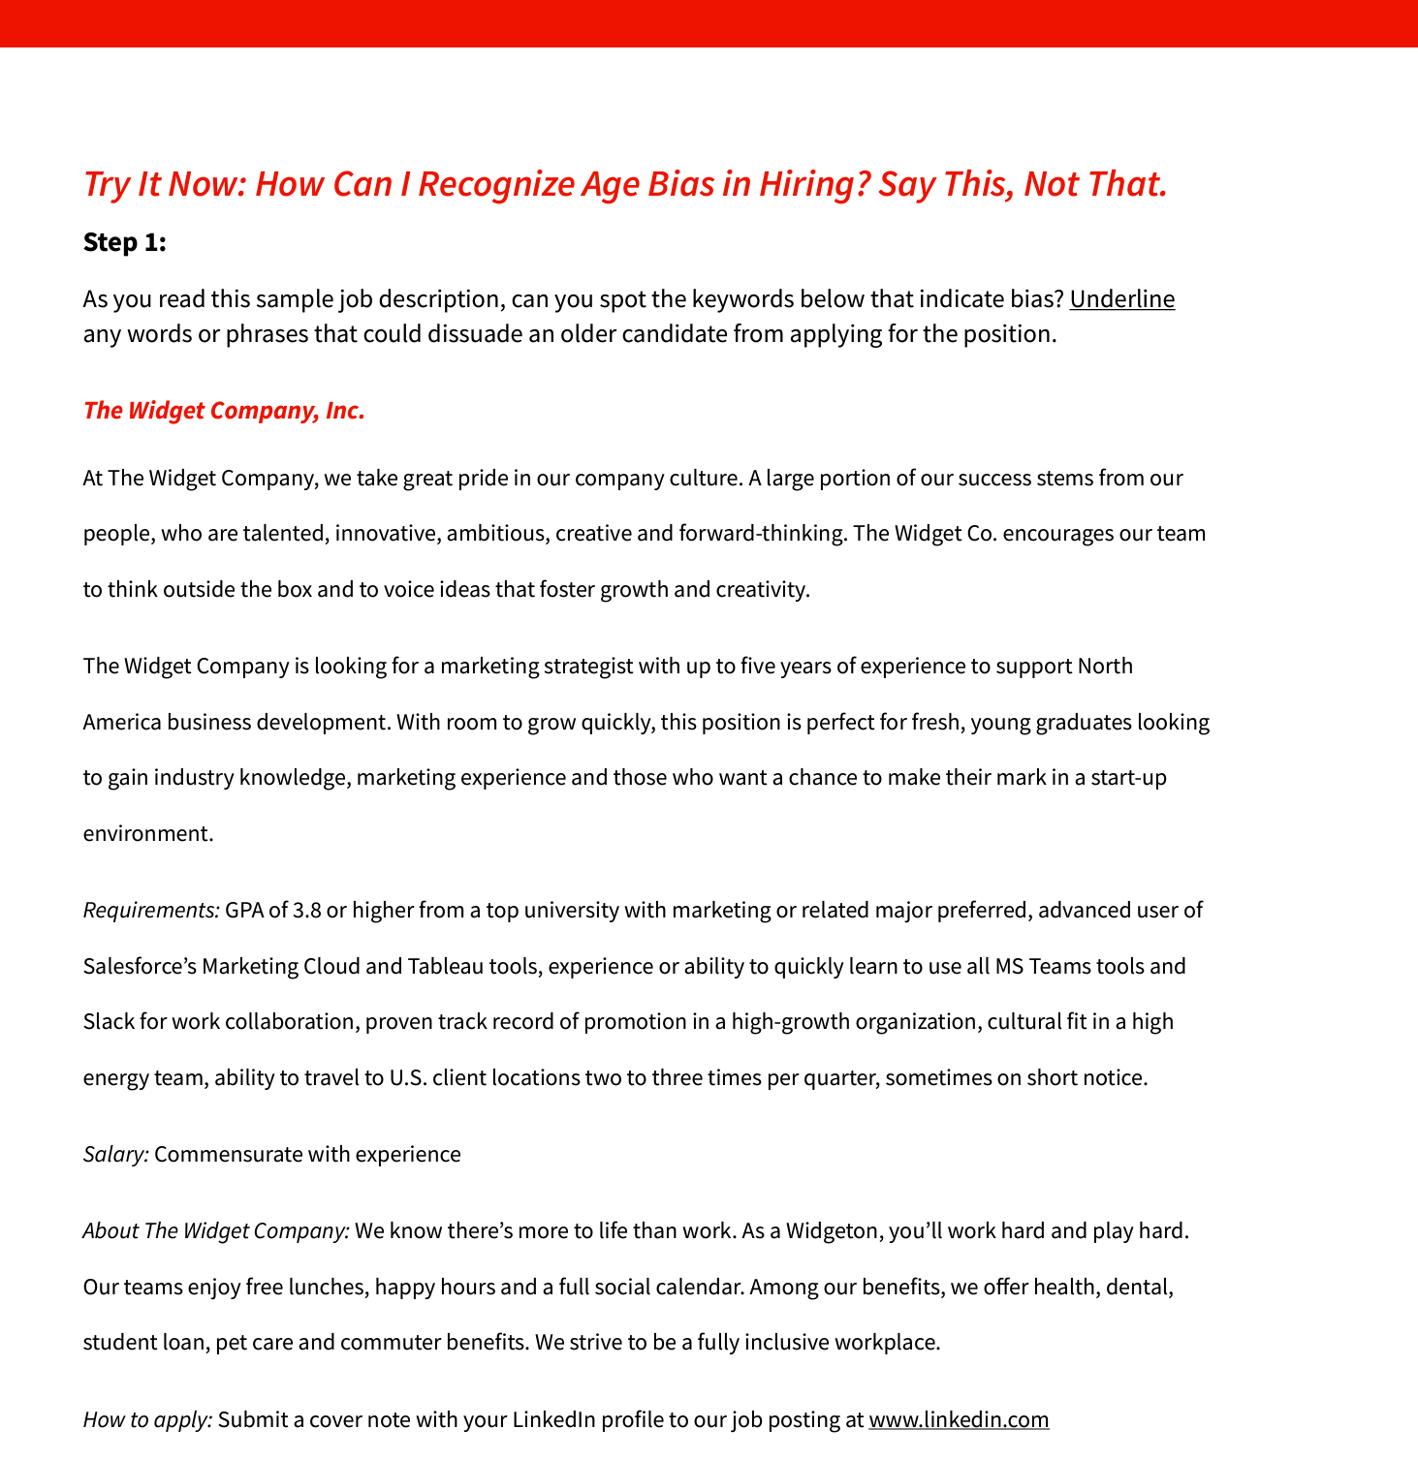
Try it now
How can I recognize age bias in hiring?
Notes:
Facilitator note: Beforehand, decide if you want participants to do this individually, in pairs, or as a full group together. It’s a great option for a pair-and-share approach if it works for your set up.
Source: https://employerportal.aarp.org/age-inclusive-workforce/follow-age-inclusive-recruitment-practices/guide-say-this-not-that

Slide 35
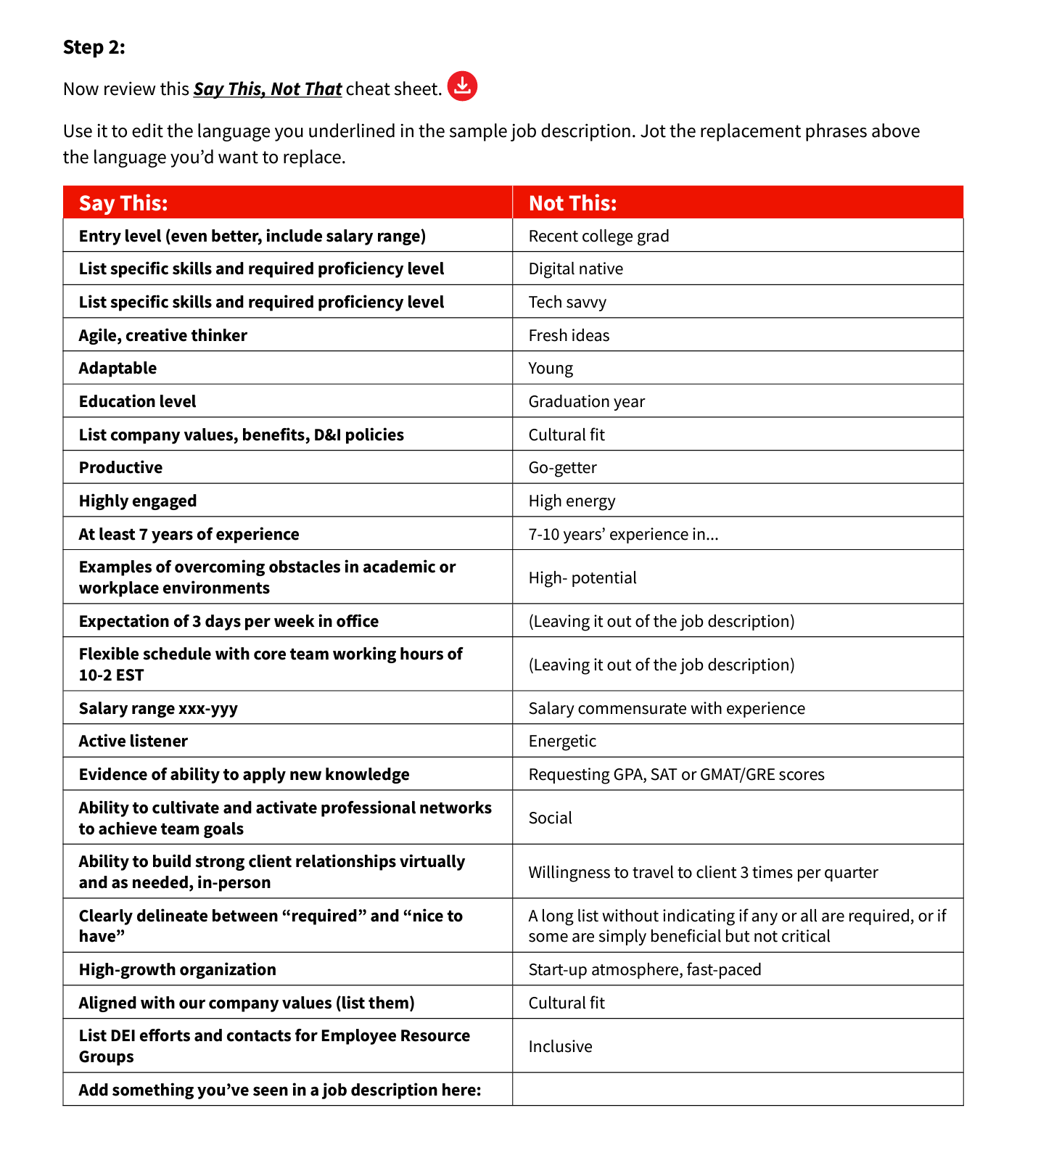
Try it now
How can I recognize age bias in hiring?
Notes:
Facilitator note: can hide this slide if you are using printed handouts from the guide. If you are hosting virtually, you may choose to include this slide so everyone can see the worksheet clearly together. Beforehand, decide if you want participants to do this individually, in pairs, or as a full group together. It’s a great option for a pair-and-share approach if it works for your set up.
Source: https://employerportal.aarp.org/age-inclusive-workforce/follow-age-inclusive-recruitment-practices/guide-say-this-not-that

Slide 36
Reflect
What is a current or upcoming job description you can review and edit?
Share your thoughts in Chat or in our conversation
Notes:
Facilitator note: If hosting virtually, prompt this to be input to Chat. If in person, consider a “popcorn” call out where you are jotting their responses on a white board as they try to brainstorm as many as possible in 60 seconds.

Slide 37
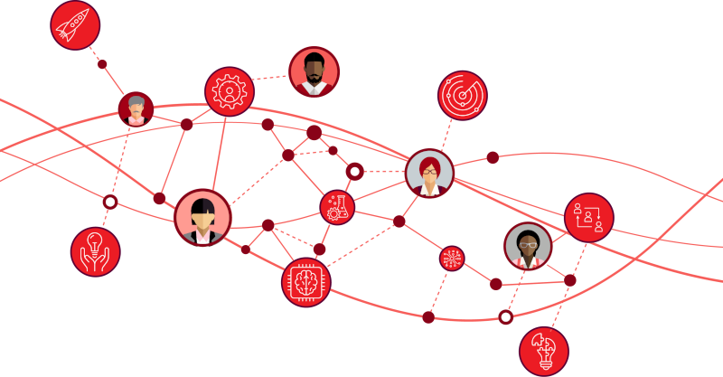
How can I prevent age bias in recruiting and hiring?
Stanford research shows that “there are two, small — but powerful — ways managers can block bias:
First, by closely examining and broadening their definitions of success, and second, by asking what each person adds to their teams, what we call their “additive contribution.”¹⁶
We can build these and other age-bias prevention strategies into both key elements of hiring: the people influencing the hiring and the processes they use during hiring.
Courtesy Getty Images
Source: https://higherlogicdownload.s3.amazonaws.com/AARP/c1f2494b-8a7a-4706-b3c0-487f38b16b8e/UploadedImages/age_inclusive_workforce/Follow_Age-Inclusive_Recruitment_Practices/6122_AARP_SayThisNotThat_Toolkit_R4_080923.pdf
Notes:
Facilitator notes
Once we can see age bias, and understand it may be happening unconsciously, we want to take steps to prevent it in our team’s recruiting and hiring efforts.
[Bullets on page]
People:
As a hiring manager, you are a key influencer of every person involved in the processes and conversations you’ll use to recruit, hire and onboard your new team member. Use that leverage to encourage the team to learn to see, prevent and interrupt age bias. These people, whom you can engage to “examine and broaden their definitions of success” and to focus on the “additive contribution” of each potential job candidate, could include: recruiters who filter candidates, your own direct reports, people outside your own team who will participate in interviews or assessments of candidates.
Processes:
As a hiring manager, you likely inherit a set of hiring processes that your organization uses. As you use these processes, remain curious about where they may inadvertently exacerbate bias issues and use your agency to adjust and evolve them as needed.
To help prevent age bias, consider using research-backed best practices at each step of the hiring process.
Content notes:
All from STNT p 11
16 https://hbr.org/2018/10/two-powerful-ways-managers-can-curb-implicit-biases

Slide 38
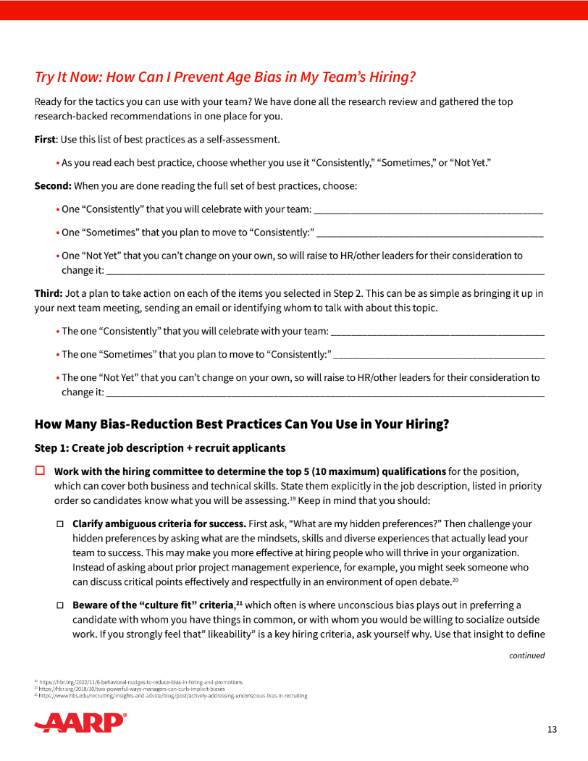
Try it now
How can I prevent age bias in hiring?
Ready for the tactics you can use with your team to prevent age bias?
We have reviewed all the research and gathered the top research-backed recommendations in one place for you.
Use the checklist as an easy self-assessment tool.
Then it easily morphs into an action plan to make targeted improvements in preventing age bias in your team’s hiring.
Courtesy Getty Images
Source: https://employerportal.aarp.org/age-inclusive-workforce/follow-age-inclusive-recruitment-practices/guide-say-this-not-that
Notes:
Facilitator notes: This Try it Now exercise in the Say This, Not That Guide is great but best for your participants to each do individually rather than once all together. As you prepare to facilitate, read this exercise fully in the guide and decide how you will provide the worksheets to them for this exercise. If you are hosting in person we recommend printing, if virtually we recommend asking them to print on their own and have these worksheets handy. It is a long document that really requires people to be able to read, write on it, and keep it for reference.

Slide 39
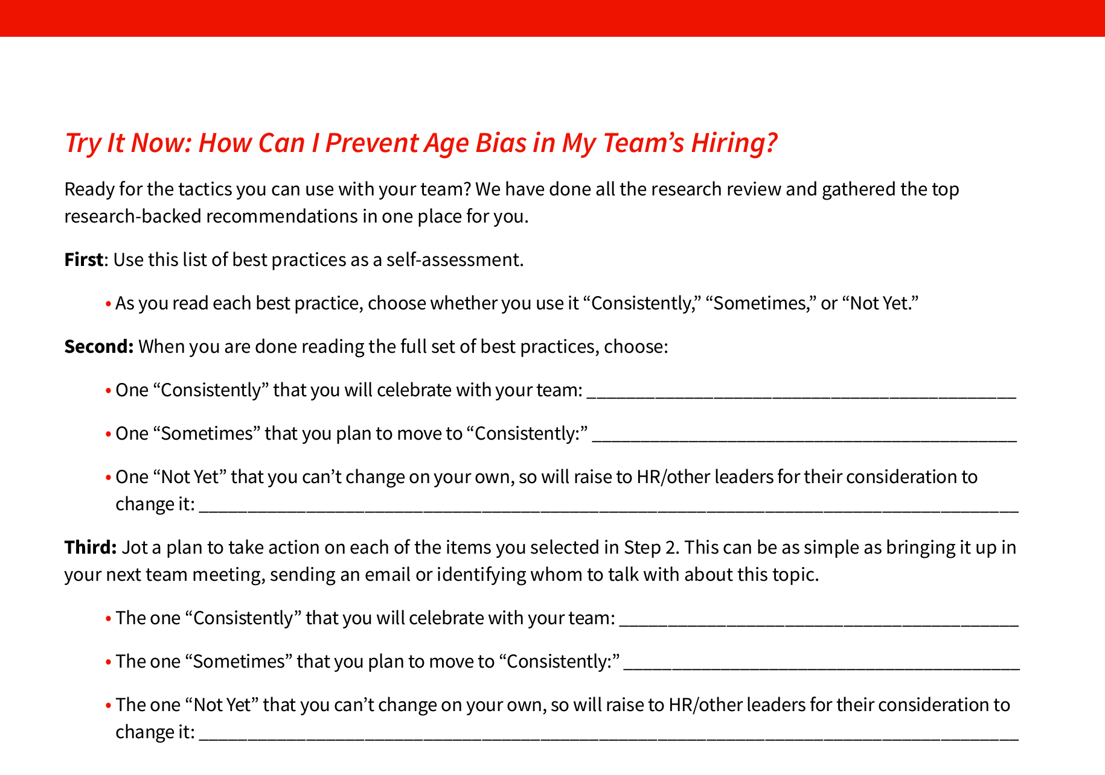
Try it now
How can I prevent age bias in hiring?

Slide 40
Reflect
What is one best practice you use “consistently” and how can you celebrate it with your team?
Share your thoughts in Chat or in our conversation
Notes:
Facilitator note: If hosting virtually, prompt this to be input to Chat. If in person, consider a “popcorn” call out where you are jotting their responses on a white board as they try to brainstorm as many as possible in 60 seconds.

Slide 41
Reflect
What is one best practice you use “sometimes” and how can you move it to “consistently?”
Share your thoughts in Chat or in our conversation
Notes:
Facilitator note: If hosting virtually, prompt this to be input to Chat. If in person, consider a “popcorn” call out where you are jotting their responses on a white board as they try to brainstorm as many as possible in 60 seconds.

Slide 42
How can I help my team interrupt age bias in recruiting and hiring?
As a hiring manager, you are a key influencer of every person involved in the processes and conversations you’ll use to recruit, hire and onboard your new team member. Use that leverage to encourage people to learn to see, prevent and interrupt age bias.
Similarly, you are all using processes and tools you have inherited from the organization or relied on yourself in the past. Encourage your team to interrupt age bias by speaking up when they see it accidentally embedded in the hiring processes and tools they are actively using.
The Say This, Not That: Age Inclusive Hiring Guide offers specific actions you can take with both people and processes to interrupt age bias.
Courtesy Getty Images
Source: https://higherlogicdownload.s3.amazonaws.com/AARP/c1f2494b-8a7a-4706-b3c0-487f38b16b8e/UploadedImages/age_inclusive_workforce/Follow_Age-Inclusive_Recruitment_Practices/6122_AARP_SayThisNotThat_Toolkit_R4_080923.pdf
Notes:
Facilitator Notes
Hiring managers who use the best practices described earlier will have less need to interrupt age bias during the hiring process. Still, moments will pop up and each member of the hiring team needs to be willing and able to interrupt age bias as it happens so the team can self-correct.
We can use strategies to interrupt age bias during an active hiring scenario by addressing both key influences of hiring: people and processes. This is a particularly important area for you to train your full team, as each person will see and be willing to interrupt different situations of potential age bias. The good news is that the same strategies that reduce other types of bias, and may already be embedded in your efforts, are also effective for reducing age bias.

Slide 43
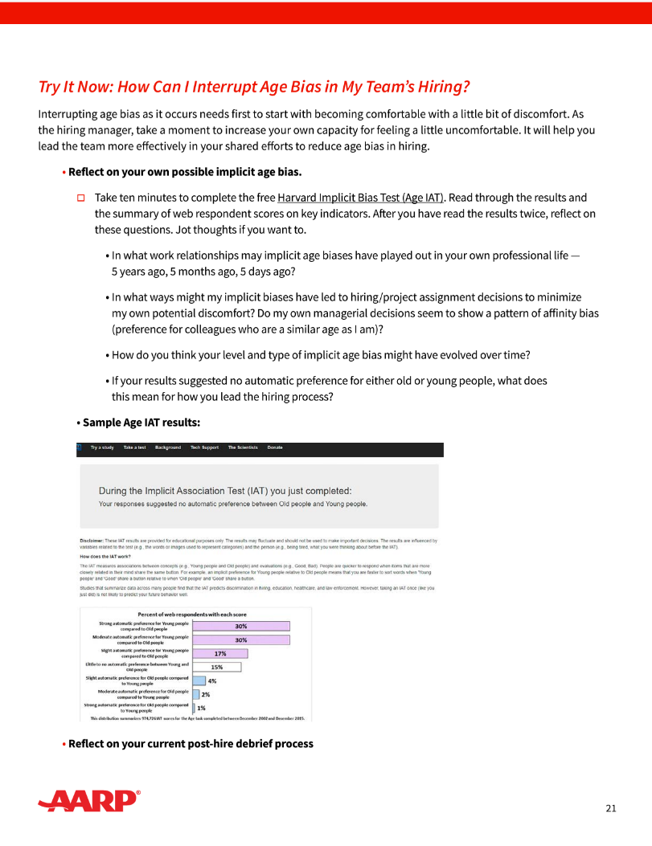
Try it now
How can I help interrupt age bias in hiring?
Reflect on your own possible implicit biases by taking the free Harvard Implicit Bias Test (Age IAT).
Then reflect on questions such as “Do my own managerial decisions seem to show a pattern of affinity bias (preference for colleagues who are a similar age as I am)?”
Finally, reflect on your current process for debriefing after you’ve made a hiring decision.
Courtesy Getty Images
Source: https://employerportal.aarp.org/age-inclusive-workforce/follow-age-inclusive-recruitment-practices/guide-say-this-not-that
Notes:
Facilitator notes: Participants can use the QR code on this slide to access the full worksheet and/or follow along on the screen shots of the worksheet on the next two slides.
You can say “Interrupting age bias as it occurs needs first to start with becoming comfortable with a little bit of discomfort. As the hiring manager, take a moment to increase your own capacity for feeling a little uncomfortable. It will help you lead the team more effectively in your shared efforts to reduce age bias in hiring.”

Slide 44
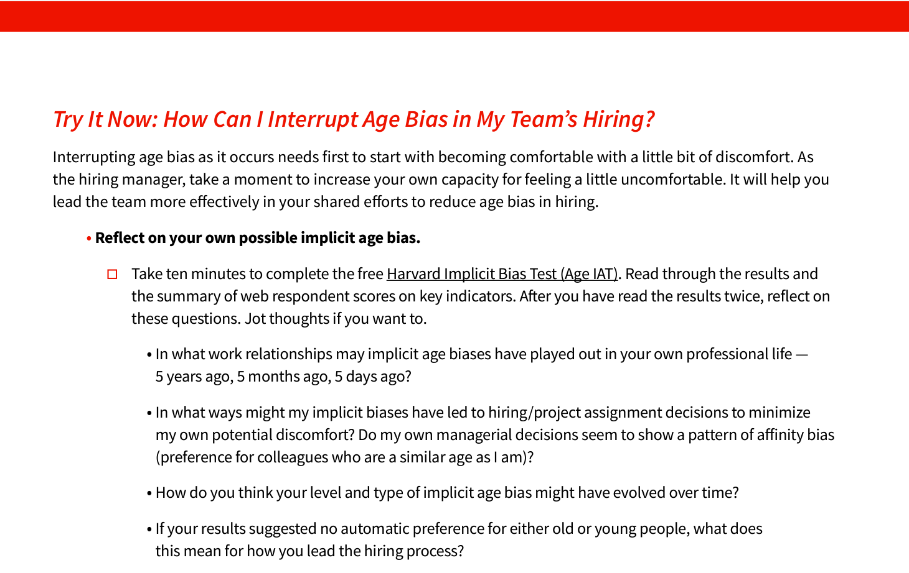
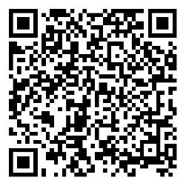
Try it now
How can I help interrupt age bias in hiring?
https://implicit.harvard.edu/implicit/selectatouchtestv2.html
Courtesy Getty Images
Source: https://employerportal.aarp.org/age-inclusive-workforce/follow-age-inclusive-recruitment-practices/guide-say-this-not-that
Notes:
Facilitator Note: The link and QR code on this slide can be used by participants to access the Harvard Implicit Bias Test Age IAT. The Age Bias results are part of the Social Attitudes section, which requires users to create their own log in. Assure participants that this information is not shared with your employer organization. It does take 10 minutes.
AARP recommends using this assessment yourself before you facilitate the workshop, so you can speak to it from personal experience with it.

Slide 45
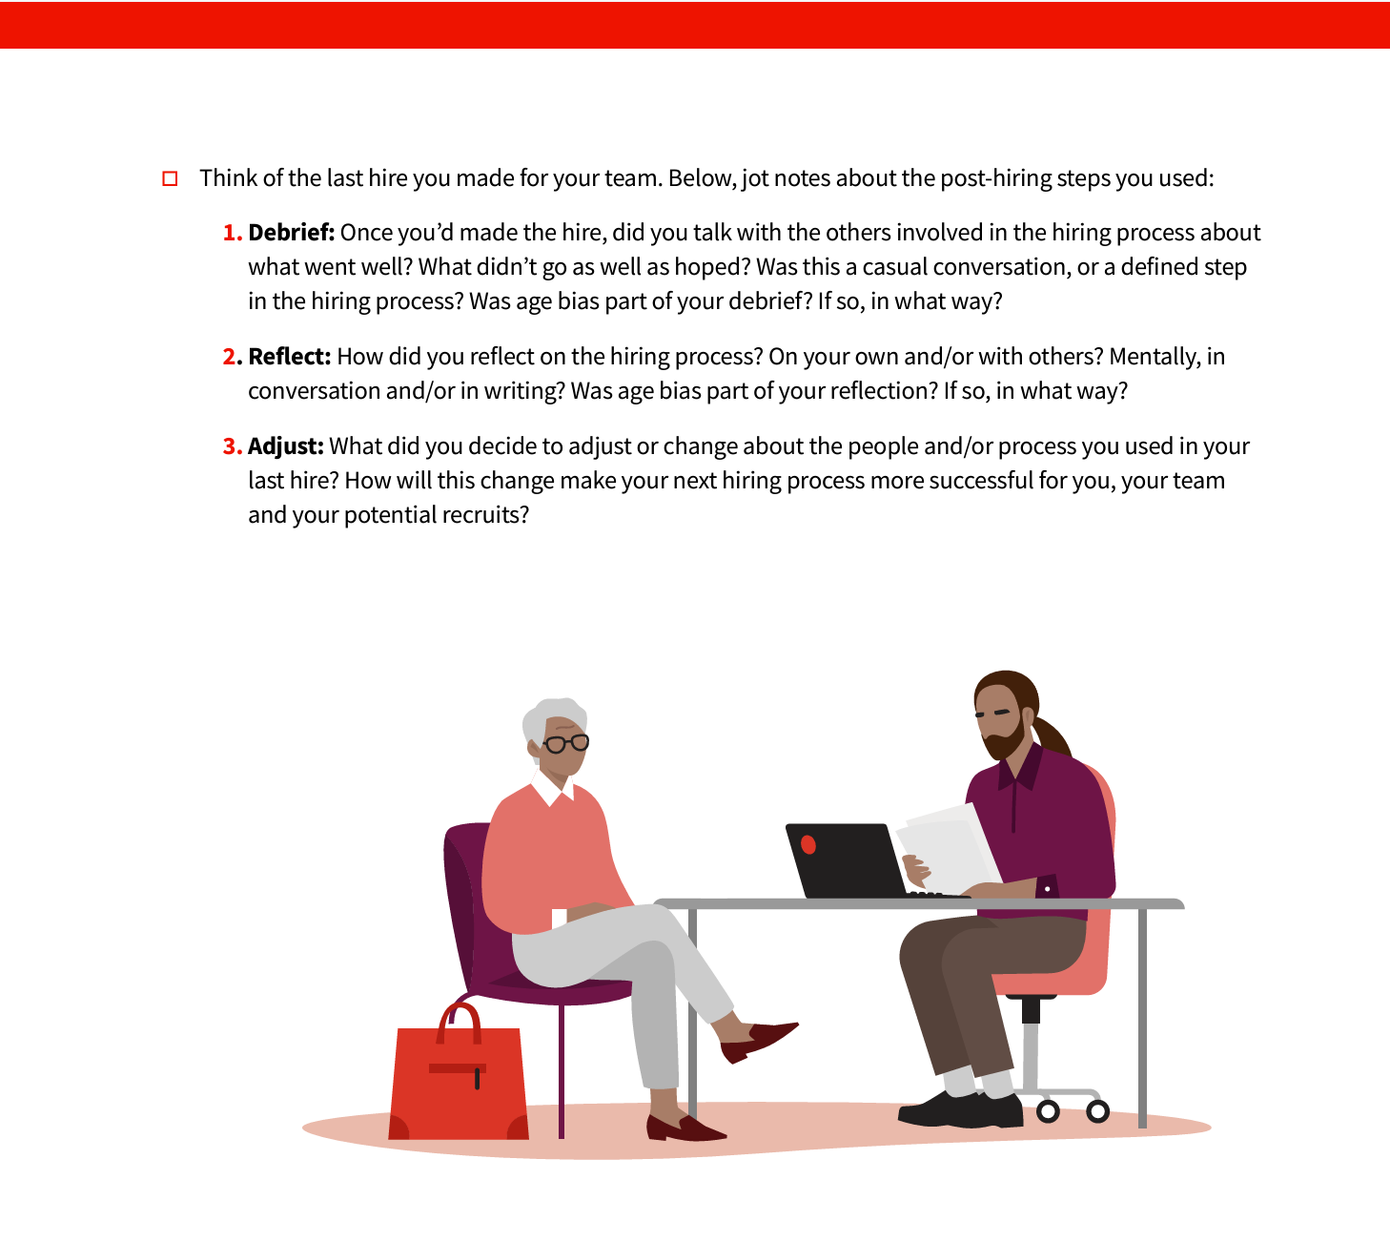
Try it now
How can I help interrupt age bias in hiring?
Courtesy Getty Images
Source: https://employerportal.aarp.org/age-inclusive-workforce/follow-age-inclusive-recruitment-practices/guide-say-this-not-that

Slide 46
Reflect
What is one aspect of your last hire that you could do differently in your next hiring effort?
Share your thoughts in Chat or in our conversation
Notes:
Facilitator note: If hosting virtually, prompt this to be input to Chat. If in person, consider a “popcorn” call out where you are jotting their responses on a white board as they try to brainstorm as many as possible in 60 seconds.

Slide 47
Agenda
|
|
|
|
|
What is age-inclusion and how can it play out in recruiting and hiring?
Why should we recruit and hire with age inclusion in mind?
How can I hire with age inclusion in mind?
How can I use this in my own hiring?
Q&A and resources to use and share
Courtesy Getty Images
Source: xxx

Slide 48
Poll
When are you likely to need to start the process to hire your next team member?
Today
Next month
Next quarter
Please don’t let anyone on my team quit. I don’t have time to hire and retrain someone new!
Courtesy Getty Images

Slide 49
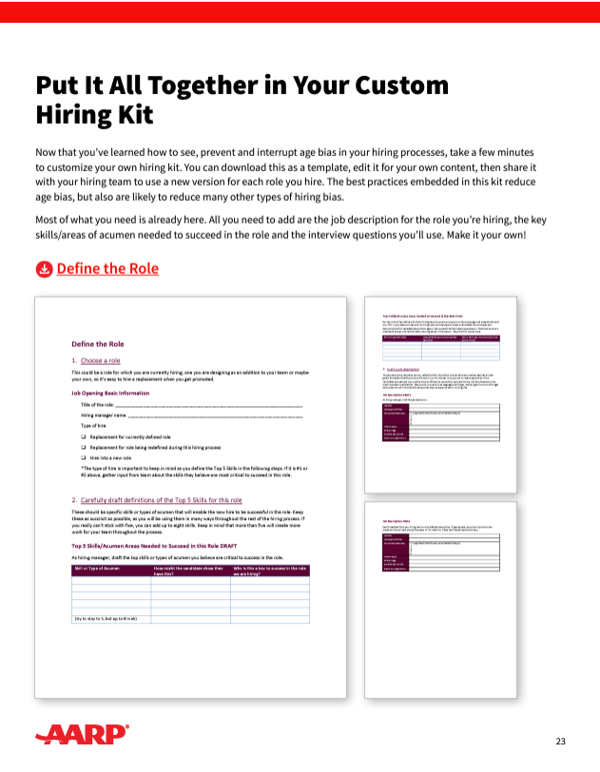
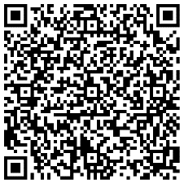
So many best practices, so little time?
We make it easy to put it all together in your own customized hiring kit
Now that you’ve learned how to see, prevent and interrupt age bias in your hiring processes, take a few minutes to customize your own hiring kit.
You can download this kit as a MSWord template, edit it for your own content, then share it with your hiring team. It’s simple to update a new version for each role you hire.
The best practices embedded in this kit reduce age bias, but also are likely to reduce many other types of hiring bias.
Source: https://higherlogicdownload.s3.amazonaws.com/AARP/c1f2494b-8a7a-4706-b3c0-487f38b16b8e/UploadedImages/age_inclusive_workforce/Follow_Age-Inclusive_Recruitment_Practices/6122_AARP_SayThisNotThat_Toolkit_R4_080923.pdf

Slide 50
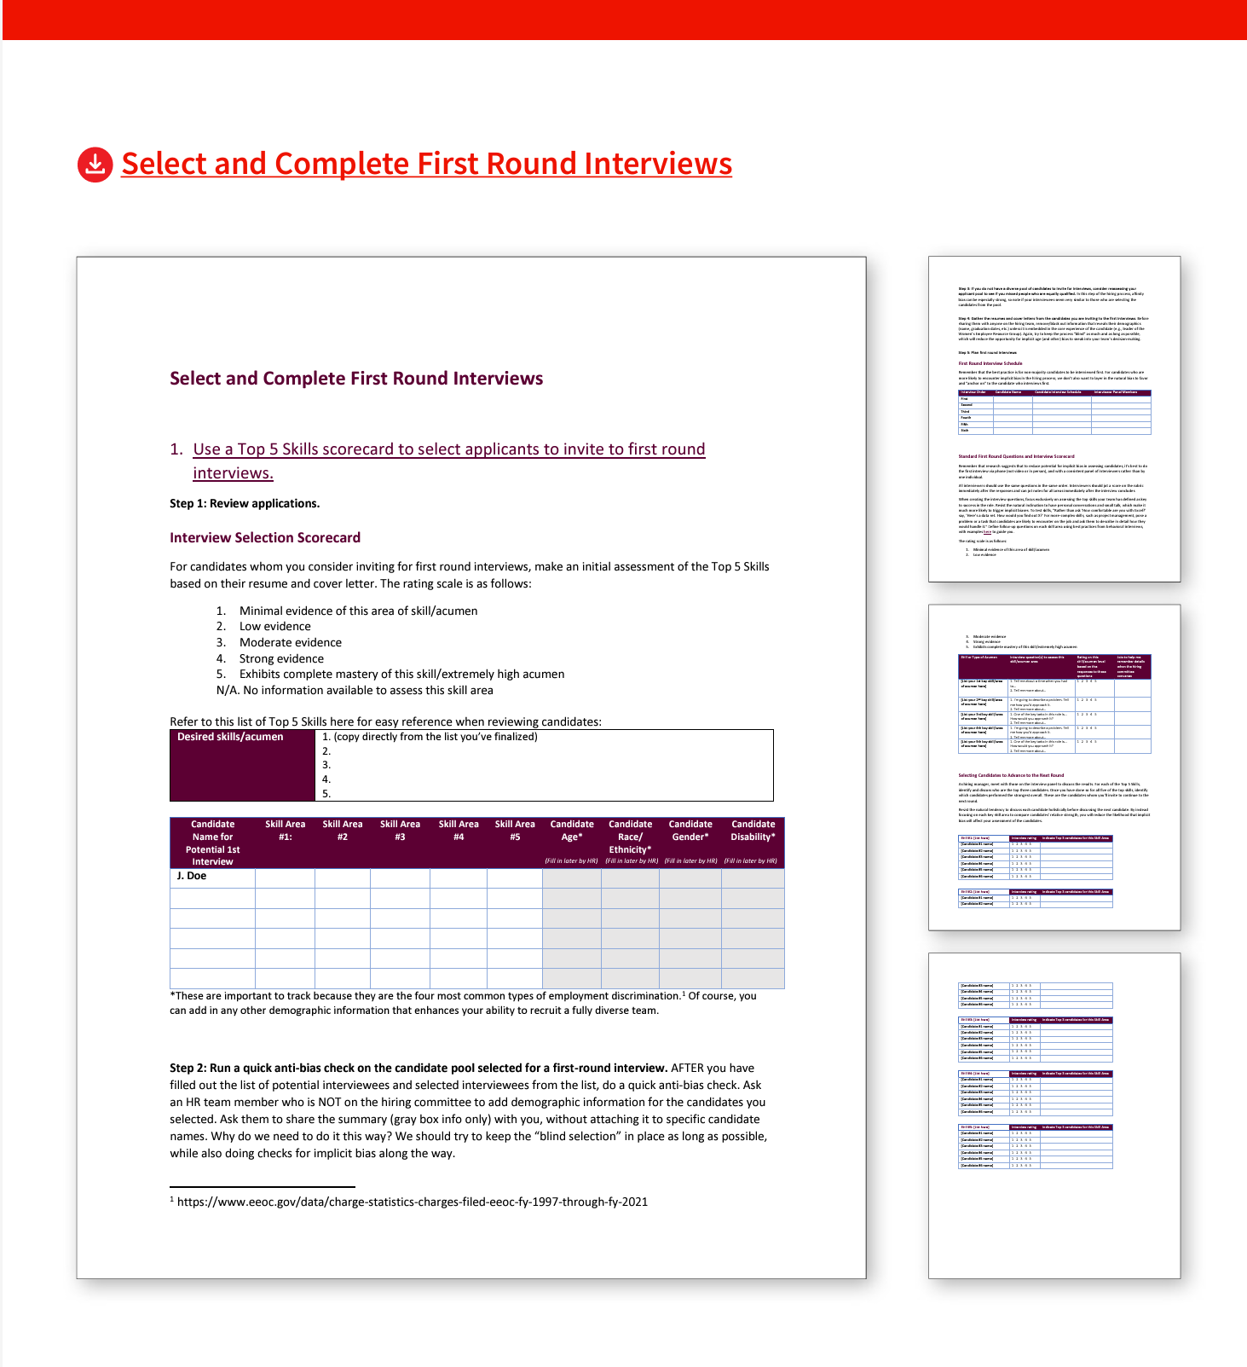
We made it easy with editable templates
Your templates support each step:
Define the role
Select candidates and complete first round interviews
Request and assess a work sample from candidates advancing to the second round
Complete second round interviews
Score second round interviews and work samples
Gather the hiring team and select the final candidate
Draft an offer letter that shows you believe the candidate belongs on your team
Source: https://higherlogicdownload.s3.amazonaws.com/AARP/c1f2494b-8a7a-4706-b3c0-487f38b16b8e/UploadedImages/age_inclusive_workforce/Follow_Age-Inclusive_Recruitment_Practices/6122_AARP_SayThisNotThat_Toolkit_R4_080923.pdf

Slide 51
It can take under an hour to customize your kit
You only need to add 3 things:
The job description for the role you are hiring
The key skills or areas of acumen needed to succeed in that role
The interview questions you’ll use
Everything else you need to use the best practices is already embedded in the hiring kit. Each template easily translates research-based best practices to your daily life as a hiring manager, recruiter, interviewer or other participant in the recruiting and hiring process.
Source: https://higherlogicdownload.s3.amazonaws.com/AARP/c1f2494b-8a7a-4706-b3c0-487f38b16b8e/UploadedImages/age_inclusive_workforce/Follow_Age-Inclusive_Recruitment_Practices/6122_AARP_SayThisNotThat_Toolkit_R4_080923.pdf

Slide 52
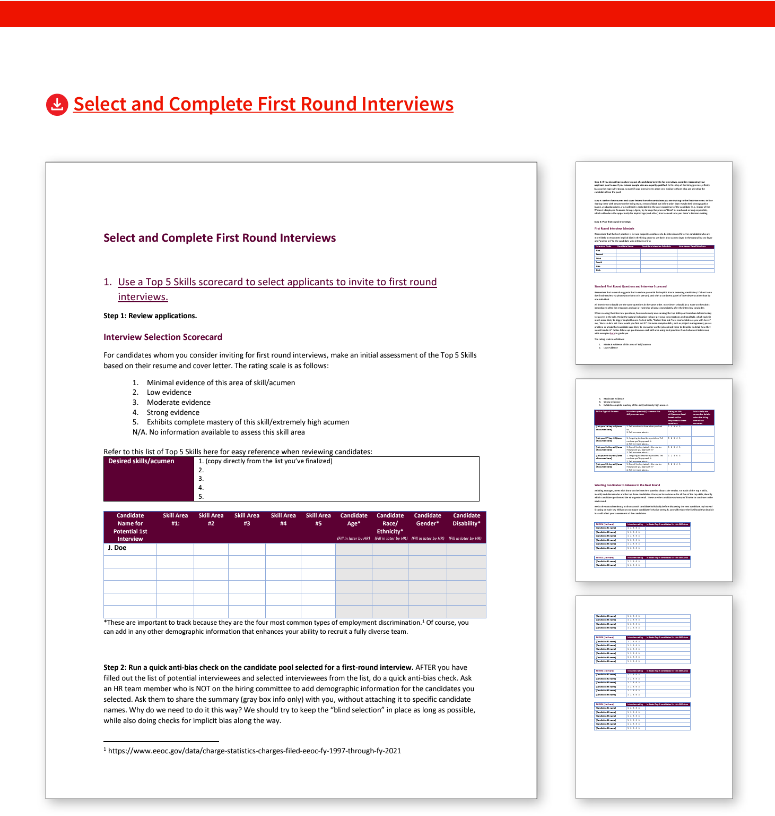
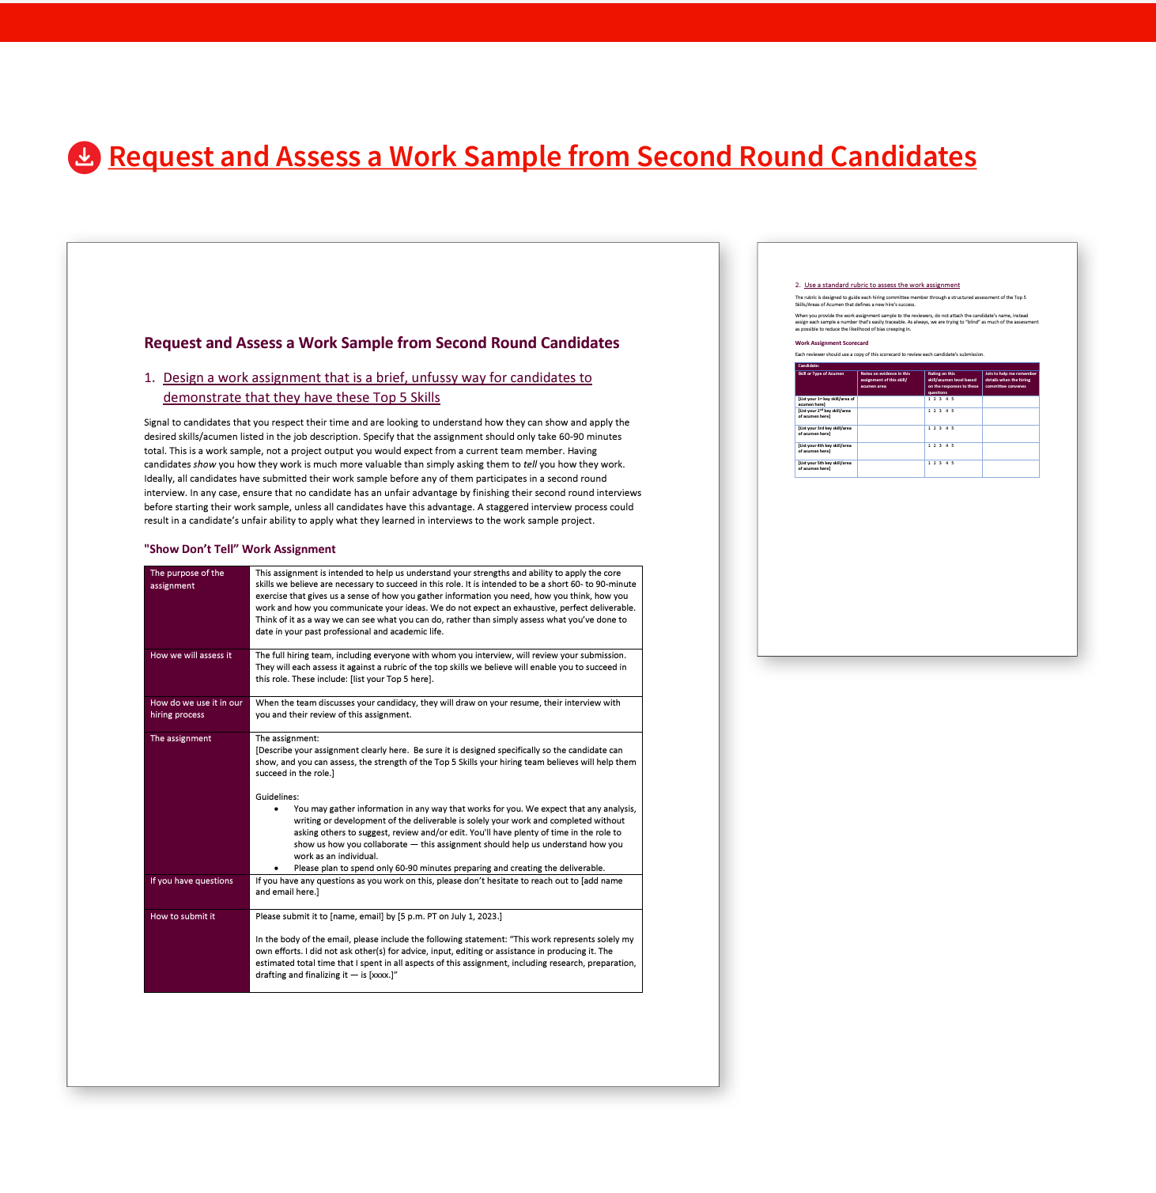
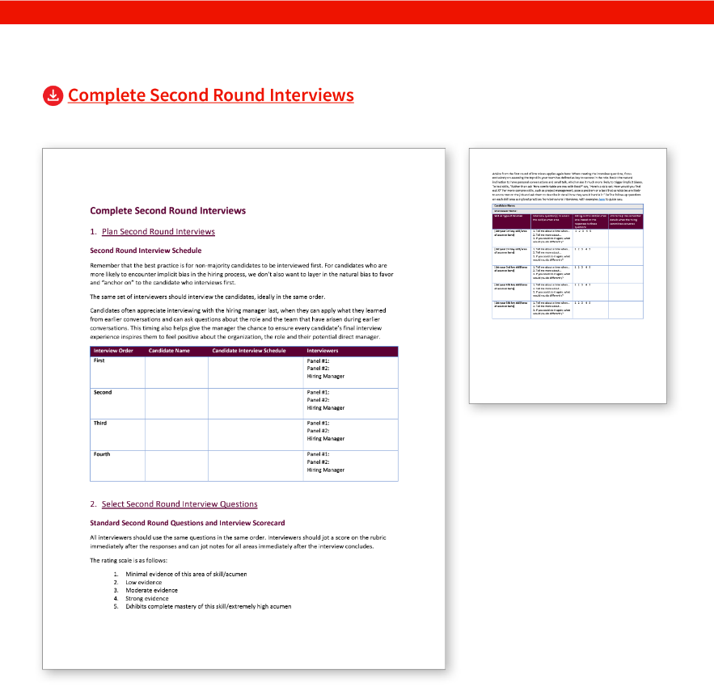
We made it easy with editable templates
Source: https://higherlogicdownload.s3.amazonaws.com/AARP/c1f2494b-8a7a-4706-b3c0-487f38b16b8e/UploadedImages/age_inclusive_workforce/Follow_Age-Inclusive_Recruitment_Practices/6122_AARP_SayThisNotThat_Toolkit_R4_080923.pdf
Notes:
Facilitator note: These screen shots of the templates are here just to orient the participants to the resource. You do not need to speak to each one in detail. Instead, the message is “These were built to be practical tools you and your team really can use at every step of the recruiting and hiring process. If you use them, you’re using all the best practices-- and it actually makes the process easier.”

Slide 53
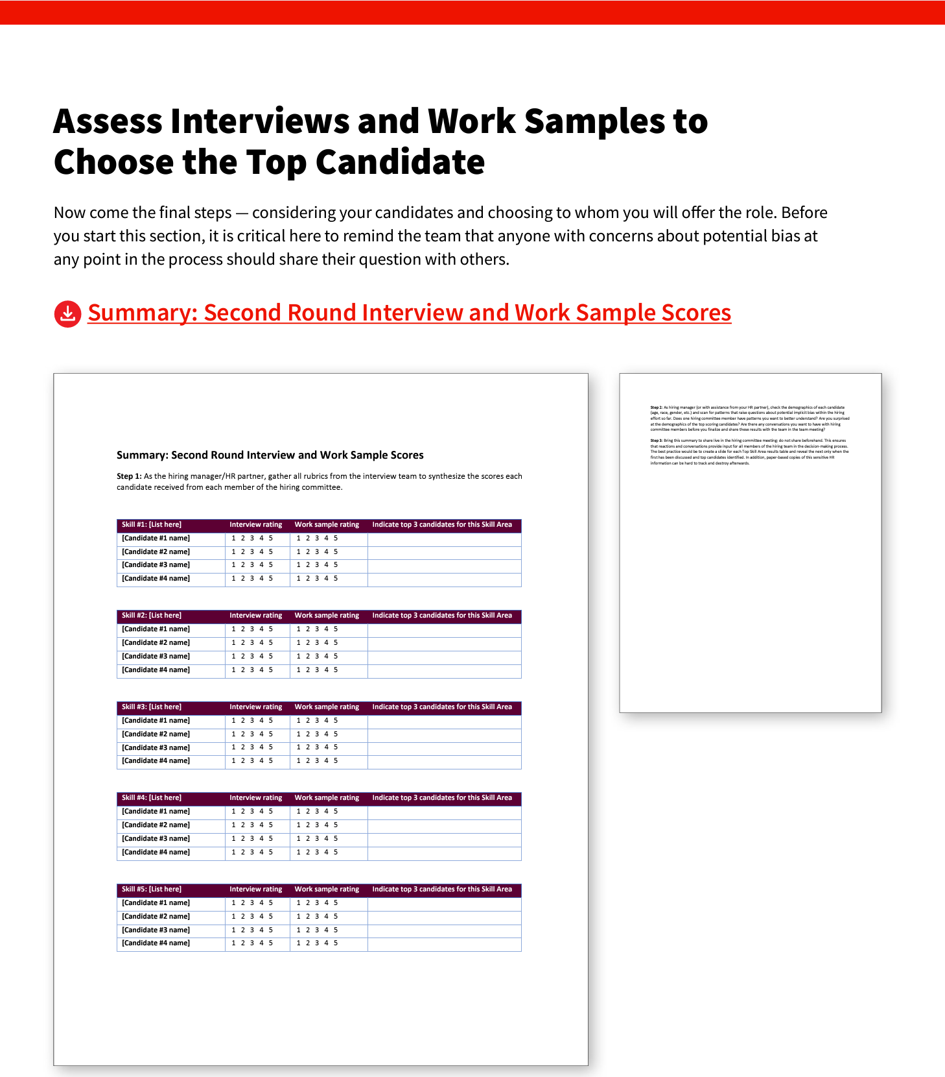
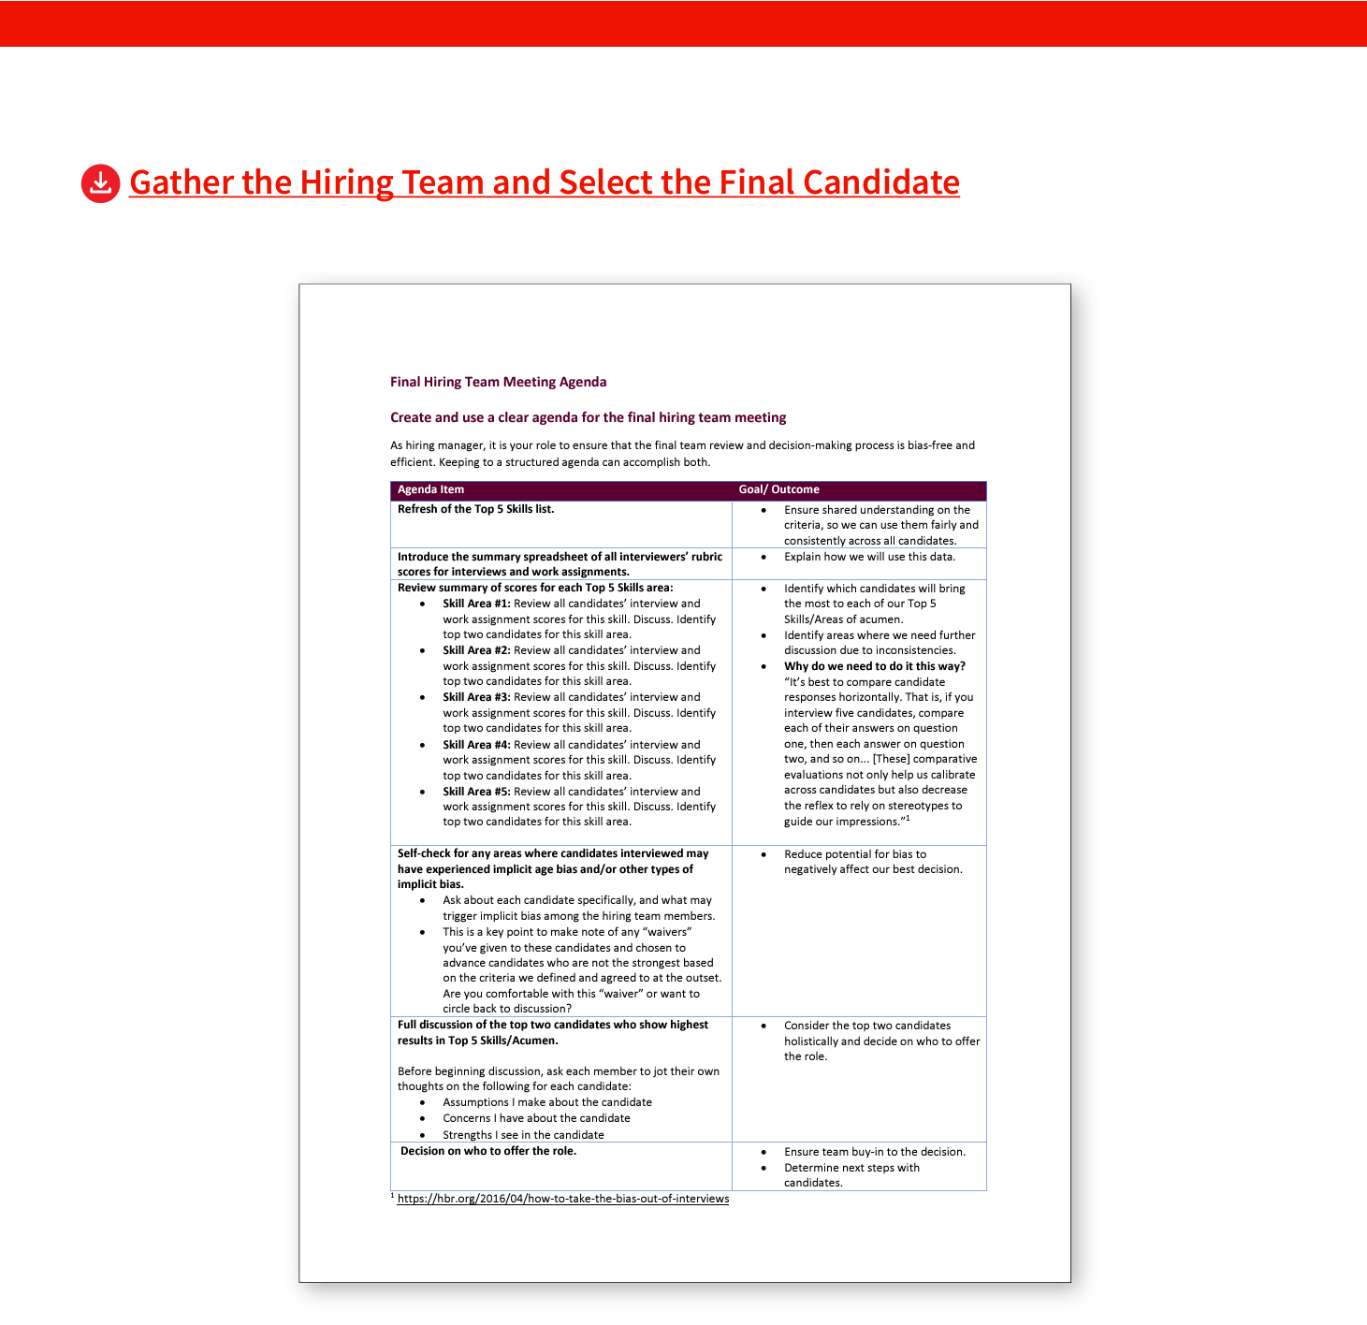
We made it easy with editable templates
Source: https://higherlogicdownload.s3.amazonaws.com/AARP/c1f2494b-8a7a-4706-b3c0-487f38b16b8e/UploadedImages/age_inclusive_workforce/Follow_Age-Inclusive_Recruitment_Practices/6122_AARP_SayThisNotThat_Toolkit_R4_080923.pdf

Slide 54
Reflect
When can you find 30 minutes to customize your team’s hiring kit?
Share your thoughts in Chat or in our conversation
Notes:
Facilitator note: If hosting virtually, prompt this to be input to Chat. If in person, consider a “popcorn” call out where you are jotting their responses on a white board as they try to brainstorm as many as possible in 60 seconds.

Slide 55
Your questions help us all. What’s on your mind?
Q&A
Courtesy Getty Images

Slide 56
Is it better to approach my team with this topic now, or when we are about to start the process of hiring someone new? I’m not sure my own manager sees mixed-age teams as key to team performance. How do I bring it up? Who do I talk to if my team identifies ways our organization’s standard recruiting and hiring tools and processes could be more age-inclusive?
FAQs
Courtesy Getty Images
Notes:
Facilitator, feel free to edit the proposed FAQs to highlight topics that are key to your own organization and recruiting and hiring processes and people. Show this slide and ask people which questions they want to address.

Slide 57
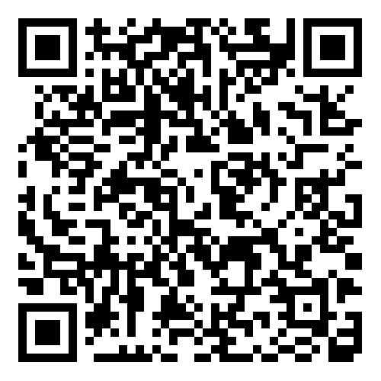
We welcome your feedback on today’s session
Please complete this short participant survey by using the QR code or link now before we wrap up today.
https://aarpresearch.qualtrics.com/jfe/form/SV_6nkTYFpWEmeEI3s
Notes:
Copy and paste this link into the Chat for people to do right now before they leave the session. Assure them that responses are anonymous. And ask them to use their phone to scan the QR code and take the brief survey now. Thank you!
Hosts can access the survey summary results by emailing the AARP Work Jobs team to request.
Hosts– please note that after the Thank You closing slide there is a hidden slide with a HOST/ FACILITATOR survey. We’d love your feedback about your experience hosting and/or facilitating this workshop.

Slide 58
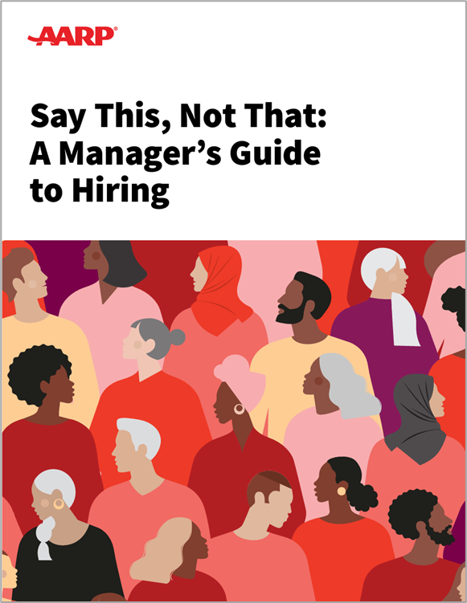
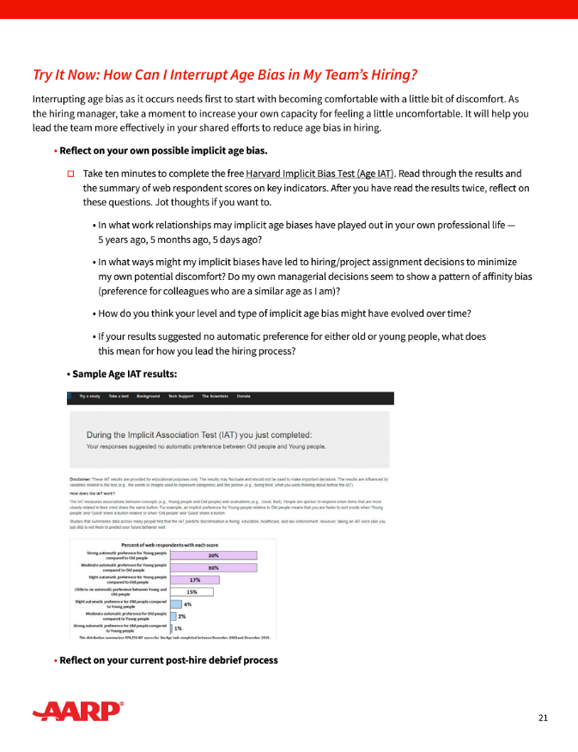
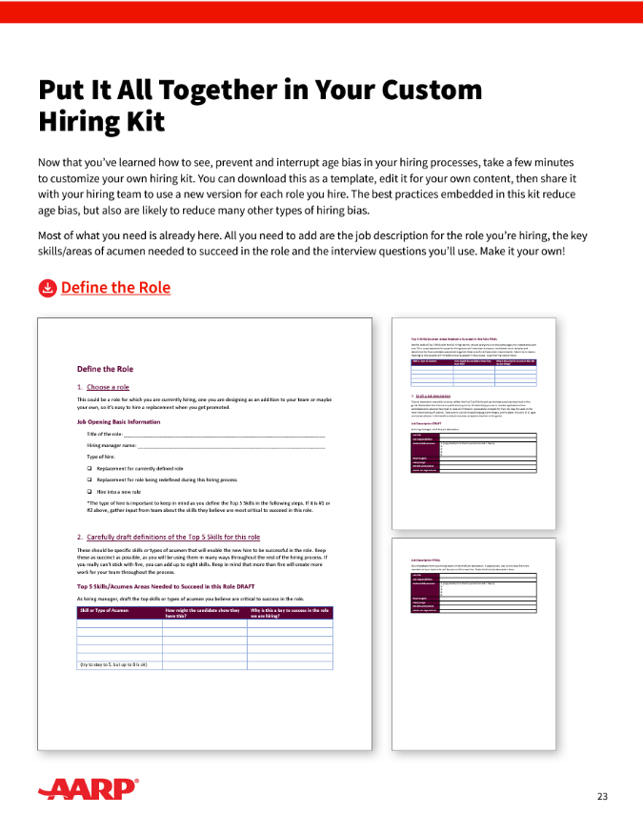
Today’s key takeaways
1| Bookmark the guide
2| Choose a time to complete this exercise on your own (p.21)
3| Use the custom hiring kit for your next hire (p.23)
Family Caregiving
Family Caregiving
Family Caregiving
AARP Family Caregiver
AARP Family Caregiver
AARP Family Caregiver
Resource Guide
Resource Guide
Resource Guide

Slide 59
Thanks for joining us!
Notes:
This is the last slide of the presentation to share with participants.
Slides that follow contain resources for the host to use after the session ends.

Slide 60
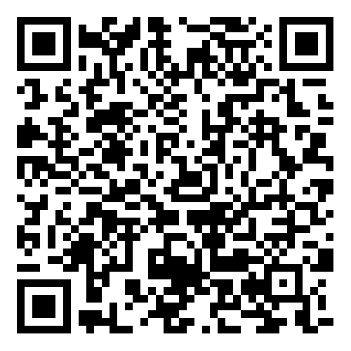
Share your feedback on hosting this session
After your participants have left the session, please complete this short host survey using the QR code or link.
https://aarpresearch.qualtrics.com/jfe/form/SV_4SdIGU3zkKfEgUC
Notes:
This survey is only for people involved in HOSTING the session, not for all of the participants. If your team had multiple people involved in organizing and hosting this session, they are each welcome to fill out their own survey response. Responses are anonymous. AARP’s Work Jobs Team reads all responses and uses your input to celebrate wins and to address opportunities to improve. Thank you for taking 3 minutes of your time to share your feedback.

Slide 61
Follow up with participants after today’s session
You can use the draft email we have added into the Notes section of this slide. Edit as needed and send it out to all who were invited today.
Notes:
Be sure to follow up with all participants as soon as possible after the conclusion of the workshop. Here’s a draft email that you can copy, paste, edit and send out. If you choose, you can also send it to everyone you invited, or to everyone who registered even if they were unable to make it.
Dear ,
Thanks so much for your interest in today’s workshop, Age Inclusive Hiring. This is a topic that affects every hiring manager across the organization—and all our employees—so we appreciate your investing your time to learn about best practices.
The key resource we used in our workshop is AARP’s Say This, Not That: Manager's Guide to Age Inclusive Hiring. We encourage you to bookmark it—and to use the activities with your own direct reports so that your team can explore the opportunities and challenges of different generations at work and learn how to work together to deliver the best results.
If you have any questions or thoughts about the workshop, please reach out to [name] at [xxx.]
All the best,

Slide 62
Update leaders after today’s session
Update the leader(s) who approved today’s session to highlight wins and learnings from the completed workshop. You can use the draft email we added into the Notes section of this slide.
Notes:
Be sure to follow up with those with whom you worked to gain approval and support to host the workshop. Here’s a draft email that you can copy, paste, edit and send out.
Dear ,
Thanks so much for your support of our team’s efforts to host the AARP workshop Age Inclusive Hiring. This is a topic that affects every hiring manager across the organization—and all employees who report to them—so we are gratified that the workshop was a success.
On [date], [name] welcomed [##] HR team members from across the organization for a 1.5-hour workshop to train them as workshop facilitators. Those facilitators then led [x] sessions that reached [xxx] total employees who are involved in some way in the talent acquisition process.
We introduced compelling data about how mixed-age teams can drive employee engagement, innovation, knowledge transfer, and productivity. We then introduced and practiced specific research-backed best practices for hiring managers and their team members who participate in interviewing and assessing potential candidates.
[If you have survey data from the participant survey that you’d like to highlight, add a sentence or two about that here.]
The key resource we used in our workshop is AARP’s Say This, Not That: Manager's Guide to Age Inclusive Hiring. If you were not able to join us for the workshop, we encourage you to bookmark it—and to share it with your own direct reports so that your teams can explore how to work together to unleash the value of a multigenerational workforce.
If you have any questions or thoughts about the workshop, please reach out to [name] at [xxx.]
All the best,

Slide 63
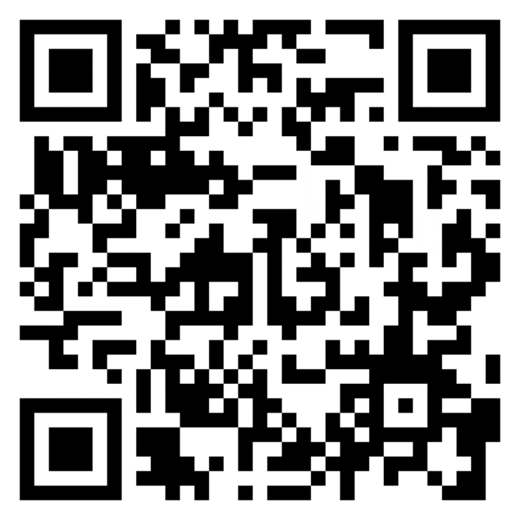
Explore additional actions
AARP’s tool Generations at Work is packed with resources to help you take action to build and leverage a multigenerational workforce
https://employerportal.aarp.org/generations/
Notes:
This workshop is one of a full suite of resources available for leaders, managers and employees to use to create a more age-inclusive workplace. We invite you to explore additional actions, and/or to complete the self-assessment to help you find your next step in the journey.

