Slide 1
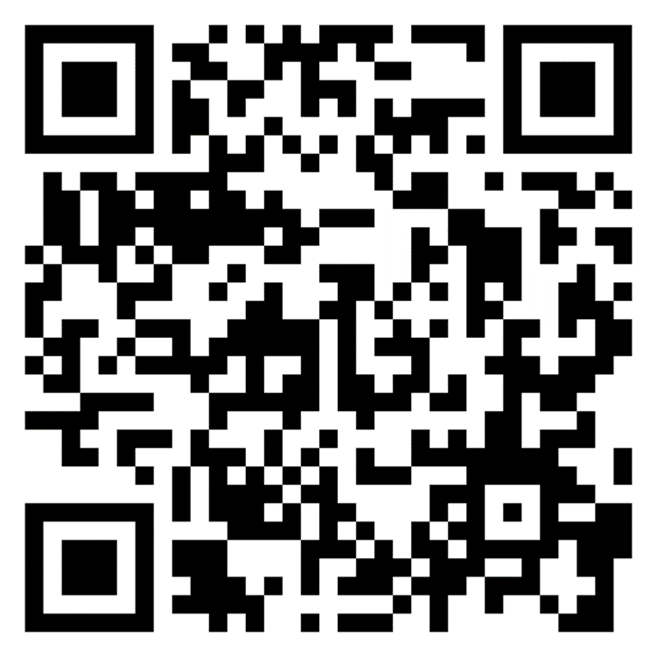
Design Our Plan
To leverage a multigenerational workforce
Notes:
Make your plan for this year
This 1-hour workshop will help you lead your HR leaders through a simple activity to understand current employees’ experiences in your multigenerational workforce, and then to create a high-level map of strengths and opportunity areas. You'll leave with a short, targeted action plan for the year that can include actions across your 1) HR functions, 2) manager support initiatives, and 3) employee engagement initiatives. Each element of your plan will include specific AARP resources to help you execute your plan successfully.
Participants: Human Resources team leaders
Facilitator: CHRO or senior HR leader
Cost: Free
Time Commitment: 1.5 hrs to plan, 1 hr to facilitate

Slide 2
Design Our Plan
We are bringing our human resources leaders together to talk about our current employees’ experiences in a multigenerational workforce, to look at our current strengths and gaps, and then to develop a targeted action plan to improve age-inclusion for the coming year.
We’ll leave with a draft of short, targeted action plan for the year that can include actions across our 1) HR functions, 2) manager support initiatives, and 3) employee engagement initiatives. Each element of our plan will include specific AARP resources to help us execute our plan successfully with efficient use of our time.
Courtesy Getty Images
Notes:
As you plan this session, feel free to use the following draft to invite your human resource leaders to join you. Also note that some slides require pre-work such as gathering organizational data, selecting or changing discussion questions, etc., so make sure to read through the deck to prepare for the session. These resources are meant to be customizable based on your needs.
Dear ,
As you know, we are working towards building a more inclusive workplace, including along dimensions of age. We also have incredible potential to more fully leverage the power of our multi-generational workforce to create the culture, teamwork and results we all want.
I recently learned about a suite of resources AARP has created for employers that we can use in this effort. I’m excited because this resource suite (which is no cost to us) can help us drive progress with highly efficient use of staff, employee and financial resources.
I’d like you to join a small group of HR leaders for a special one-hour workshop that I’ll facilitate. Here are the details from AARP’s workshop resources:
This 1-hour workshop will lead your HR leaders through simple activities to understand current employees’ experiences in your multigenerational workforce, and then to create a high-level map of strengths and opportunity areas. You'll leave with a short, targeted action plan for the year that can include actions across your 1) HR functions, 2) manager support initiatives, and 3) employee engagement initiatives. Each element of your plan will include specific AARP resources to help you execute your plan successfully.
Please let me know your thoughts and look for a specific meeting invitation that will have details on how and when to join this important session.
Best,

Slide 3
Introductions
Use any or all of these prompts
My name is __________________________________________
My role is to _________________________________________
Today I want to talk about ____________________________
One word to describe how I’m feeling right now ________
Courtesy Getty Images
Notes:
Note to host: Edit these prompts to fit your team. We recommend including a prompt that allows each individual to share some aspect of how they are feeling/ what they are hoping for about this working session.

Slide 4
Agenda
|
|
|
|
|
What is the strategic value of a multi-generational workforce?
What are current employees’ experiences?
Where are our current strengths and gaps?
What should our action plan include?
Next steps
Courtesy Getty Images

Slide 5
Strategic value of a multigenerational workforce
A value creation strategy hiding in plain sight
In a recent AARP study, 83%¹ of employers said that creating a more multigenerational workforce would drive their success and growth.
The depth of experience and skill sets in an age-diverse workforce – whether technical, professional, or durable human skills –creates major opportunities for employers who can unleash those synergies.
The best decisions result when people from different life and career stages work together to define problems and create solutions.
Source: 1 AARP Global Employer Survey 2020
Notes:
Note: "durable human skills" are often called soft skills – critical thinking, communication, negotiation, judgement calls, etc.
1 “According to the AARP Global Employer Survey 2020, 83% of employers state that it would be very or at least somewhat valuable to their organisation’s success and growth to create a more multigenerational workforce. Executives in large global companies recognize that their organization would need to undertake more efforts to maximise the full potential that an age-diverse workforce offers, listing age, besides disability, as the area of diversity management that requires most improvement (Forbes Insights, 2011[33]).”

Slide 6
Strategic value of a multigenerational workforce
A talent management necessity
“Declining populations or labor force participation rates among younger workers may lead to talent shortages. Retaining older workers can help employers address this challenge.”
We are on the cusp of a significant demographic shift affecting the U.S. labor market. Over the coming decades, more people will exit the workforce than will enter it.
In the near future, the Bureau of Labor Statistics forecasts that workers 65+ will be the fastest-growing portion of the labor market, with other age groups either holding steady or declining.
Sources: 1 AARP Global Employer Survey 2020
2 https://www.oecd-ilibrary.org/docserver/59752153-en.pdf?expires=1636142224&id=id&accname=guest&check
3 https://www.oecd-ilibrary.org/docserver/59752153-en.pdf?expires=1636142224&id=id&accname=guest&check
Notes:
https://blog.aarp.org/thinking-policy/how-population-age-shifts-will-affect-us-labor-market

Slide 7
Strategic value of a multigenerational workforce
A proven way to improve team performance
Research has shown that mixed-age teams perform better than homogenous-aged teams:
In companies that utilized mixed-age work teams, the relative productivity of both older and younger workers was higher than in companies that did not use mixed-age teams.
When the task “entails dealing with strategic and complex decision-making with vaguely defined problems in a dynamic setting…increased age diversity can lead to enhanced group discussions, better analysis and superior problem-solving.”
Courtesy Getty Images
Sources: Human Resource Management Journal, vol. 23, Issue 3, (2013); Personnel Psychology, 67, (2014); Labour Economics, 22, (2013); Journal of Applied Psychology, 93, (2008). https://ideas.repec.org/p/iso/educat/0093.html http://repec.business.uzh.ch/RePEc/iso/leadinghouse/0093_lhwpaper.pdf
Notes:
Facilitator note: As you customize this deck to meet your needs, feel free to bring in additional data from AARP’s Business Case for Age-Inclusion slide deck at https://employerportal.aarp.org/age-inclusive-workforce/commit-to-an-age-inclusive-culture/business-case-basic-slides

Slide 8
Reflect
What aspect of this data surprises you? Which seems to have the most potential for our organization?
First, jot for yourself, then we can share out.
Courtesy Getty Images
Source: xxx

Slide 9
Agenda
|
|
|
|
|
What is the strategic value of a multi-generational workforce?
What are current employees’ experiences?
Where are our current strengths and gaps?
What should our action plan include?
Next steps
Courtesy Getty Images
Notes:
Facilitator note:
To prepare this section, when you are gathering existing data to try to see it through an age lens, consider this and use what works for you from this information included in 2.1.1 Worksheet_Data through Age Lens:
Step 1: Gather or access employee engagement or satisfaction data.
Ask the team who manages employee surveys what data they have collected that can be used to generate a report that filters by employee age. Look at a sample of the age-filtered report they can run, and work with that team to create a report structure that offers the most insight. If you can define age “cohorts” by using employee birth year, consider the following, which map to generational boundaries:
1995-2012 (Gen Z)
1980-1994 (Millennial)
1965-1979 (Gen X)
1946-1964 (Baby Boomer)
Before 1945 (Traditionalists)
You may also want to run a version of the report that compares the data split by: All employees, Employees under age 40, and Employees age 40+. This data view may help you see opportunities and issues among the 40+ group, who are members of a legally protected class under the federal Age Discrimination in Employment Act (ADEA).
Step 2: Analyze and discuss your data.
1. Within each survey question result, are the employees’ experiences roughly similar? Are they different? Circle areas where employee results for a key age group skew higher or lower or note differences from group to group. Talk about what may influence this result.
2. Distill your learnings into a short list of questions you’d like to ask to employees in each age group/ generation. These may reflect results that are very surprising to you (either in a positive or a negative sense). You might ask people to share their personal experience so you can understand the quantitative data in a qualitative context, or you might ask for ideas the organization can consider that can improve the employee experience.
3. Make a plan for how to gather that additional information from employees so that you can best interpret your data. A few interviews? A short, targeted employee pulse survey to a specific employee demographic? Engaging a specific ERG to talk with their members?
4. Now you are ready to use the data effectively to design an age inclusion action plan that is grounded in a deeper understanding of your employees’ current experiences working in a multi-generational workforce. Action plans that meet employees where they are are usually more successful!

Slide 10
Experiences of our current employees
Sourcing, recruiting and hiring
[Spend time to see what data you already have that you can analyze through the lens of age. e.g. employee engagement survey results, DEI data, promotion/ pipeline data, and data around voluntary exits]
[Add key points here, and include key charts, graphs or employee quotes on the right-hand side of this slide. Duplicate this slide and use those to build this info out.]
[Ideally, you can include the results for all ages of employees in your charts. Remember that age bias is most common for both younger and older employees.]
Courtesy Getty Images
Source: xxx
Notes:
As you complete this section of your working presentation, remember that there is value in using the data you have rather than waiting to collect perfect data. This is a starting point! You may also want to use the worksheet titled 2.1.1 Worksheet_Data Through an Age Lens in the AARP Generations at Work resource suite.
For your convenience, the text of the worksheet is pasted below:
Worksheet: Look at your current employee data through an age lens
How to use this worksheet:
Before choosing the actions to take this year, take a moment to understand how age might already influence your current employees' experiences. Use this worksheet to help guide discussion about how a multi-generational workforce affects your employees' experiences.
Who to include in the conversations:
You can use it as an exercise with your HR leadership team and then integrate the outcome into a broader presentation(s) with organizational leaders and/or Human Resources sub-teams who are taking action to address the key take-aways from this worksheet.
Before jumping in to create an action plan to leverage a multi-generational workforce, it’s important to be curious about the experiences of current employees. What does available data from your own organization tell you? What questions does it raise? Which areas emerge as opportunities for taking action?
Step 1: Gather or access employee engagement or satisfaction date.
Ask the team who manages employee surveys what data they have collected that can be used to generate a report that employee respondent’s age. Look at a sample of the age-filtered report they can run, and work with that team to create a report structure that offers the most insight. If you can define age “cohorts” by using employee birth year, consider the following, which map to generational boundaries:
1995-2012 (Gen Z)
1980-1994 (Millennial)
1965-1979 (Gen X)
1946-1964 (Baby Boomer)
Before 1945 (Traditionalists)
You may also want to run a version of the report that compares the data split by: All employees, Employees under age 40, and Employees age 40+. This data view may help you see opportunities and issues among the 40+ group, who are members of a legally protected class under the federal Age Discrimination in Employment Act (ADEA).
If you are not able to access existing employee survey data that can be filtered by age/ birthdate, you can use the AARP template survey available in the AARP Generations at Work resource suite.
Step 2: Analyze and discuss your data.
Within each survey question result, are the employees’ experiences roughly similar? Are they different? Circle areas where employee results for a key age group skew higher or lower or note differences from group to group. Talk about what may influence this result.
Distill your learnings into a short list of questions you’d like to ask to employees in each age group/ generation. These may reflect results that are very surprising to you (either in a positive or a negative sense.) You might ask people to share their personal experience so you can understand the quantitative data in a qualitative context, or you might ask for ideas the organization can consider that can improve the employee experience.
Make a plan for how to gather that additional information from employees so that you can best interpret your data. A few interviews? A short, targeted employee pulse survey to a specific employee demographic? Engaging a specific ERG to talk with their members?
Now you are ready to use the data effectively to design an age inclusion action plan that is grounded in a deeper understanding of your employees’ current experiences working in a multi-generational workforce. Action plans that meet employees where they are are usually more successful!

Slide 11
Experiences of our current employees
Employee engagement
[Spend time to see what data you already have that you can analyze through the lens of age. e.g. employee engagement survey results, DEI data, promotion/ pipeline data, and data around voluntary exits]
[Add key points here, and include key charts, graphs or employee quotes on the right-hand side of this slide. Duplicate this slide and use those to build this info out.]
[Ideally, you can include the results for all ages of employees in your charts. Remember that age bias is most common for both younger and older employees.]
Courtesy Getty Images
Source: xxx

Slide 12
Experiences of our current employees
Career Development
[Spend time to see what data you already have that you can analyze through the lens of age. e.g. employee engagement survey results, DEI data, promotion/ pipeline data, and data around voluntary exits]
[Add key points here, and include key charts, graphs or employee quotes on the right-hand side of this slide. Duplicate this slide and use those to build this info out.]
[Ideally, you can include the results for all ages of employees in your charts. Remember that age bias is most common for both younger and older employees.]
Courtesy Getty Images
Source: xxx

Slide 13
Experiences of our current employees
Promotion and pipeline
[Spend time to see what data you already have that you can analyze through the lens of age. e.g. employee engagement survey results, DEI data, promotion/ pipeline data, and data around voluntary exits]
[Add key points here, and include key charts, graphs or employee quotes on the right-hand side of this slide. Duplicate this slide and use those to build this info out.]
[Ideally, you can include the results for all ages of employees in your charts. Remember that age bias is most common for both younger and older employees.]
Courtesy Getty Images
Source: xxx

Slide 14
Experiences of our current employees
Voluntary attrition
[Spend time to see what data you already have that you can analyze through the lens of age. e.g. employee engagement survey results, DEI data, promotion/ pipeline data, and data around voluntary exits]
[Add key points here, and include key charts, graphs or employee quotes on the right-hand side of this slide. Duplicate this slide and use those to build this info out.]
[Ideally, you can include the results for all ages of employees in your charts. Remember that age bias is most common for both younger and older employees.]
Courtesy Getty Images
Source: xxx

Slide 15
Reflect
What aspect of our data surprises you? Which seems to have the most potential for our organization?
First, jot for yourself, then we can share out.

Slide 16
Agenda
|
|
|
|
|
What is the strategic value of a multi-generational workforce?
What are current employees’ experiences?
Where are our current strengths and gaps?
What should our action plan include?
Next steps
Courtesy Getty Images

Slide 17
What are our current strengths and gaps?
Self-assessment Worksheet
We are going to use the AARP Generations at Work tool’s Map Strengths and Gaps worksheet to gain a bird’s eye view of where our organization may have pockets both of progress and of opportunity to build a more age-inclusive workplace.
We’ll assess these three areas for best practices:
Strengthen HR
Including: Talent Acquisition, DEI, Benefits and HR Policies, Learning and Development, Workforce Management
Support Managers and Teams
Empower Employees
Courtesy Getty Images
Notes:
Note to host: You can choose the mix of approaches that works best for your team dynamics and your time available:
Decision 1: Choose how you want team members to consider the questions posed by the worksheet. Will discussion be more effective if you ask people to complete it as individuals, in partners, or in a full group discussion for the full set of questions? If you have gathered the leaders of each HR function listed on the worksheet, you might ask each person to fill out the section for their own group, then have everyone report out and discuss. If you know you are pressed for time in facilitating this session, you can ask the HR leader for each function to fill out their own section BEFORE the session and you can include the completed version of each chart on the following slides. It’s up to you!
Decision 2: Choose your platform: You can either download, print and use the worksheet from the AARP Generations at Work resource suite OR you can use the same content on the set of slides to follow. If you use the printed version for people to work through on their own or with a partner, you can use the following slides to document their reported-out results during group discussion.

Slide 18
What are our current strengths and gaps?
Best practices for an organization working to optimize a multi-generational workforce | Step 1: Has your organization taken this action? | Step 2: Jot a note about any current organizational priorities or initiatives that could align and support this action (or “none”) | Step 3: Place an “X” in the box if you answered “No” or “Somewhat” in Step 1 AND identified an opportunity in Step 2
Strengthen HR: Talent Acquisition
We have reviewed our Talent Acquisition practices to see where we can better support a multi-generational workforce. | Yes No Somewhat
We have provided training for our Talent Acquisition on best practices to support a multi-generational workforce. | Yes No Somewhat
We have applied an age lens to analyze our current Talent Acquisition data. | Yes No Somewhat
Courtesy Getty Images
Source: AARP Generations at Work resource suite
Notes:
Note to host: You can choose the mix of approaches that works best for your team dynamics and your time available:
Decision 1: Choose how you want team members to consider the questions posed by the worksheet. Will discussion be more effective if you ask people to complete it as individuals, in partners, or in a full group discussion for the full set of questions? If you have gathered the leaders of each HR function listed on the worksheet, you might ask each person to fill out the section for their own group, then have everyone report out and discuss.
Decision 2: Choose your platform: You can either download, print and use the worksheet from the AARP Generations at Work resource suite OR you can use the same content on the set of slides to follow. If you use the printed version for people to work through on their own or with a partner, you can use the following slides to document their reported-out results during group discussion.

Slide 19
What are our current strengths and gaps?
Best practices for an organization working to optimize a multi-generational workforce | Step 1: Has your organization taken this action? | Step 2: Jot a note about any current organizational priorities or initiatives that could align and support this action (or “none”) | Step 3: Place an “X” in the box if you answered “No” or “Somewhat” in Step 1 AND identified an opportunity in Step 2
Strengthen HR: DEI
We have included age inclusion in our Diversity, Equity and Inclusion formal policies. | Yes No Somewhat
We have integrated age inclusion into an existing DEI program. | Yes No Somewhat
We have applied an age lens to analyze our current DEI data. | Yes No Somewhat
Courtesy Getty Images
Source: Source: AARP Generations at Work resource suite
Notes:
Note to host: You can choose the mix of approaches that works best for your team dynamics and your time available:
Decision 1: Choose how you want team members to consider the questions posed by the worksheet. Will discussion be more effective if you ask people to complete it as individuals, in partners, or in a full group discussion for the full set of questions? If you have gathered the leaders of each HR function listed on the worksheet, you might ask each person to fill out the section for their own group, then have everyone report out and discuss.
Decision 2: Choose your platform: You can either download, print and use the worksheet from the AARP Generations at Work resource suite OR you can use the same content on the set of slides to follow. If you use the printed version for people to work through on their own or with a partner, you can use the following slides to document their reported-out results during group discussion.

Slide 20
What are our current strengths and gaps?
Best practices for an organization working to optimize a multi-generational workforce | Step 1: Has your organization taken this action? | Step 2: Jot a note about any current organizational priorities or initiatives that could align and support this action (or “none”) | Step 3: Place an “X” in the box if you answered “No” or “Somewhat” in Step 1 AND identified an opportunity in Step 2
Strengthen HR: Benefits and HR Policies
We have reviewed our Benefits and HR policies practices to see where we can better support a multi-generational workforce | Yes No Somewhat
We have integrated age inclusion into an existing benefits practice | Yes No Somewhat
We have applied an age lens to analyze our current benefits utilization and satisfaction data. | Yes No Somewhat
Courtesy Getty Images
Source: Source: AARP Generations at Work resource suite
Notes:
Note to host: You can choose the mix of approaches that works best for your team dynamics and your time available:
Decision 1: Choose how you want team members to consider the questions posed by the worksheet. Will discussion be more effective if you ask people to complete it as individuals, in partners, or in a full group discussion for the full set of questions? If you have gathered the leaders of each HR function listed on the worksheet, you might ask each person to fill out the section for their own group, then have everyone report out and discuss.
Decision 2: Choose your platform: You can either download, print and use the worksheet from the AARP Generations at Work resource suite OR you can use the same content on the set of slides to follow. If you use the printed version for people to work through on their own or with a partner, you can use the following slides to document their reported-out results during group discussion.

Slide 21
What are our current strengths and gaps?
Best practices for an organization working to optimize a multi-generational workforce | Step 1: Has your organization taken this action? | Step 2: Jot a note about any current organizational priorities or initiatives that could align and support this action (or “none”) | Step 3: Place an “X” in the box if you answered “No” or “Somewhat” in Step 1 AND identified an opportunity in Step 2
Strengthen HR: Learning and Development
We have reviewed our L&D content and practices to see where we can better support a multi-generational workforce. | Yes No Somewhat
We have integrated age inclusion into an existing L&D practice. | Yes No Somewhat
We have applied an age lens to analyze our current L&D data. | Yes No Somewhat
Courtesy Getty Images
Source: Source: AARP Generations at Work resource suite
Notes:
Note to host: You can choose the mix of approaches that works best for your team dynamics and your time available:
Decision 1: Choose how you want team members to consider the questions posed by the worksheet. Will discussion be more effective if you ask people to complete it as individuals, in partners, or in a full group discussion for the full set of questions? If you have gathered the leaders of each HR function listed on the worksheet, you might ask each person to fill out the section for their own group, then have everyone report out and discuss.
Decision 2: Choose your platform: You can either download, print and use the worksheet from the AARP Generations at Work resource suite OR you can use the same content on the set of slides to follow. If you use the printed version for people to work through on their own or with a partner, you can use the following slides to document their reported-out results during group discussion.

Slide 22
What are our current strengths and gaps?
Best practices for an organization working to optimize a multi-generational workforce | Step 1: Has your organization taken this action? | Step 2: Jot a note about any current organizational priorities or initiatives that could align and support this action (or “none”) | Step 3: Place an “X” in the box if you answered “No” or “Somewhat” in Step 1 AND identified an opportunity in Step 2
Strengthen HR: Workforce Management
We have reviewed our workforce management practices to see where we can better support a multi-generational workforce. | Yes No Somewhat
We have integrated age inclusion into an existing workforce management practice. | Yes No Somewhat
We have applied an age lens to analyze our current workforce management data. | Yes No Somewhat
Courtesy Getty Images
Source: AARP Generations at Work resource suite
Notes:
Note to host: You can choose the mix of approaches that works best for your team dynamics and your time available:
Decision 1: Choose how you want team members to consider the questions posed by the worksheet. Will discussion be more effective if you ask people to complete it as individuals, in partners, or in a full group discussion for the full set of questions? If you have gathered the leaders of each HR function listed on the worksheet, you might ask each person to fill out the section for their own group, then have everyone report out and discuss.
Decision 2: Choose your platform: You can either download, print and use the worksheet from the AARP Generations at Work resource suite OR you can use the same content on the set of slides to follow. If you use the printed version for people to work through on their own or with a partner, you can use the following slides to document their reported-out results during group discussion.

Slide 23
What are our current strengths and gaps?
Best practices for an organization working to optimize a multi-generational workforce | Step 1: Has your organization taken this action? | Step 2: Jot a note about any current organizational priorities or initiatives that could align and support this action (or “none”) | Step 3: Place an “X” in the box if you answered “No” or “Somewhat” in Step 1 AND identified an opportunity in Step 2
Strengthen HR: Support Managers and Teams
We have provided training to managers on how to lead a mixed-age team. | Yes No Somewhat
We have asked people managers to adopt age-inclusive best practices within their teams. | Yes No Somewhat
We have encouraged managers to reflect on how effectively they have adopted age-inclusive managerial and team practices. | Yes No Somewhat
Courtesy Getty Images
Source: AARP Generations at Work resource suite
Notes:
Note to host: You can choose the mix of approaches that works best for your team dynamics and your time available:
Decision 1: Choose how you want team members to consider the questions posed by the worksheet. Will discussion be more effective if you ask people to complete it as individuals, in partners, or in a full group discussion for the full set of questions? If you have gathered the leaders of each HR function listed on the worksheet, you might ask each person to fill out the section for their own group, then have everyone report out and discuss.
Decision 2: Choose your platform: You can either download, print and use the worksheet from the AARP Generations at Work resource suite OR you can use the same content on the set of slides to follow. If you use the printed version for people to work through on their own or with a partner, you can use the following slides to document their reported-out results during group discussion.

Slide 24
What are our current strengths and gaps?
Best practices for an organization working to optimize a multi-generational workforce | Step 1: Has your organization taken this action? | Step 2: Jot a note about any current organizational priorities or initiatives that could align and support this action (or “none”) | Step 3: Place an “X” in the box if you answered “No” or “Somewhat” in Step 1 AND identified an opportunity in Step 2
Strengthen HR: Empower Employees
We provide resources and support to employees to make their own teams more age inclusive. | Yes No Somewhat
We provide resources to equip employees to create a career plan for longevity | Yes No Somewhat
We provide programming or resources to prepare employees to integrate caregiving and work | Yes No Somewhat
Courtesy Getty Images
Source: AARP Generations at Work resource suite
Notes:
Note to host: You can choose the mix of approaches that works best for your team dynamics and your time available:
Decision 1: Choose how you want team members to consider the questions posed by the worksheet. Will discussion be more effective if you ask people to complete it as individuals, in partners, or in a full group discussion for the full set of questions? If you have gathered the leaders of each HR function listed on the worksheet, you might ask each person to fill out the section for their own group, then have everyone report out and discuss.
Decision 2: Choose your platform: You can either download, print and use the worksheet from the AARP Generations at Work resource suite OR you can use the same content on the set of slides to follow. If you use the printed version for people to work through on their own or with a partner, you can use the following slides to document their reported-out results during group discussion.

Slide 25
What are our current strengths and gaps?
Now we can see them!
Where are our strengths? List or highlight in green all the best practices where we checked “yes” in Step 1. Then take a moment to celebrate and to reflect on what helped the organization adopt these best practices– and what we can learn from areas that were challenging.
Where are the gaps that create our opportunity areas? List or highlight in yellow all actions with an “X” in Step 3. Then we will use these to create our action plan.
Courtesy Getty Images
Source: AARP Generations at Work resource suite
Notes:
Note to host: You can choose the mix of approaches that works best for your team dynamics and your time available:
Decision 1: Choose how you want team members to consider the questions posed by the worksheet. Will discussion be more effective if you ask people to complete it as individuals, in partners, or in a full group discussion for the full set of questions? If you have gathered the leaders of each HR function listed on the worksheet, you might ask each person to fill out the section for their own group, then have everyone report out and discuss.
Decision 2: Choose your platform: You can either download, print and use the worksheet from the AARP Generations at Work resource suite OR you can use the same content on the set of slides to follow. If you use the printed version for people to work through on their own or with a partner, you can use the following slides to document their reported-out results during group discussion.

Slide 26
Reflect
What aspect of this data surprises you? Which seems to have the most potential for our organization?
First, jot for yourself, then we can share out.

Slide 27
Agenda
|
|
|
|
|
What is the strategic value of a multi-generational workforce?
What are current employees’ experiences?
Where are our current strengths and gaps?
What should our action plan include?
Next steps
Courtesy Getty Images

Slide 28
How do we use this to design our plan?
Focus on the best practices that fill gaps.
Consider the list of all actions with an “X” in Step 3. For each of these, the Generations at Work tool offers resources we can use to take that action.
Discuss which actions you believe are the best to include in our action plan.
Draft the Age Inclusion Action Plan (version 1) on the next slide.
Visit the AARP Generations at Work resource suite online to see the resources provided to help us execute each one.
Discuss key reflection questions to pressure test our v.1 action plan.
Update the Age Inclusion Action Plan (Final) to reflect any changes.
Courtesy Getty Images
Source: xxx
Notes:
Facilitator Note: In the initial work session, all teams should be able to complete through #3: draft v1 of the Age Inclusion Action Plan. Based on your team’s available time and work style, you can continue in the same work session through to iterate to a final plan in #6.
OR
You can choose to have participants complete #4 as homework, then reconvene for a second workshop to complete #5-6 together.

Slide 29
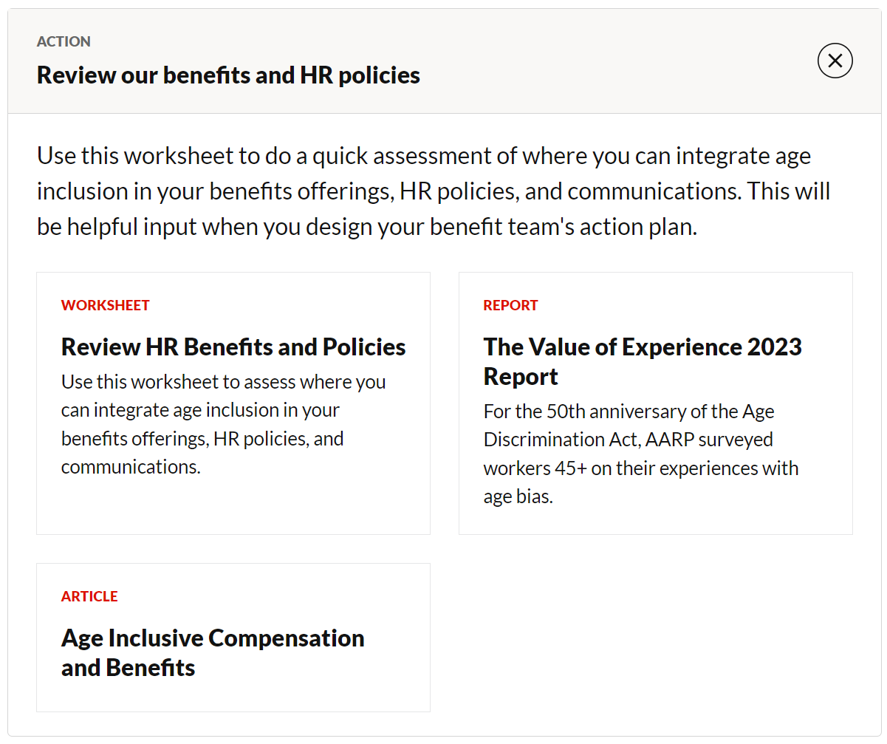
How do we use this to design our plan?
For every action we add to our plan, we have a free Generations at Work resource to support it
If we choose:
Then we use:
Courtesy Getty Images
Source: xxx

Slide 30
Our organization’s age-inclusion action plan (v.1)
Timeline for this action plan: 3/6/ 12 months?
Action | Owner | Contributors to organizing | Employee participants | Completion Date | Link to AARP Generations at Work resources
[Review our benefits and HR policies]
[Integrate age inclusion more fully into an existing L&D practice ]
[Invite all people managers to join a workshop on Leading Mixed Age Teams]
[Support employees to make their own teams more age-inclusive]
Notes:
Facilitator note: This slide should be used to describe the actions you have chosen for your organization. (e.g. which actions are you choosing from the Generations at Work tool for your organization?) Content included here is sample only.
A later slide will provide space to draft the next steps for this team to execute this organizational plan (e.g. who leads each action in the organizational plan? Who leads any budgeting activities? Who communicates with the employees about the plan?

Slide 31
Pause here and consider
This is a good spot to pause, celebrate that the team has created a first draft action plan for the organization, and choose how to proceed.
Options include:
Keep going right now! We want to pressure test, iterate and finalize our plan today.
OR
Wrap up here for today. As homework, ask everyone to review the Generations at Work resources for the actions we included in our v1 plan. Pick up next time on the next slide.
Courtesy Getty Images
Notes:
[Facilitator Note: Hide this slide before presenting to a group of employees by right clicking the thumbnail and choosing “Hide Slide” from the list.]

Slide 32
Explore the resources that support our plan
AARP’s tool Generations at Work has resources to support us in every action we chose from the tool. They are designed to be practical and use our time efficiently.
https://employerportal.aarp.org/generations/
Notes:
This workshop is one of a full suite of resources available for leaders, managers and employees to use to create a more age-inclusive workplace. We invite you to explore additional actions, and/or to complete the self-assessment to help you find your next step in the journey.

Slide 33
Reflect
Which aspects of our v1 action plan do you think will catch momentum easily? Need more support to garner buy-in and full participation?
First, jot for yourself, then we can share out.

Slide 34
Reflect
Which aspects of our v1 action plan easily align with current areas of focus or other initiatives during the same time frame?
First, jot for yourself, then we can share out.

Slide 35
Reflect
Are there any actions included that we have concerns about our own bandwidth to organize and execute? Or for employees to participate?
First, jot for yourself, then we can share out.

Slide 36
Reflect
Are there any actions included that we have concerns about our ability to find budget to support them? Or is there any unused budget we can use to grow our plan?
First, jot for yourself, then we can share out.

Slide 37
Reflect
With this discussion in mind, are there actions we want to add or delete from our v.1 Age Inclusion Action Plan before we finalize it?
First, jot for yourself, then we can share out.

Slide 38
Reflect
With the final list of actions chosen, what order should we plan for these actions? Can some overlap? Does any one action need to happen before another can be successful?
First, jot for yourself, then we can share out.

Slide 39
Our organization’s age-inclusion action plan (Final)
Timeline for this action plan: 3/6/ 12 months?
Action from the Generations at Work tool | Owner | Contributors to organizing | Employee participants | Completion Date | Link to AARP Generations at Work resources
[Review our benefits and HR policies]
[Integrate age inclusion more fully into an existing L&D practice ]
[Invite all people managers to join a workshop on Leading Mixed Age Teams]
[Support employees to make their own teams more age-inclusive]
Notes:
Facilitator note: This slide should be a place where your team can iterate the v.1. plan based on their reflections from the prior set of slide prompts.

Slide 40
Next steps for this team
Action | Owner | Contributors | Due Date | Notes
[Edit all content to suit your needs. All content is sample only.]
Draft action plan in more detail?
Present plan to senior leadership?
Develop execution plan with contributors to organizing?
Communicate about plan with layers of teams as appropriate
Execute action #1…
Execute action #2…

Slide 41
Reflect
What is your own personal next step as we move ahead on this together? What do you need from others in this group so you can take that step?
First, jot for yourself, then we can share out.

Slide 42
Thanks for your efforts!
Notes:
This is the last slide of the presentation to share with participants.
Slides that follow contain resources for the host to use after the session ends.

Slide 43
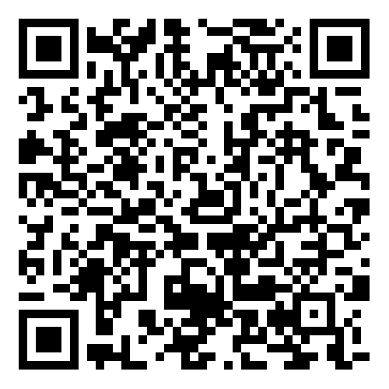
Share your feedback on hosting this session
After your participants have left the session, please complete this short host survey using the QR code or link.
https://aarpresearch.qualtrics.com/jfe/form/SV_4SdIGU3zkKfEgUC
Notes:
This survey is only for people involved in HOSTING the session, not for all of the participants. If your team had multiple people involved in organizing and hosting this session, they are each welcome to fill out their own survey response. Responses are anonymous. AARP’s Work Jobs Team reads all responses and uses your input to celebrate wins and to address opportunities to improve. Thank you for taking 3 minutes of your time to share your feedback.

Slide 44
Explore additional actions
AARP’s tool Generations at Work is packed with resources to help you take action to build and leverage a multigenerational workforce
https://employerportal.aarp.org/generations/
Notes:
This workshop is one of a full suite of resources available for leaders, managers and employees to use to create a more age-inclusive workplace. We invite you to explore additional actions, and/or to complete the self-assessment to help you find your next step in the journey.

