Slide 1
Find Our Why
To leverage a multigenerational workforce
Notes:
To align senior leaders on age inclusion as a strategic opportunity, use our resources to present and facilitate a conversation, and secure buy-in to develop an age inclusion plan for the coming year.
Participants: Leadership team of organization
Facilitator: CHRO or senior HR leader
Cost: Free
Time Commitment: 2 hrs to plan, 30 min to present
If you need to secure buy-in and/or approval from your leadership team in order to host this workshop, copy this email draft into a fresh email, edit it as needed, and send it out!
To align senior leaders and secure their buy-in to an initiative to leverage the value of a multi-generational workforce, request time to present at an upcoming senior leadership team meeting. Simply copy this email draft into a fresh email, edit it as needed, and send it out!
Dear ,
I’m reaching out to request a 30-minute agenda item at an upcoming senior leadership team meeting. The goal is to align senior leaders around age inclusion as a strategic opportunity and to begin to secure buy-in for an initiative to help us not only manage multi-generational teams, but also leverage their power.
I recently learned about a suite of resources AARP has created for employers that we can use to develop these skills and apply best practices. I’ll be happy to share an overview of these resources, which I believe will be able to help us drive progress with highly efficient use of staff, employee and financial resources.
This is an amazing opportunity to use AARP’s research-backed resources –at no cost to us - to help us increase workforce engagement and retention as well as prepare for upcoming demographic shifts.
Please let me know your thoughts on scheduling time with the team.
Best,

Slide 2
Today’s focus: Find Our Why
Most executives are aware that the multigenerational makeup of the workforce calls for awareness of age as a factor in diversity and inclusion initiatives. They also increasingly understand that there are challenges and opportunities present within an age-diverse workforce that affect all employees, particularly at either end of the age spectrum.
Today we will discuss how a multigenerational workforce creates value for organizations, and we hope to secure buy-in to develop an age inclusion plan for the coming year.
Courtesy Getty Images

Slide 3
Agenda
|
|
|
|
|
Strategic value of a multigenerational workforce
The business case for a multigenerational workforce
Considerations for our organization
Why we need an age-inclusion action plan
Next steps
Courtesy Getty Images
Source: xxx
Notes:
To align senior leaders on age inclusion as a strategic opportunity, use our resources to present and facilitate a conversation, and secure buy-in to develop an age inclusion plan for the coming year.

Slide 4
Strategic value of a multigenerational workforce
A value creation strategy hiding in plain sight
In a recent AARP study, 83%¹ of employers said that creating a more multigenerational workforce would drive their success and growth.
The depth of experience and skill sets in an age-diverse workforce – whether technical, professional, or durable human skills –creates major opportunities for employers who can unleash those synergies.
The best decisions result when people from different life and career stages work together to define problems and create solutions.
Source: 1 AARP Global Employer Survey 2020
Notes:
Note: "durable human skills" are often called soft skills – critical thinking, communication, negotiation, judgement calls, etc.
1 “According to the AARP Global Employer Survey 2020, 83% of employers state that it would be very or at least somewhat valuable to their organisation’s success and growth to create a more multigenerational workforce. Executives in large global companies recognize that their organization would need to undertake more efforts to maximise the full potential that an age-diverse workforce offers, listing age, besides disability, as the area of diversity management that requires most improvement (Forbes Insights, 2011[33]).”

Slide 5
Strategic value of a multigenerational workforce
A talent management necessity
“Declining populations or labor force participation rates among younger workers may lead to talent shortages. Retaining older workers can help employers address this challenge.”
We are on the cusp of a significant demographic shift affecting the U.S. labor market. Over the coming decades, more people will exit the workforce than will enter it.
In the near future, the Bureau of Labor Statistics forecasts that workers 65+ will be the fastest-growing portion of the labor market, with other age groups either holding steady or declining.
Sources: 1 AARP Global Employer Survey 2020
2 https://www.oecd-ilibrary.org/docserver/59752153-en.pdf?expires=1636142224&id=id&accname=guest&check
3 https://www.oecd-ilibrary.org/docserver/59752153-en.pdf?expires=1636142224&id=id&accname=guest&check
Notes:
https://blog.aarp.org/thinking-policy/how-population-age-shifts-will-affect-us-labor-market

Slide 6
Strategic value of a multigenerational workforce
A proven way to improve team performance
Research has shown that mixed-age teams perform better than homogenous-aged teams:
In companies that utilized mixed-age work teams, the relative productivity of both older and younger workers was higher than in companies that did not use mixed-age teams.
When the task “entails dealing with strategic and complex decision-making with vaguely defined problems in a dynamic setting…increased age diversity can lead to enhanced group discussions, better analysis and superior problem-solving.”
Courtesy Getty Images
Sources: Human Resource Management Journal, vol. 23, Issue 3, (2013); Personnel Psychology, 67, (2014); Labour Economics, 22, (2013); Journal of Applied Psychology, 93, (2008). https://ideas.repec.org/p/iso/educat/0093.html http://repec.business.uzh.ch/RePEc/iso/leadinghouse/0093_lhwpaper.pdf
Notes:
Facilitator note: As you customize this deck to meet your needs, feel free to bring in additional data from AARP’s Business Case for Age-Inclusion slide deck at https://employerportal.aarp.org/age-inclusive-workforce/commit-to-an-age-inclusive-culture/business-case-basic-slides

Slide 7
Considerations for our own organization
Talking it through
How are we (or are we not) fully leveraging the mixed-age nature of our current workforce?
Are there pockets within our organization where we don’t yet have mixed-age teams, or where there is generational tension?
What would happen if we could more successfully recruit and hire both early career and late career workers (the groups most likely to experience age bias)?
How much more productive could our teams be if we trained managers on how to lead mixed-age teams effectively?
If we more fully leveraged multi-gen teams, how would decision-making improve? Innovation? Service delivery? Customer understanding? Knowledge retention?
Courtesy Getty Images
Notes:
Facilitator notes: Feel free to edit this general list and to customize the organization-specific list on the next page to suit your organization’s needs and guide conversation to issues you see as especially important for your senior leadership team to discuss.

Slide 8
Considerations for our own organization
Talking it through
[Feel free to list questions that are very specific to your organization on this slide.]
[Feel free to list questions that are very specific to your organization on this slide.]
[Feel free to list questions that are very specific to your organization on this slide.]
[Feel free to list questions that are very specific to your organization on this slide.]
[Feel free to list questions that are very specific to your organization on this slide.]
Courtesy Getty Images

Slide 9
Considerations for our own organization
Living our values
[Based on time available, you may choose to have an interactive element where you work through the worksheet title “Anchor in Values” available in the Generations at Work resource suite with the leadership team, as the conversation and shared viewpoints can be very valuable to securing buy-in.
Alternatively, you and your HR team might complete the worksheet, and then input high level take-aways here.]
Courtesy Getty Images
Notes:
The worksheet is available in the AARP Generations at Work resource suite as a graphically designed .pdf.
Text content of the worksheet, in case you choose to integrate it into your presentation deck, is pasted below for convenience:
Worksheet: Assess your organization's values-driven case for age inclusion
How to use this worksheet:
Use this worksheet with your team to explore how age inclusion efforts can help your organization live more fully to its stated values.
Who to include in the conversations:
You can use it as an exercise with your Senior Leadership Team, or you can use it with your HR leadership team and then integrate the outcome into a broader presentation to senior leaders.
To consider how age inclusion efforts and building a multi-generational workforce can help your organization live to its values, ask yourself these questions:
What are your organization's stated values?
______________________
______________________
______________________
______________________
______________________
How do inclusion efforts support each value?
___________________________________________________________
___________________________________________________________
___________________________________________________________
___________________________________________________________
___________________________________________________________
How could age inclusion support each value?
___________________________________________________________
___________________________________________________________
___________________________________________________________
___________________________________________________________
___________________________________________________________
Which value(s) can your organization NOT fully live to without a mixed age workforce? Why?
___________________________________________________________
___________________________________________________________
___________________________________________________________
Which value(s) already fully integrate age inclusion in how we talk about them, and which value(s) present opportunities for us to do this more fully?
We already integrate age inclusion into how we talk about these values:
We have opportunities to more fully integrate age inclusion into how we talk about these values:
Which ONE value presents the biggest opportunities to create value for the organization by addressing age inclusion?
Value: ______________________
How could you create value for the organization by integrating age inclusion into how you talk about and take action to live to this value? _______________________________________________________________________________________________________________________________________________________________________________________________________________________________
Where might you encounter skepticism or inertia within your organization when framing conversation about age inclusion as a way to live out organizational values?
__________________________________________________________________________
How can you anticipate and engage on these concerns productively? _______________________________________________________________________________________________________________________________________________________________________________________________________________________________

Slide 10
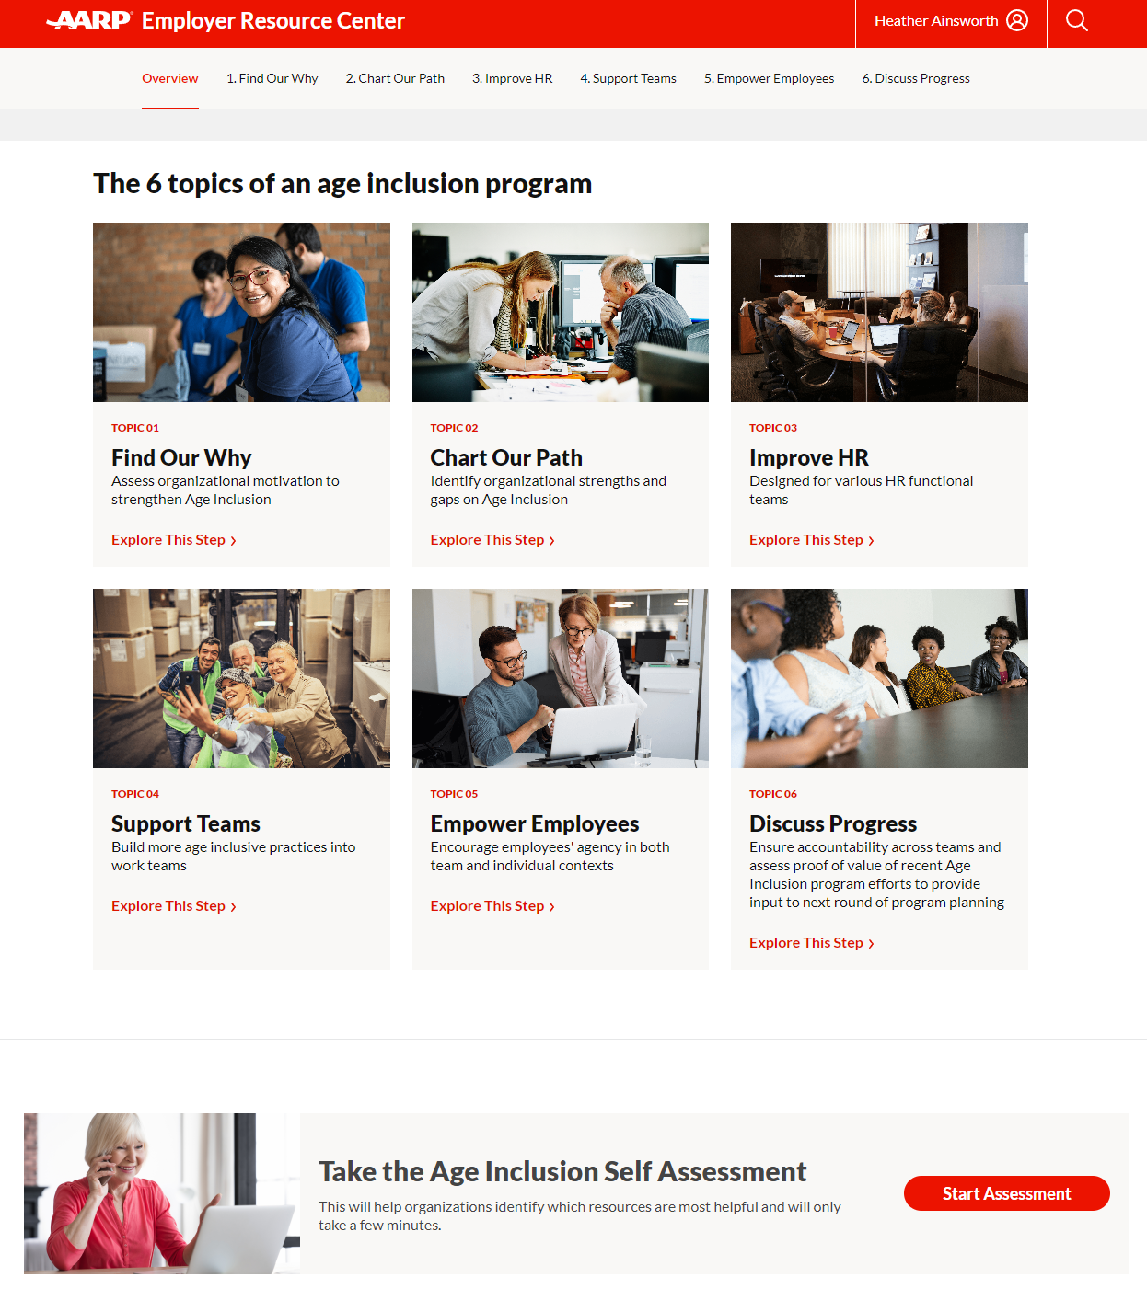
Why we need an action plan
We achieve the goals we set
Setting a handful of targeted goals to improve age-inclusion makes us more likely to achieve the changes we seek
Leveraging a multigenerational workforce requires us to consider actions across HR, with our teams and with individual employees
We have an opportunity to use the new AARP Generations at Work tool to create and execute a customized plan
Courtesy Getty Images

Slide 11
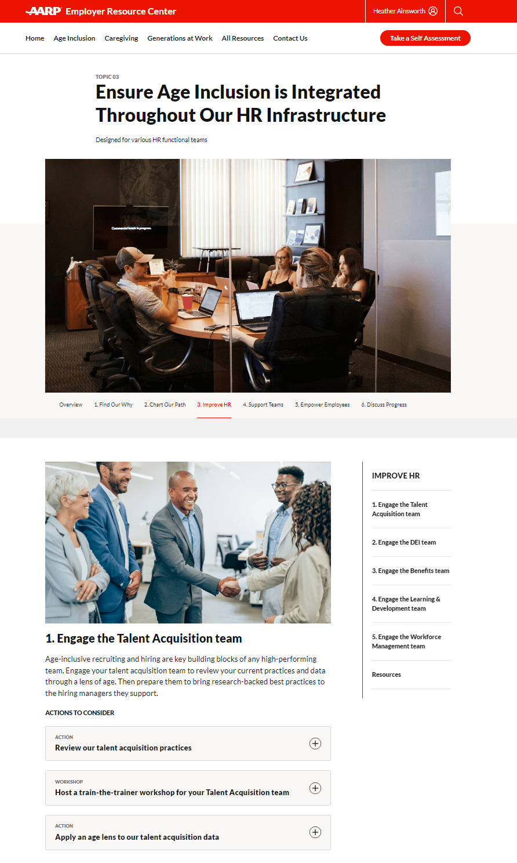
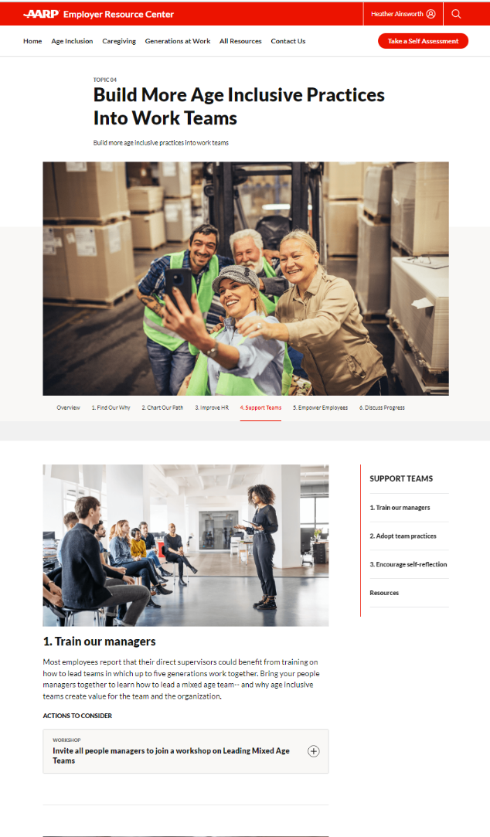
How we can design and execute our plan
Designed with HR leaders for all types of leaders
The AARP Generations at Work tool guides us through a self-assessment to help us create a customized plan
It provides free resources to help us execute each action we include in our plan
It even ensures we distill our learnings and bring them back to this team
We can drive significant improvement this year with very low financial investment and efficient use of staff time
[Add your own idea here]
Courtesy Getty Images

Slide 12
Next steps
Action | Owner | Contributors | Due Date | Notes
[Fill in this chart as fits your organization. All content is sample.]
Design draft action plan for next 12 months | CHRO | HR functional leaders | By end of this month | Design to leverage other HR initiatives
Present action plan to senior leadership team | CHRO |  |  | Will include high-level timeline, budget
Begin first steps of action plan | CHRO | Team TBD | By end of Q1 | Launch timing to avoid peak seasons
Provide updates quarterly to leadership team | CHRO
Provide distilled learnings and opportunities after 12 months | CHRO |  | End of Q1 next year
Courtesy Getty Images
Source: xxx
Notes:
Facilitator note: Fill in this chart as fits your organization. All content is sample. You can choose to leave it mainly empty and fill it in with your senior leadership team live. OR you can choose to fill it in with your proposed next steps. Select an approach that works best for the dynamics on your own senior leadership team.

Slide 13
Thank you
Notes:
This is the last slide of the presentation to share with participants.
Slides that follow contain resources for the host to use after the session ends.

Slide 14
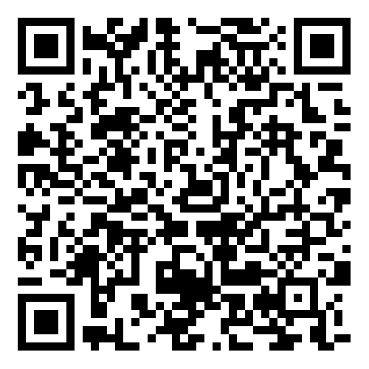
Share your feedback on hosting this session
After your participants have left the session, please complete this short host survey using the QR code or link.
https://aarpresearch.qualtrics.com/jfe/form/SV_4SdIGU3zkKfEgUC
Notes:
This survey is only for people involved in HOSTING the session, not for all of the participants. If your team had multiple people involved in organizing and hosting this session, they are each welcome to fill out their own survey response. Responses are anonymous. AARP’s Work Jobs Team reads all responses and uses your input to celebrate wins and to address opportunities to improve. Thank you for taking 3 minutes of your time to share your feedback.

Slide 15
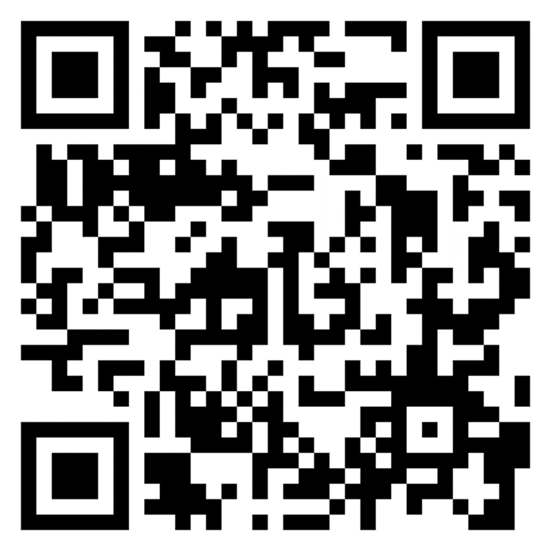
Explore additional actions
AARP’s tool Generations at Work is packed with resources to help you take action to build and leverage a multigenerational workforce
https://employerportal.aarp.org/generations/
Notes:
This workshop is one of a full suite of resources available for leaders, managers and employees to use to create a more age-inclusive workplace. We invite you to explore additional actions, and/or to complete the self-assessment to help you find your next step in the journey.

